Slide 1


Slide 2
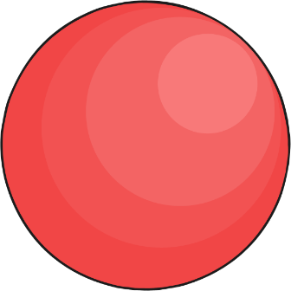
Sphere
Click the sphere!

Slide 3
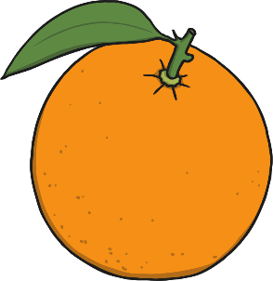
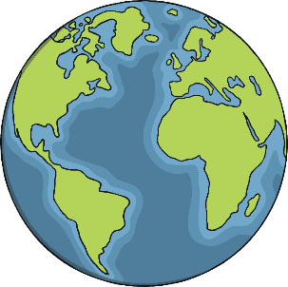
Sphere
oranges
Earth
next

Slide 4

Cube
Click the cube!

Slide 5
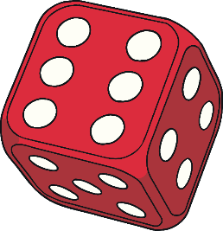

Cube
dice
presents
next

Slide 6
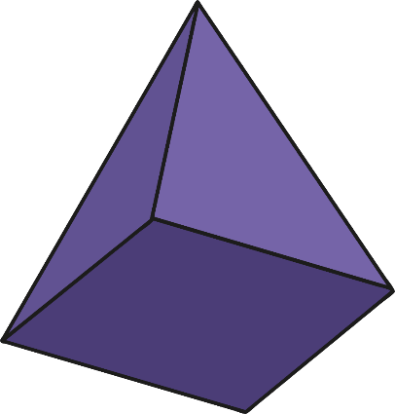
Pyramid
Click the pyramid!

Slide 7
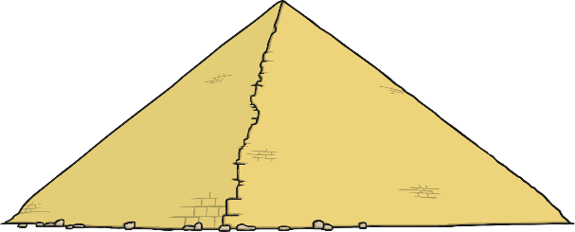
Pyramid
Egyptian pyramids
next

Slide 8

Cuboid
Click the cuboid!

Slide 9


Cuboid
cereal
loaf of bread
next

Slide 10

Cylinder
Click the cylinder!

Slide 11
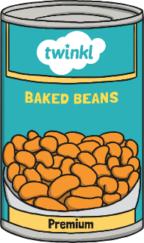

Cylinder
tin can
toilet roll tube
next

Slide 12
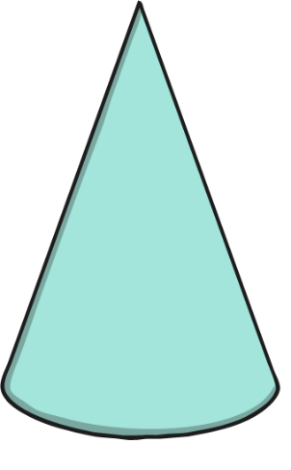
Cone
Click the cone!

Slide 13


Cone
traffic cone
ice cream cone
next

Slide 14
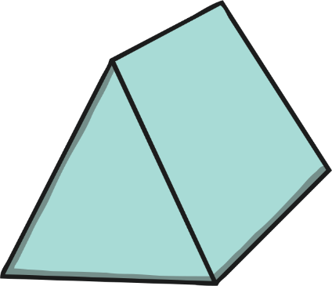
Triangular prism
Click the Triangular prism!

Slide 15

Triangular prism
tent
end

