Slide 1



RE
Caring for Others
Year One
RE | Year 1 | Caring for Others | Langar | Lesson 4

Slide 2
We are learning
I can explain what a langar meal is.

Slide 3
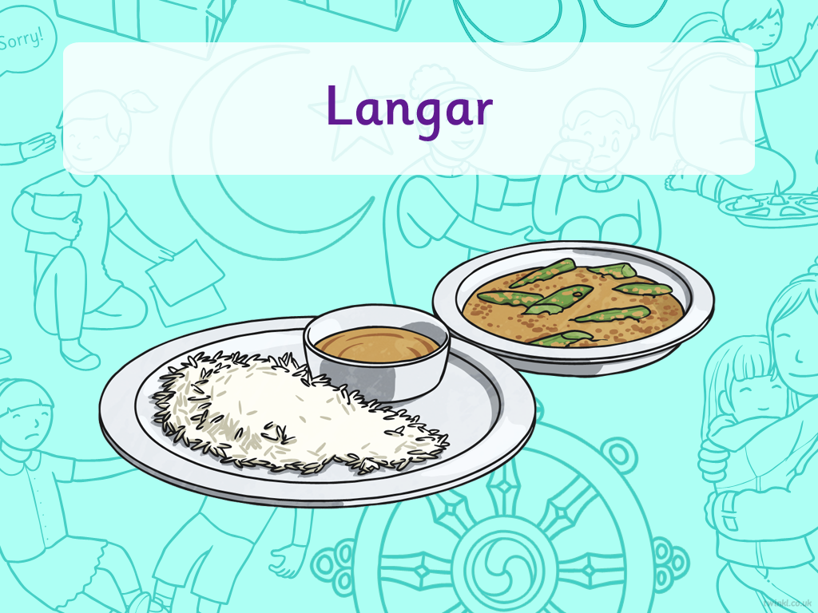


Slide 4

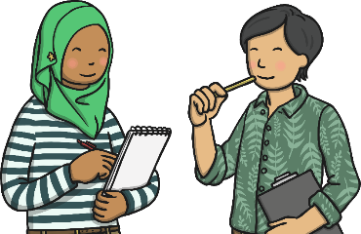
Eating Meals
Can you answer these questions?
Who do you
eat with?
Do family and friends ever come to your house to eat?
Do you sit at
a table?
Who usually makes the meals in your house?
Where do you usually eat your breakfast, lunch and dinner?

Slide 5
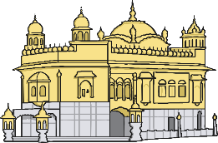
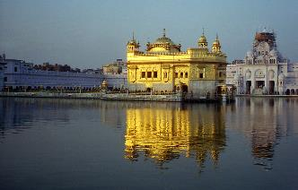
The Gurdwara
The Gurdwara is a special building for Sikhs and they go there to worship.
The most famous Gurdwara is called The Golden Temple which is in India.
Although the Gurdwara is a special building for Sikhs, people from all religions are welcome inside them.
Photo courtesy of Ryan@lickr.com - granted under creative commons licence - attribution

Slide 6
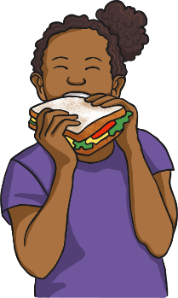
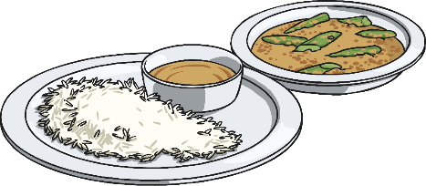
Langar
Each Gurdwara has a langar, which means free kitchen.
There is also a langar hall, where people can sit together and eat a free meal.
The langar meal is vegetarian so that people from all religions are able to eat it.
Guru Nanak created the langar because he believed in equality. That means that everyone is equal and should all be treated the same.
At the Gurdwara everyone takes it in turns to prepare, cook and serve the meal, then clear up afterwards.

Slide 7

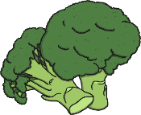









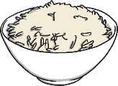






Langar

Slide 8
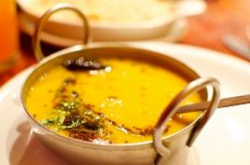
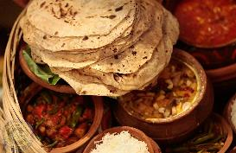
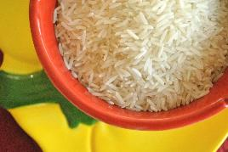
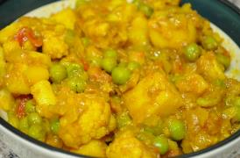
Traditional Langar Meals
Daal - lentils
Chapati - flatbread
Rice
Aloo - potatoes
Photo courtesy of aimee rivers, Vrindavan Lila, cookbookman17 and James@lickr.com - granted under creative commons licence - attribution

Slide 9

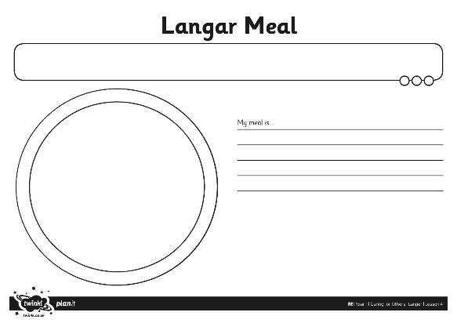
Langar

