Slide 1
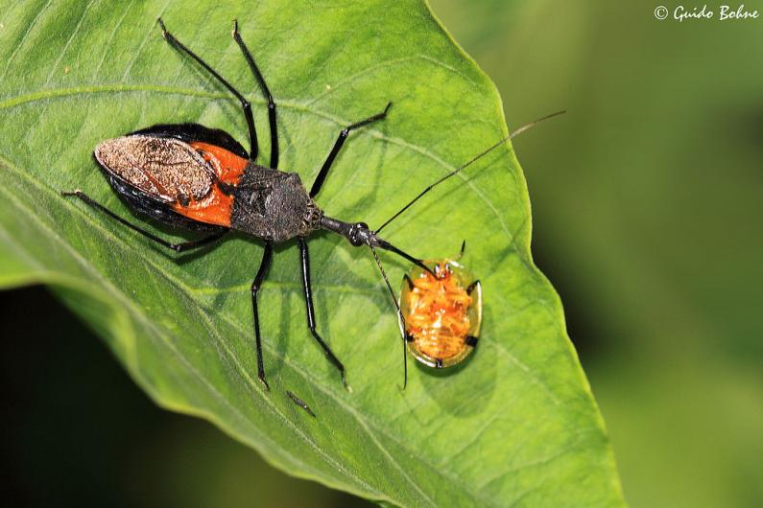
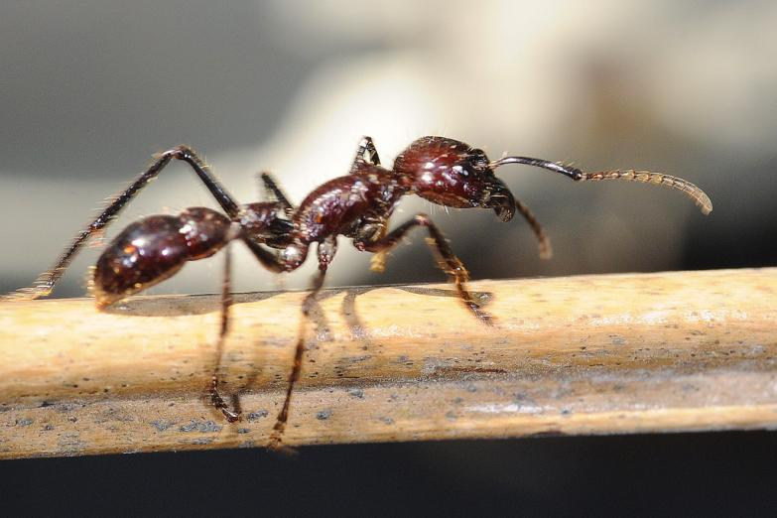
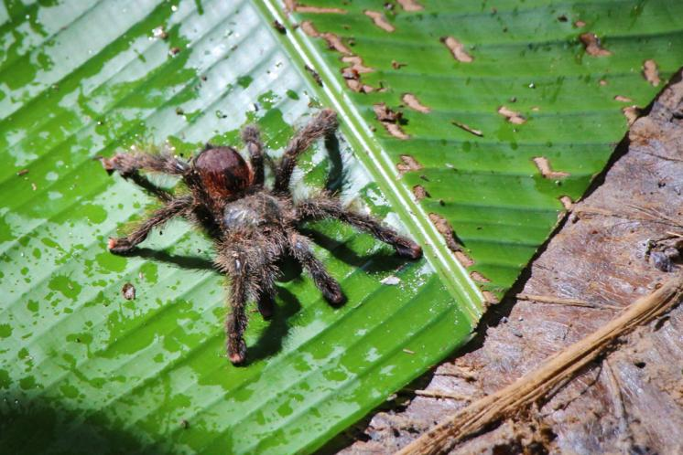
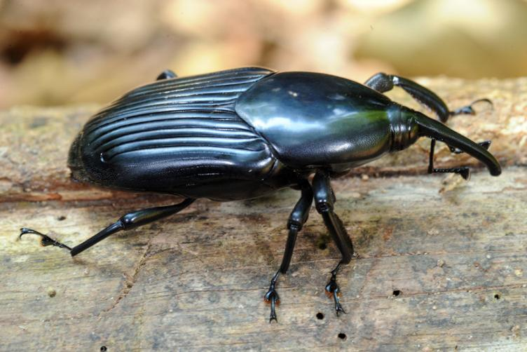

Insects of the
Amazon Rainforest

Slide 2
We are learning
To find out about an amazing creature.
To write facts about it.

Slide 3
Today we will be learning about a fascinating creature.
Look on the next slide to find out what it is......

Slide 4
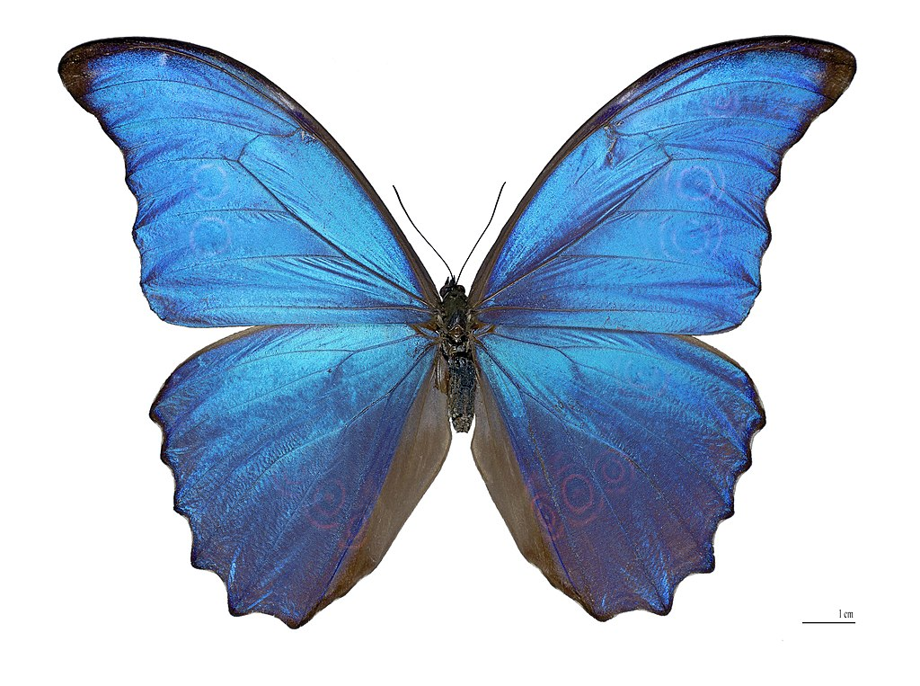
The Blue Morpho Butterfly

Slide 5
Habitat:
Blue morphos adults spend most of their time on the forest floor and in the lower shrubs and trees, with their wings folded. However, when looking for mates, the blue morpho will fly through all layers of the forest.

Slide 6
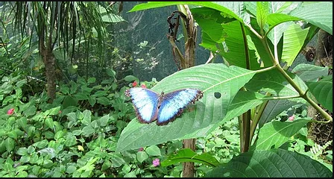
Habitat:

Slide 7
Appearance:
The Blue morpho is one of the largest species of butterfly in the world. Their wings are bright blue, edged with black. The blue colouring is because they have tiny scales on the backs of their wings, which reflect light. The underside of the morpho’s wings, are a dull brown colour with many eyespots which provide camouflage when their wings are closed.

Slide 8
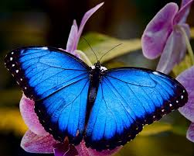
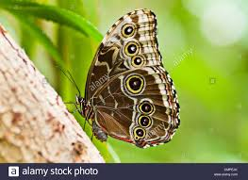
wings open wings closed

Slide 9
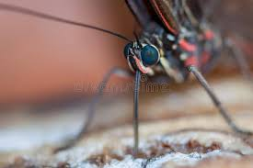
What they eat:
Adults use a long part of their mouth called a proboscis. They use it like a straw to sip the juice of rotting fruit, tree sap and wet mud.
proboscis

Slide 10
For today’s lesson, I would like you to write facts about the Blue Morpho butterfly. I would also like you to draw a picture of one too.

