Slide 1



RE
Caring for Others
Year One
RE | Year 1 | Caring for Others | The Good Samaritan | Lesson 3

Slide 2
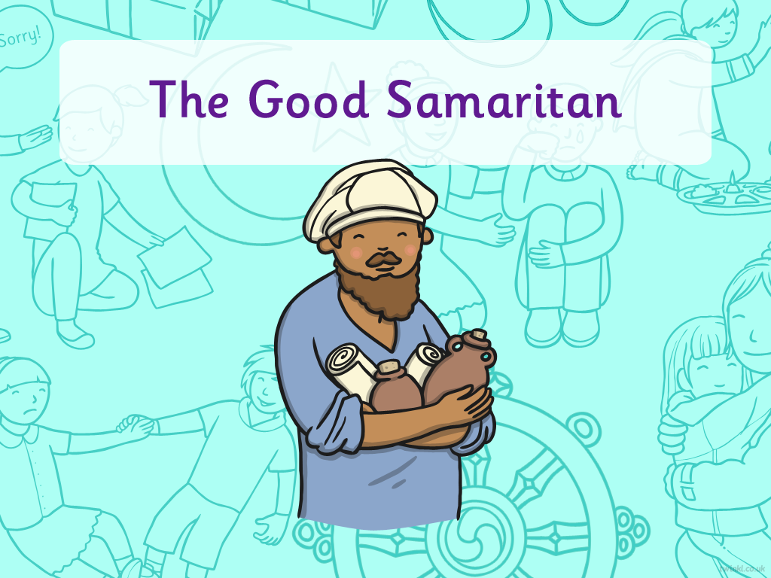


Slide 3
We are learning
To explain the message in the story The Good Samaritan.

Slide 4

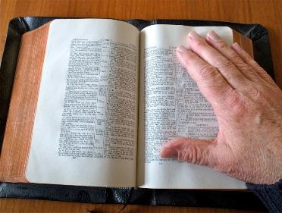
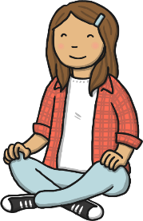
The Bible
The Bible is a special book for Christians and is made up of two sections.
It has lots of stories and teachings, which help Christians lead their lives.
Photo courtesy of Georg Redgrave@flickr.com - granted under creative commons licence - attribution

Slide 5
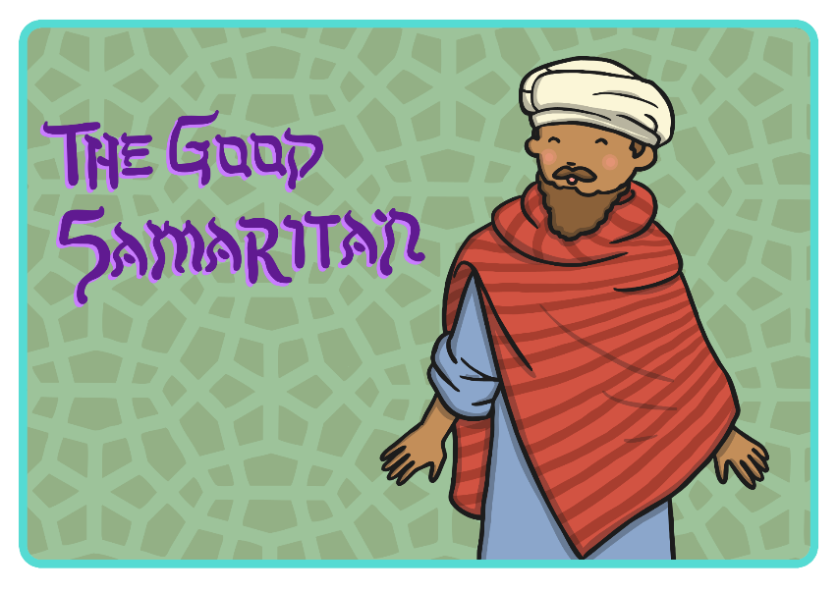

Slide 6
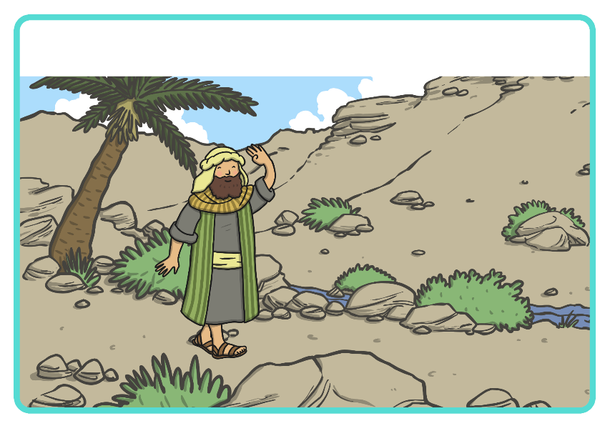
One day, a Jewish man went out for a stroll along the road between Jerusalem and Jericho.

Slide 7
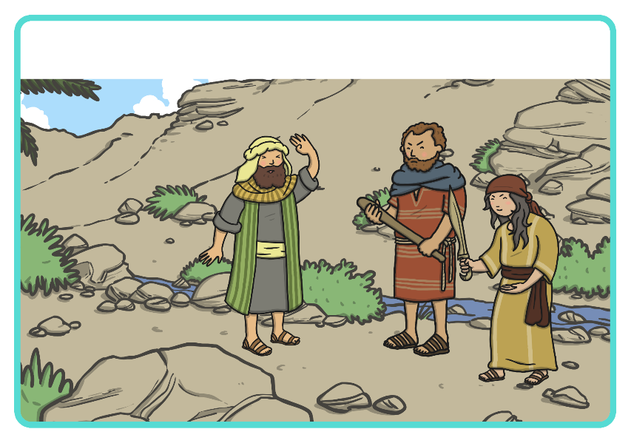
Along the way, two thieves jumped out onto the road and stole all the
man’s belongings.

Slide 8
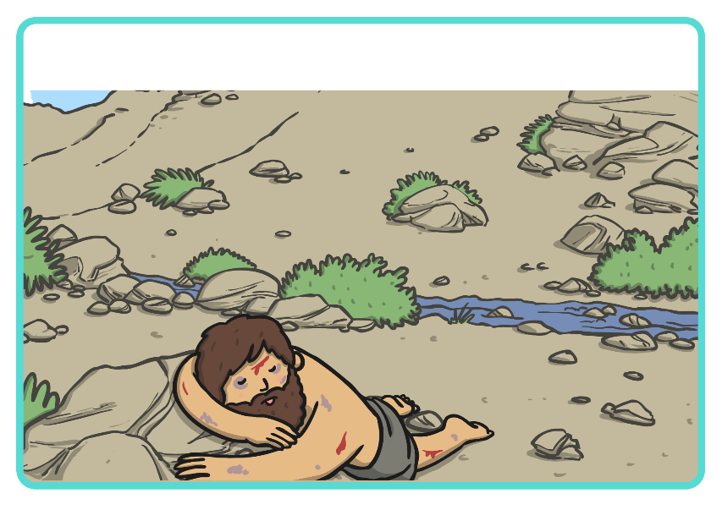
The thieves stole his clothes, hurt him and left him all alone.

Slide 9
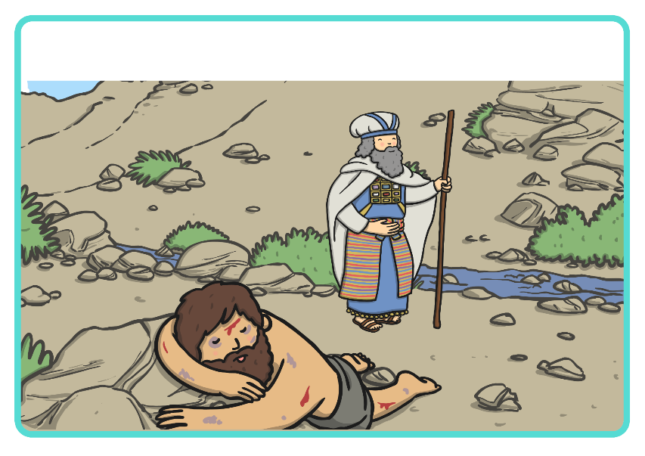
After a short while, a priest walked by and saw the man lying on the ground.

Slide 10
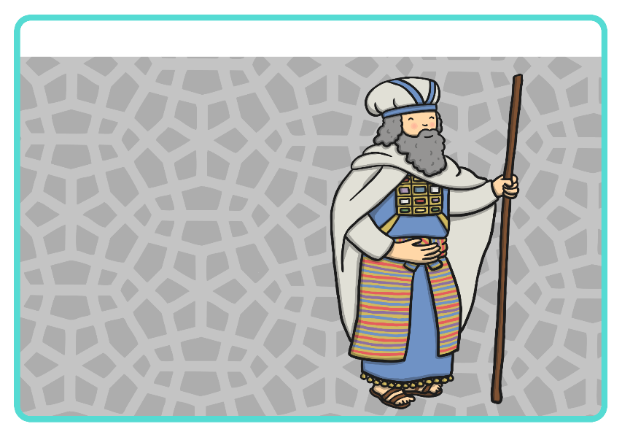
Did the priest help? No, he walked away.

Slide 11
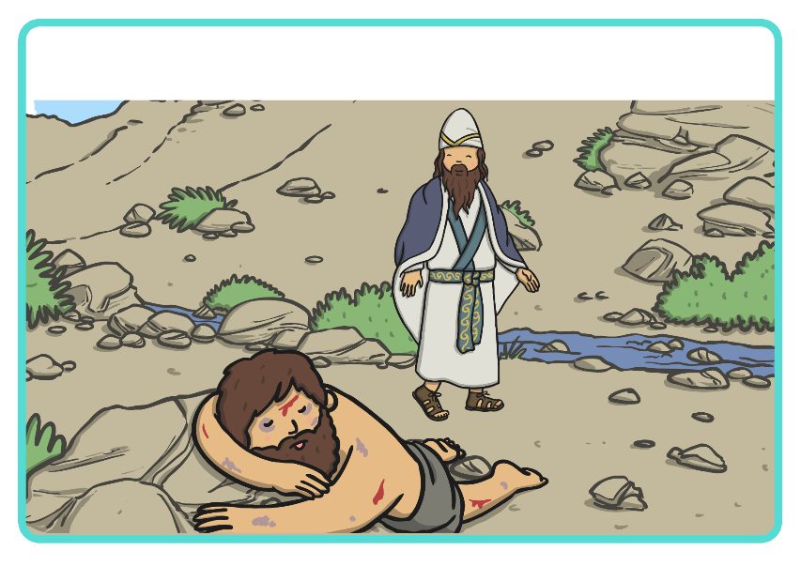
The next traveller to walk by was a Levite. The Levite’s job was to help in a temple in Jerusalem.

Slide 12
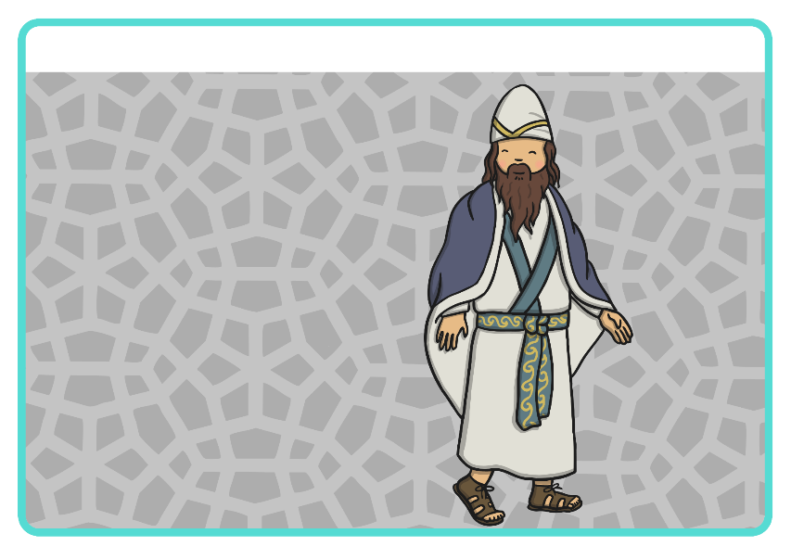
Did the Levite help? No, he walked away.

Slide 13
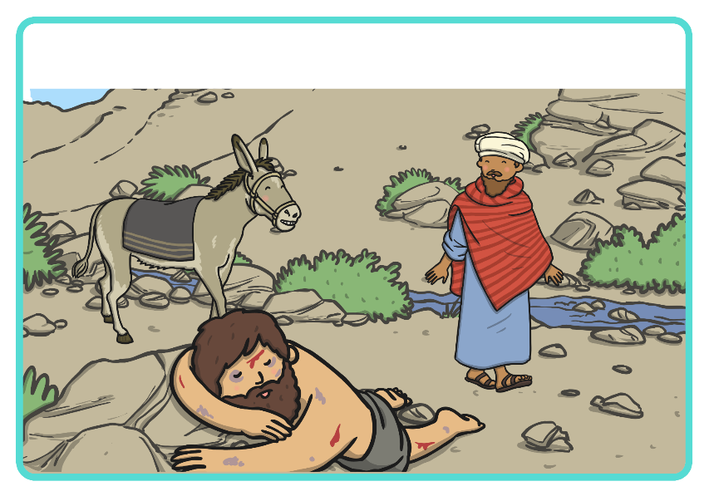
Soon, along came a Samaritan who saw the man lying on the ground.

Slide 14
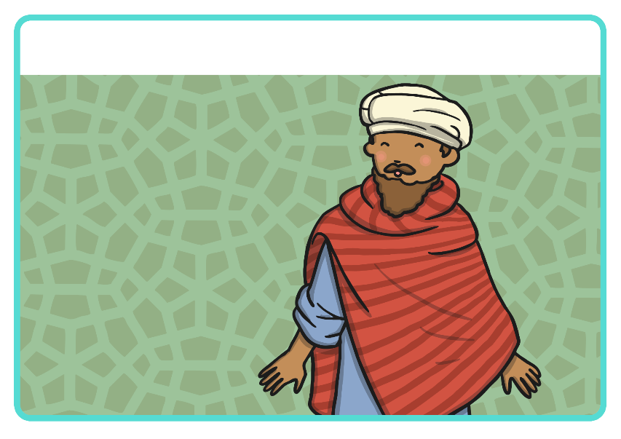
Did the Samaritan help? Yes! The Samaritan couldn’t leave the man alone and hurt.

Slide 15
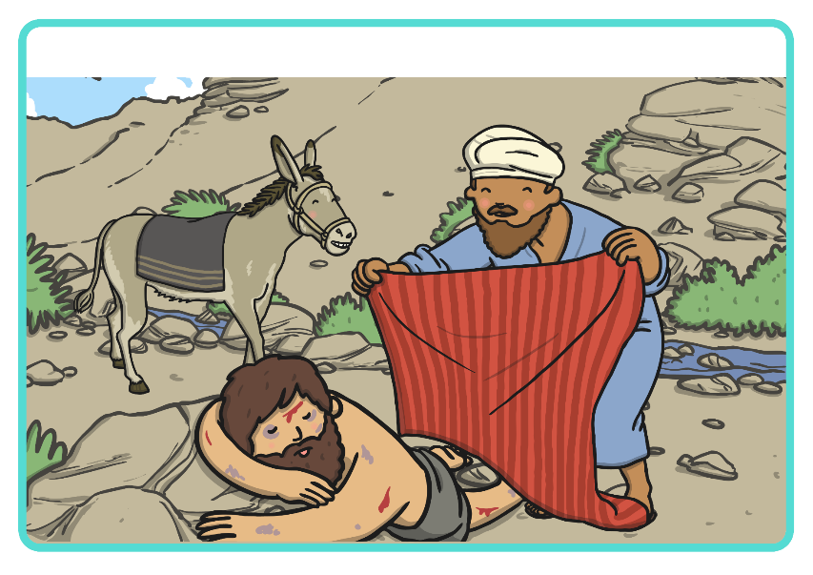
The Samaritan covered the man in his cloak.

Slide 16
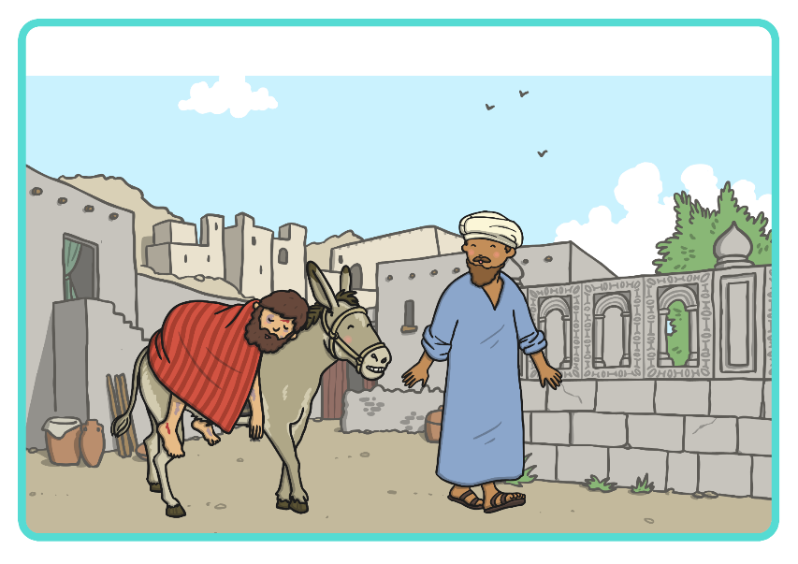
He put the man on his donkey and took him to a nearby inn.

Slide 17
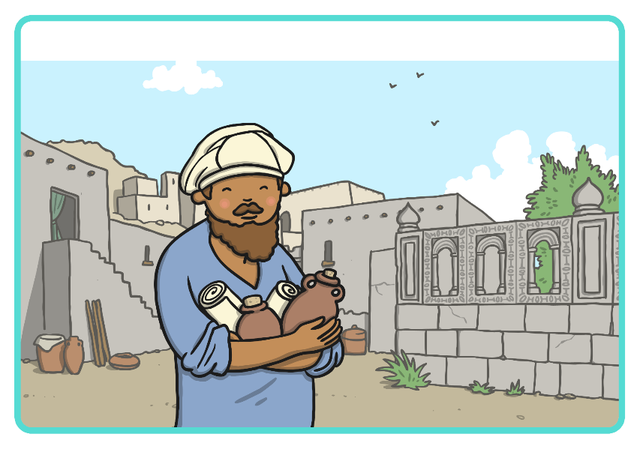
He bought wine, oil and bandages to heal the man.

Slide 18
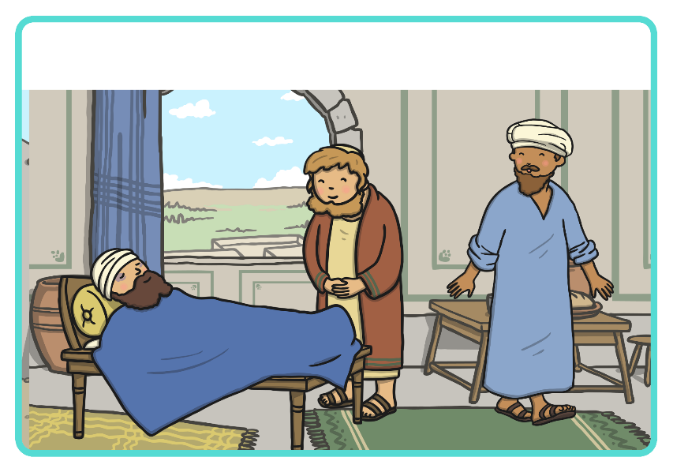
The Samaritan paid the innkeeper two silver coins to help the man feel better.

Slide 19
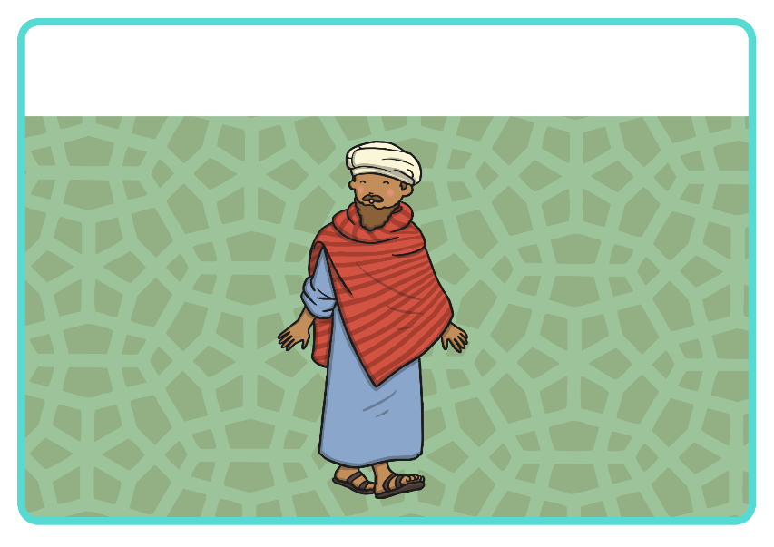
The Samaritan showed the man kindness, even when others didn’t. He was a true friend to this stranger.

Slide 20

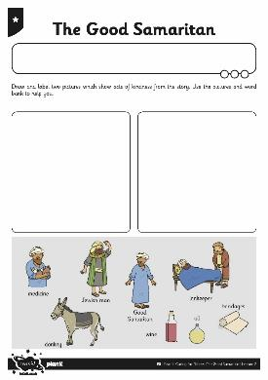
Acts of Kindness

