Slide 1
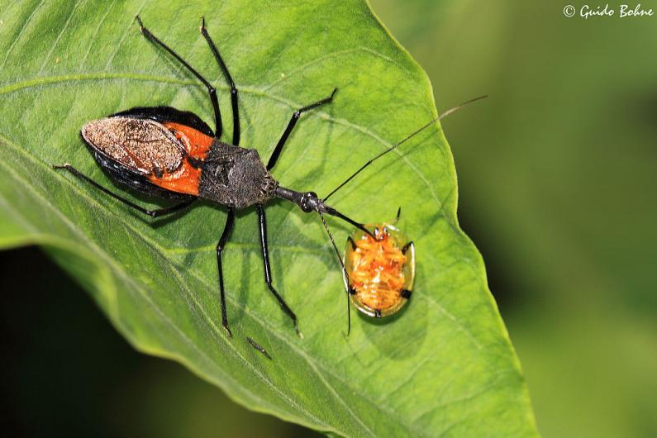
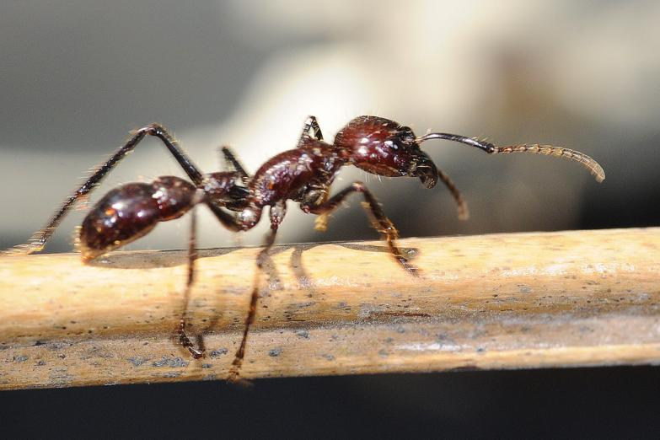
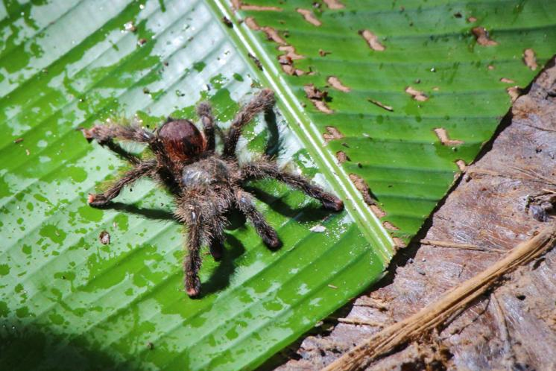
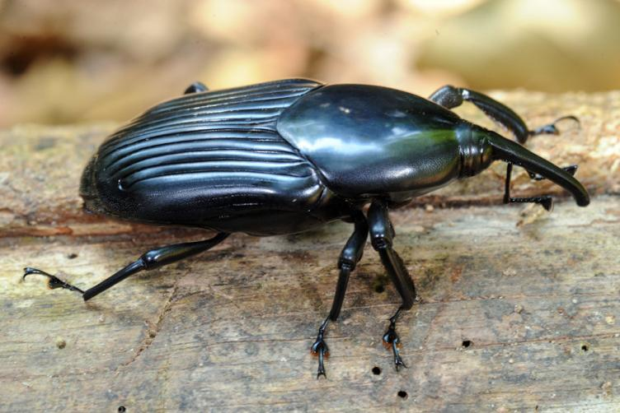

Insects of the
Amazon Rainforest

Slide 2
We are learning
To find out about an amazing creature.
To write facts about it.

Slide 3
Today we will be learning about a fascinating creature.
Look on the next slide to find out what it is......

Slide 4
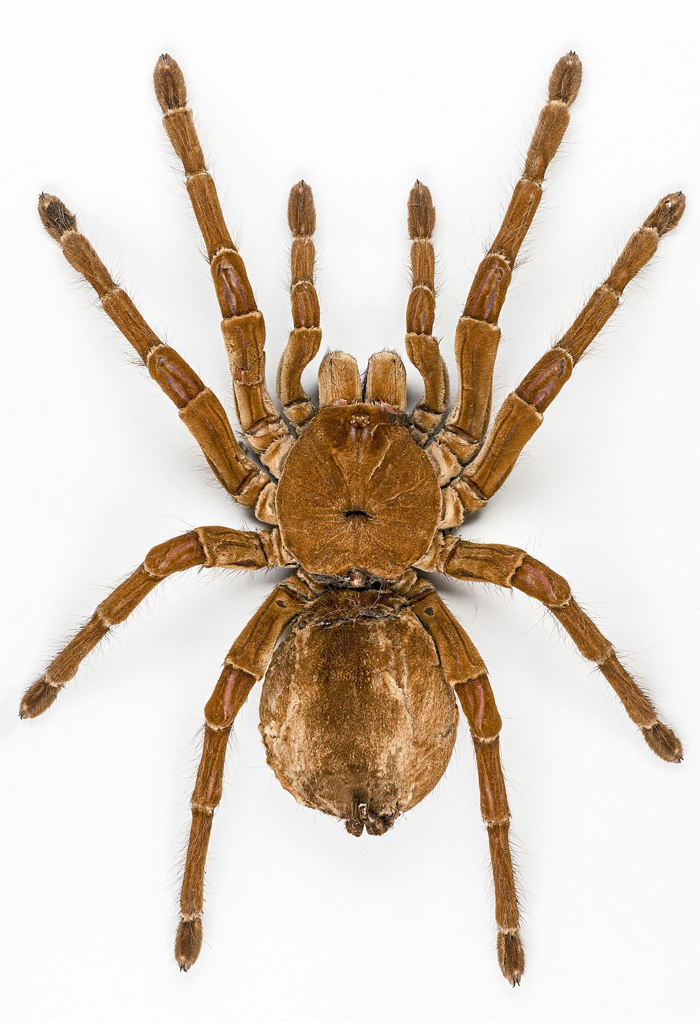
The Goliath Tarantula

Slide 5
The Goliath tarantula is also known as the ‘Bird eating tarantula’ because as you can guess, it eats birds amongst other creatures.

Slide 6
Habitat:
The goliath tarantula can be found in almost all areas of the Amazon rainforest but they particularly like marshy and swampy areas. They dig burrows in the soft, moist soil and hide inside them.

Slide 7
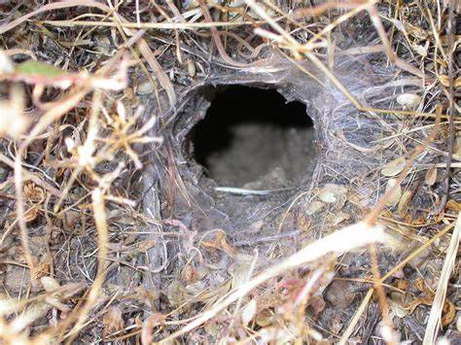
Habitat:
burrow

Slide 8
Appearance:
The goliath tarantula is both light and dark brown. Unlike some other spiders, goliaths have bad eyesight. They rely on their leg hairs which are sensitive to vibration. If they feel that a predator is close to them, they rub their legs together and their little hairs fly off and get stuck on the predator. This can make the predator very uncomfortable and they usually move away from the goliath.

Slide 9
leg eyes
thorax
abdomen

Slide 10
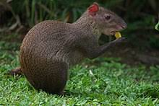
What they eat:
The goliath tarantula eats frogs, birds and small rodents. Goliaths don’t weave webs to catch their prey. They hide in their burrow instead and wait to feel movement above them before they jump out and bite their prey.
Rodent called an ‘agouti’.

Slide 11
For today’s lesson, I would like you to write facts about the Goliath Tarantula. I would also like you to draw a picture of one too.

