Slide 1


Slide 2
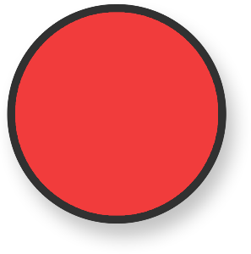
Circle
Circles only have one side.
Circles have no corners.

Slide 3

Square
Squares have 4 straight sides and 4 corners.
All the sides are the same length.

Slide 4
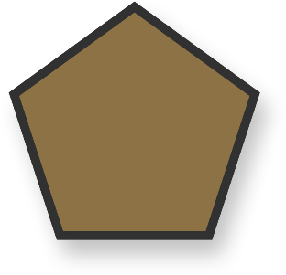
Pentagon
A pentagon has 5 straight
sides and 5 corners.

Slide 5

Rectangle/Oblong
Rectangles have 4 sides and 4 corners.
They have 2 long sides and 2 short sides.

Slide 6
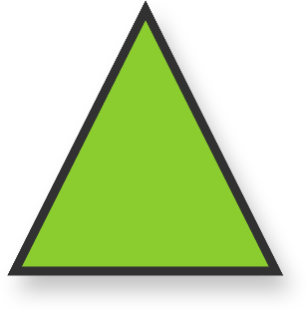
Triangle
Triangles have 3 sides and 3 corners.

Slide 7
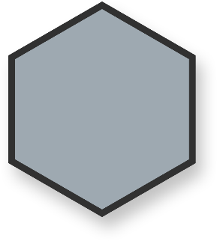
Hexagon
A hexagon has 6 sides and 6 corners.

Slide 8

Octagon
An octagon has 8 sides and 8 corners.

Slide 9
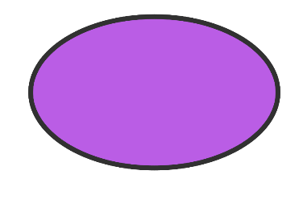
Oval
Ovals only have one side and no corners.

