Slide 1



RE
Caring for Others
Year One
RE | Year 1 | Caring for Others | Raksha Bandhan | Lesson 2

Slide 2
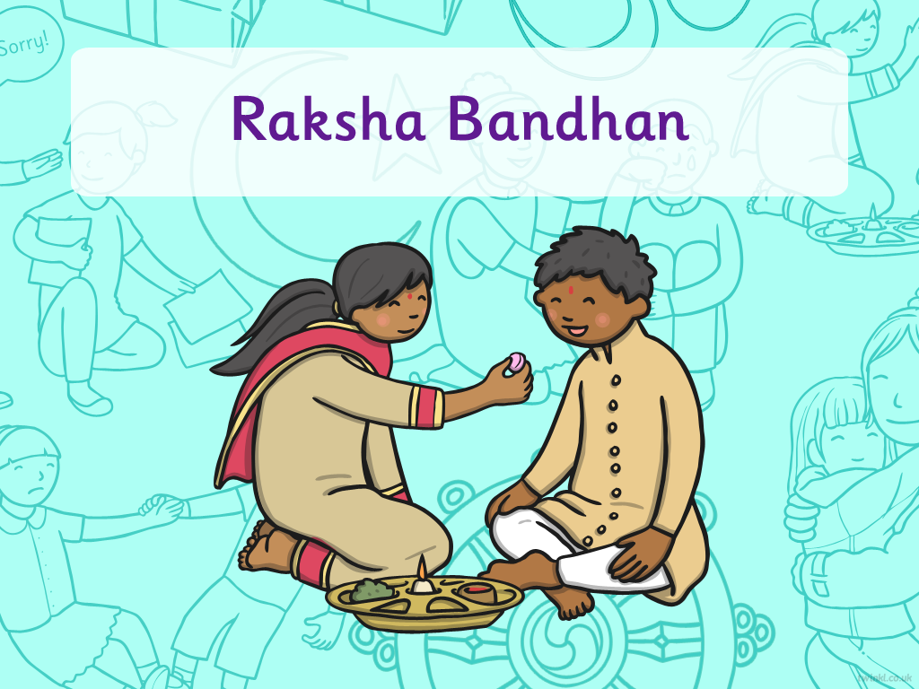


Slide 3
We are learning
I can explain what the festival of Raksha Bandhan represents.

Slide 4
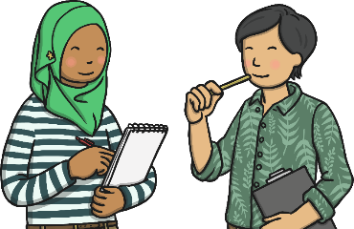
Brothers and Sisters
Can you answer these questions?
What do you like about having a brother or sister?
Are they older or younger than you?
What do you do
to look after them?
What do you do
to show them that you love them?

Slide 5
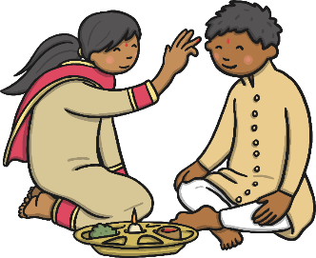
What is Raksha Bandhan?
Raksha Bandhan is a Hindu festival, usually celebrated in August.
Raksha Bandhan is also known as Rakhi.
It celebrates and strengthens the bond of love between brothers and sisters.

Slide 6
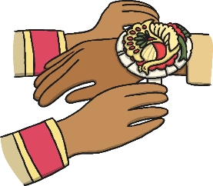
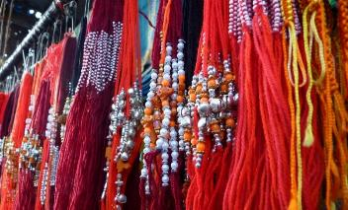
Traditions of Raksha Bandhan
The Rakhi symbolises protection.
Brothers and sisters face each other.
The sisters tie a Rakhi (bracelet) made from coloured cotton or silk around their brother’s wrist.
Red and gold threads are popular Rakhi colours and some bracelets also have beads and jewels on them.
Photo courtesy of Shriyash Jichkar@flickr.com - granted under creative commons licence - attribution

Slide 7

Traditions of Raksha Bandhan
After the Rakhi (bracelet) has been tied, the sisters say a special prayer.
Then the sisters put a tilak
(a colourful mark) on their brother’s forehead.
After the tilak, the brothers make a special promise to look after and protect their sisters.

Slide 8
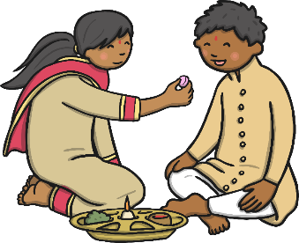
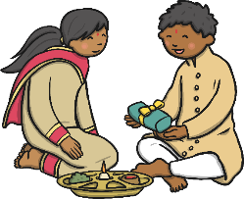
Traditions of Raksha Bandhan
The sisters give their brothers a sweet to eat.
The brothers give their sisters a present.
Brothers and sisters often hug and then families usually continue the celebration.

Slide 9

Raksha Bandhan

