Slide 1

We are learning
To write our weekend news.
To use different conjunctions in my writing.

Slide 2
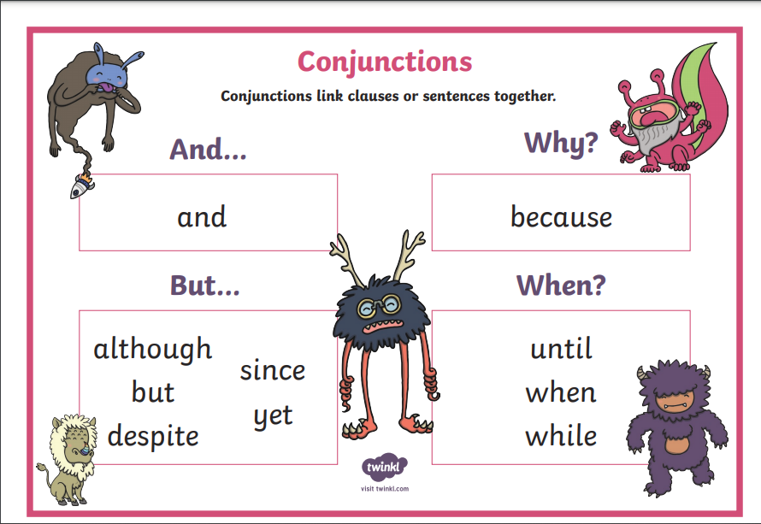
What are conjunctions?

Slide 3
On Saturday it was my nephew Oliver’s birthday. I bought him a Paw Patrol motorbike which I knew he would like. I started to wrap up his present but then I realised that I didn’t have enough wrapping paper so I had to go to Sainsbury’s to buy more. I dropped his present over but I couldn’t go inside although we did have a chat at the door.

Slide 4
On Sunday morning I was working downstairs and waiting for the snow to arrive. I made myself some egg and soldiers for breakfast and a coffee but Logan and Roxy were playing and it spilt everywhere. I wasn’t too cross as they do this quite often! In the afternoon I took the dogs for a walk which they loved. We found a dog who was running around on it’s own but eventually the owner arrived. The dog was called Sid and the owner said he likes to run away. Cheeky!

Slide 5
I would like you to write your weekend news.
I would like you to use conjunctions in your writing if you can:
and
but
because
Can you remember the things we must include in our writing?

Slide 6
full stops
ABC
capital letters
went
letters on the line
letter tails under the line
fgjpq
and, but, because
extend sentences

