Slide 1



RE
Caring for Others
Year One
RE | Year 1 | Caring for Others | Looking After Each Other | Lesson 1

Slide 2
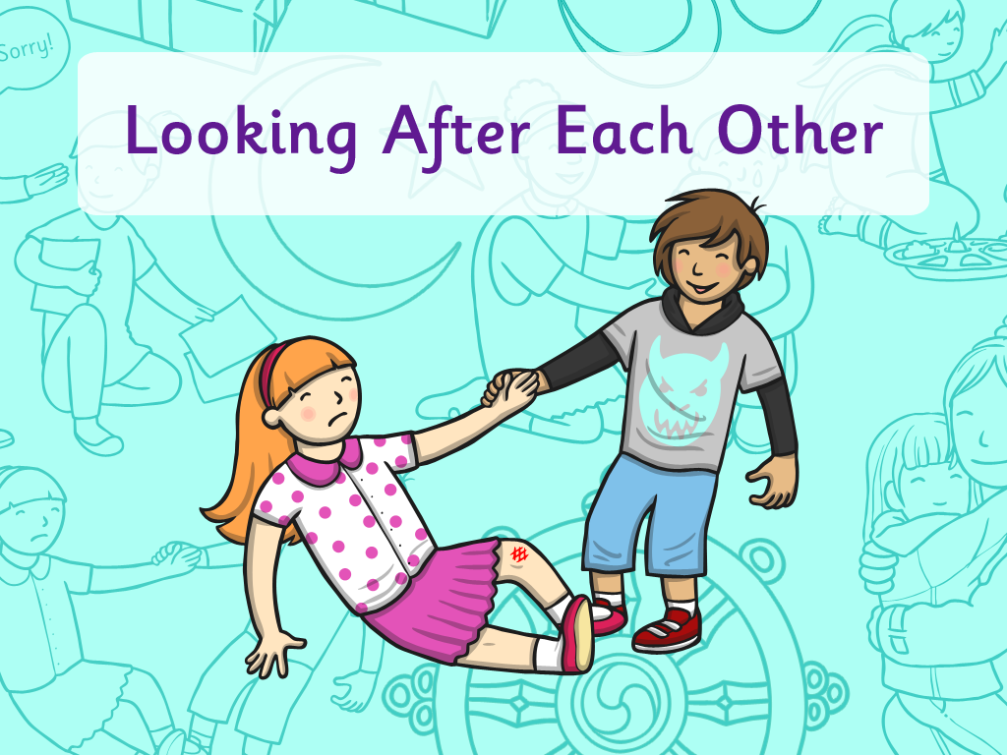


Slide 3
We are learning
To explain how people can look after each other.

Slide 4

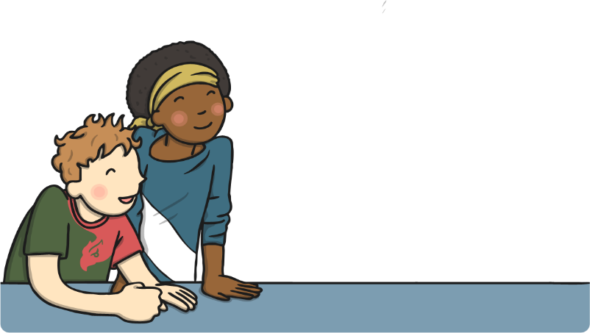
Looking After Each Other
See if you can answer some of these questions:
How do you look after yourself?

Slide 5
Looking After Each Other
See if you can answer some of these questions:
Who looks after you?

Slide 6
Looking After Each Other
See if you can answer some of these questions:
Who do you look after?

Slide 7
Looking After Each Other
See if you can answer some of these questions:
What do you do to look after people?

Slide 8


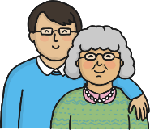
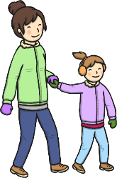
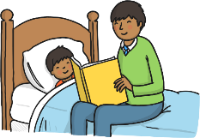
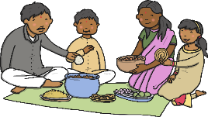
Looking After Each Other

Slide 9



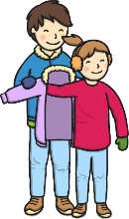

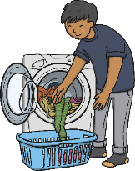

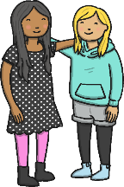
Who Looks After You?
Who looks after you?
How do they look after you?
How does it make you feel?

Slide 10

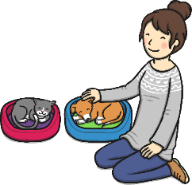
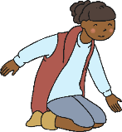
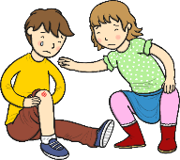
Who Do You Look After?
How do you look after your family?
Do you have any brothers or sisters?
Do you have any pets?
How do you look after them?
How do you look after them?

Slide 11
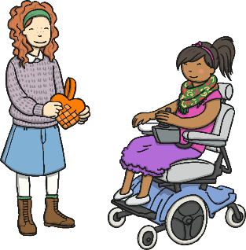
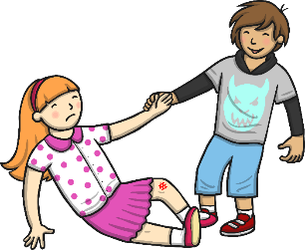
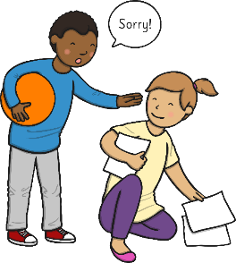
Who Do You Look After?
How do you look after your friends?

Slide 12
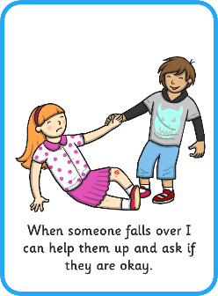
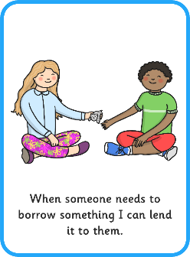
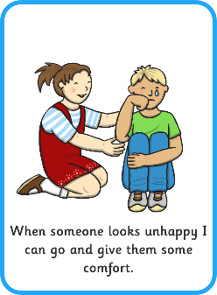
Looking After Others
How can you look after other people?

Slide 13
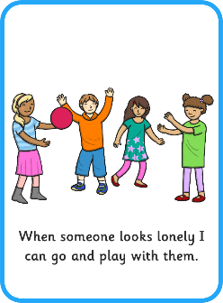
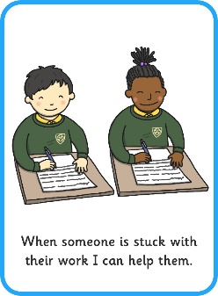
Looking After Others
How can you look after other people?

Slide 14


Looking After Others

Slide 15

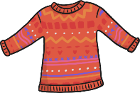

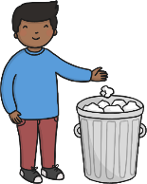
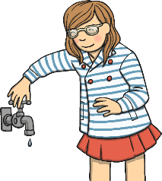
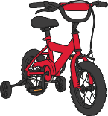

Who Do You Look After?
We should also look after
objects and belongings.
We should look after the
environment and the world too!

Slide 16




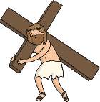

Different Religions
A religion is an organised set of beliefs which groups of people follow.
Here are some of them.
Do you recognise any?
There are lots of different
religions in the world.
Each religion has its own symbol, which is very important and special

