Slide 1

We are learning
To practise spelling the days of the week.

Slide 2
To start off with, we’re going to listen to ‘The Very Hungry Caterpillar’.
Not only is this a lovely story but it also has all the days of the week in!

Slide 3

The Very Hungry Caterpillar

Slide 4
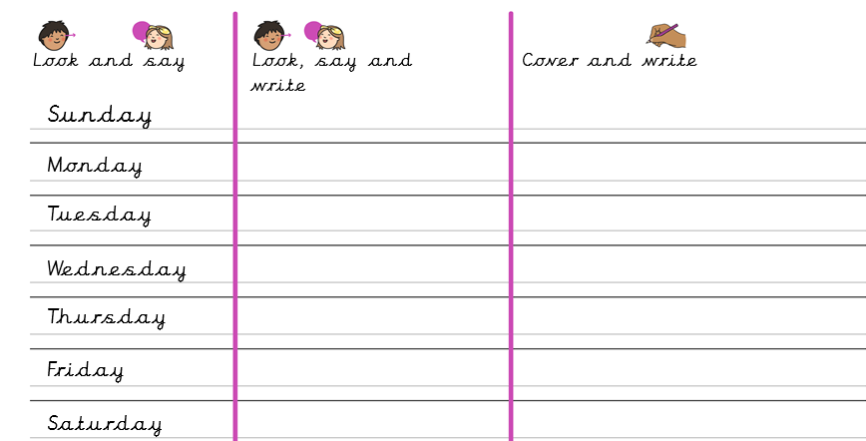
For today’s activity, I would like you to practise how to spell the days of the week.

