Slide 1

We are learning
To write sentences with a capital letter and a full stop.

Slide 2
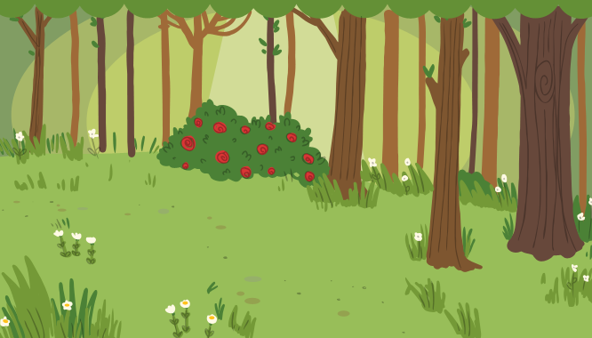
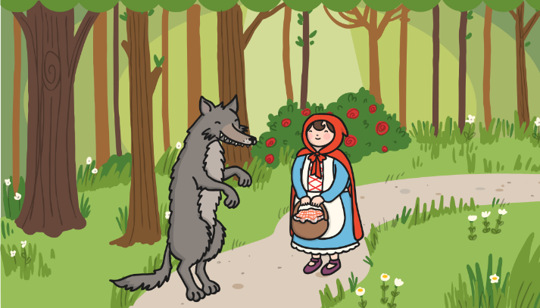
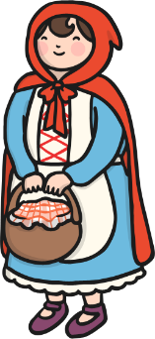
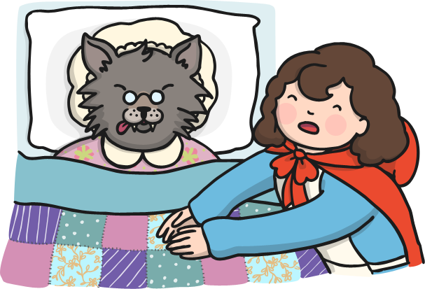
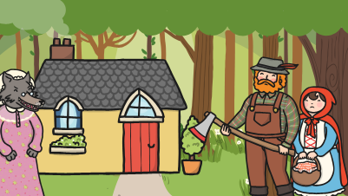
Can you write a sentence underneath each picture in the comic strip, using a full stop, to describe what is happening?

Slide 3
Can you spot where the missing capital letters belong?
penguins are interesting animals. they belong to the bird family but they can’t fly. penguins have a special layer of feathers which keep them warm. half of their life is spent on land and the other half is spent in the water.

Slide 4
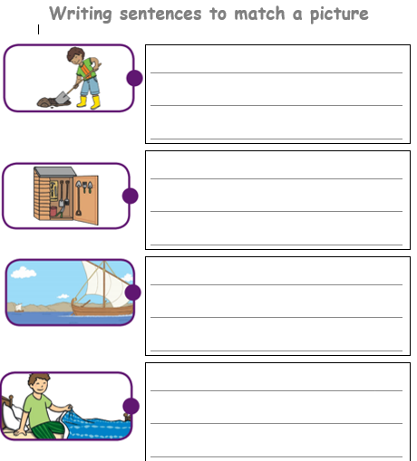
I would like you to add a sentence to each of the pictures on the sheet.

