Slide 1

We are learning
To create an animal group poster.

Slide 2
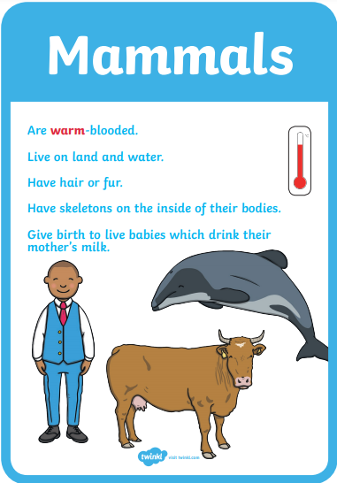

Slide 3
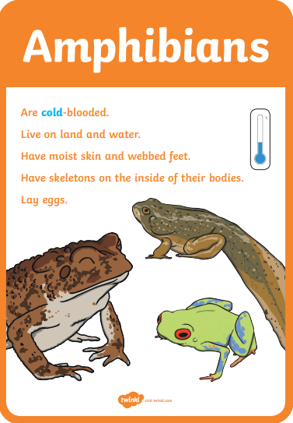

Slide 4
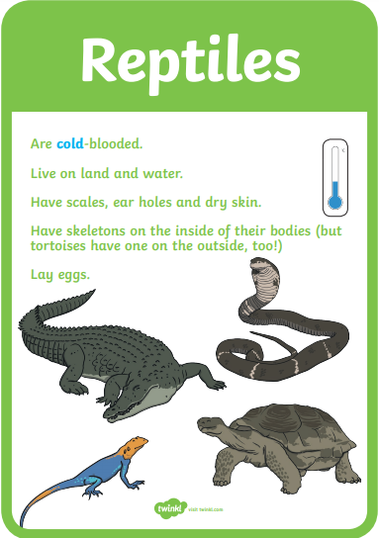

Slide 5
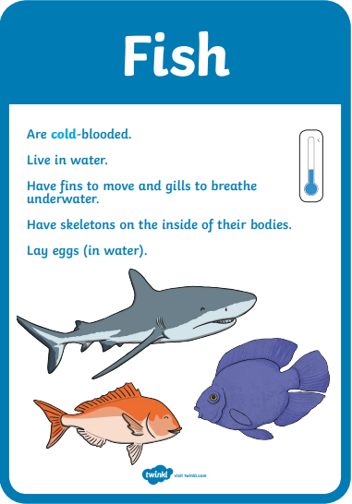

Slide 6
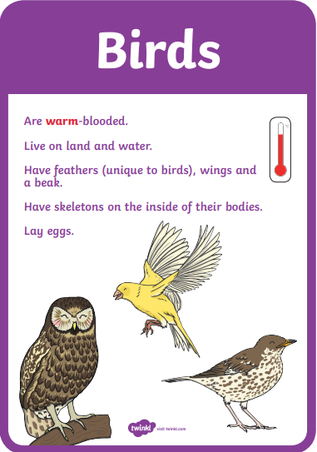

Slide 7
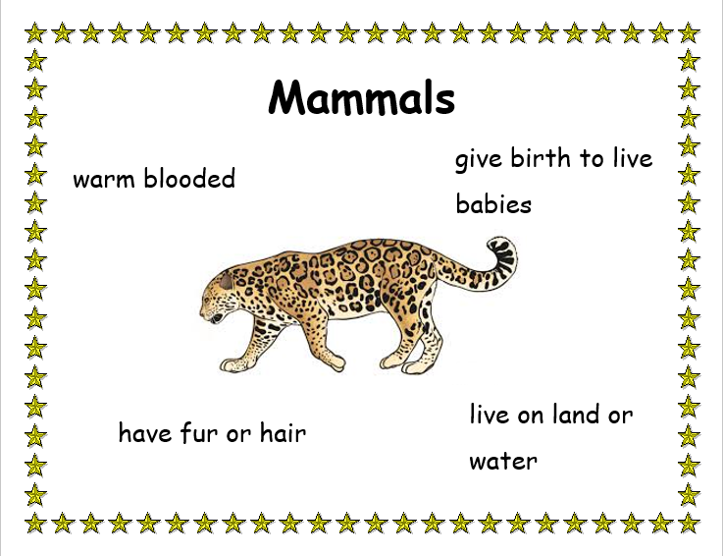

Slide 8
I would like you to create an animal poster. Decide which animal group your poster will be about.

