Slide 1

We are learning
To read a text and answer questions.

Slide 2
Today, we are going to read some information together. Once we have done that, we will answer some questions.
Sometimes the answer to a question is hidden in the text. We’ve got to search for it.

Slide 3
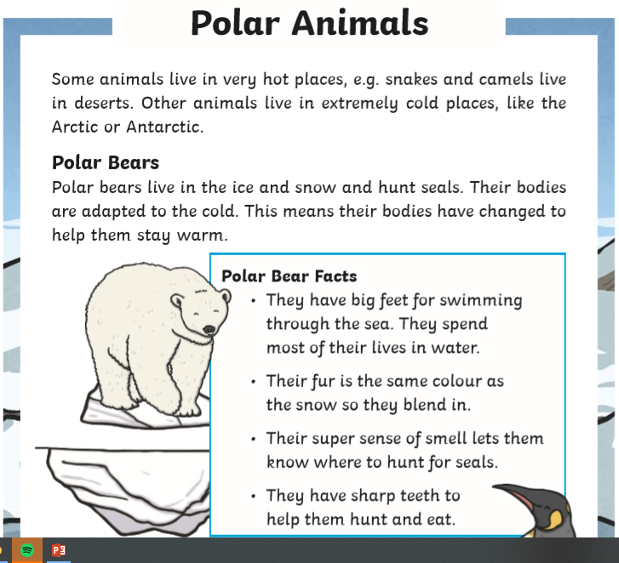
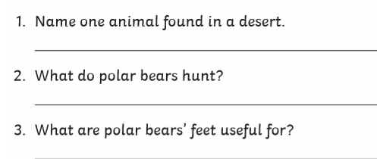

Slide 4
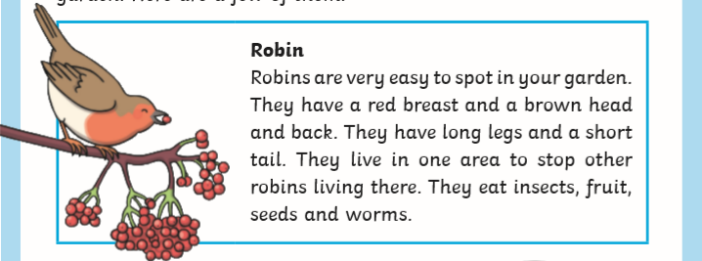
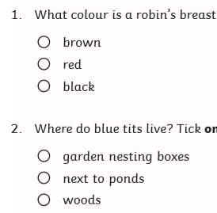
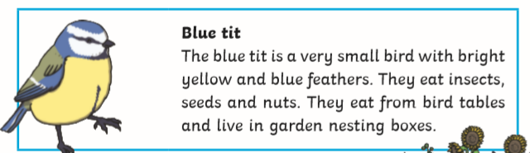

Slide 5
For today’s lesson I would like you to read a text and answer the questions.
Remember, sometimes you have to read the text again to find the answer.

