Slide 2

We are learning
To sort animals according to criteria.
Success Criteria
I can identify different animals.
I can describe similarities and differences between animals.
I can choose ways to sort the animals.

Slide 3







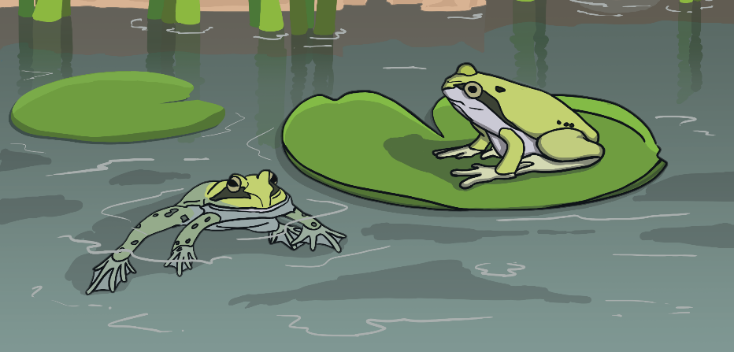

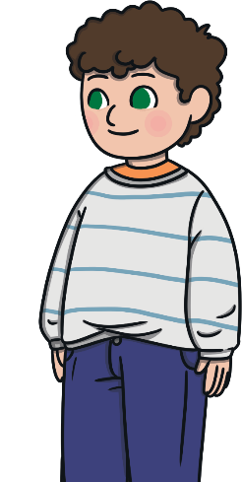
Remember It
Who do you think is right? Why?
Katie
Frogs are amphibians. They can swim but they live on land as adults.
Jack
Frogs are fish because they can swim.

Slide 4
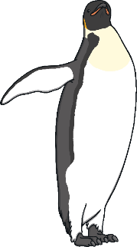
Remember It
Who do you think is right? Why?
Katie
Penguins are birds because they have feathers, two legs and a beak.
Jack
Penguins are not birds because they can’t fly.

Slide 5
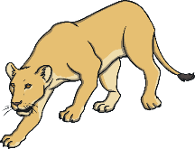

Remember It
Who do you think is right? Why?
Katie
Carnivores eat meat, not animals. Meat comes from the shops.
Jack
Carnivores eat other animals.

Slide 6
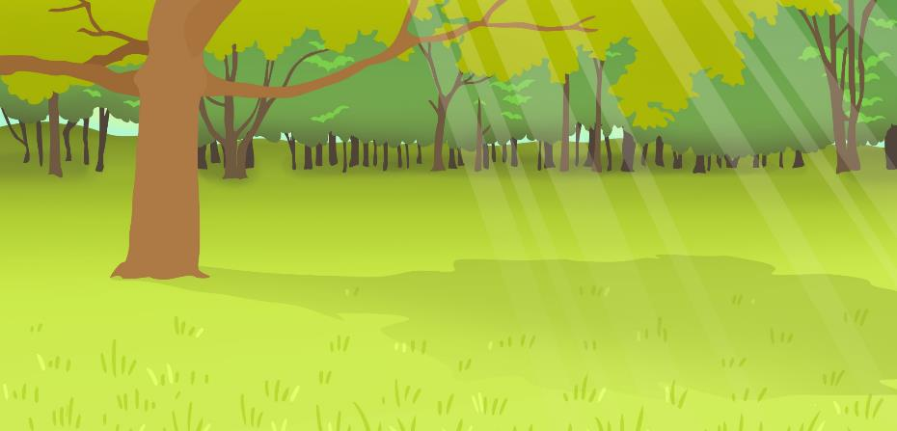
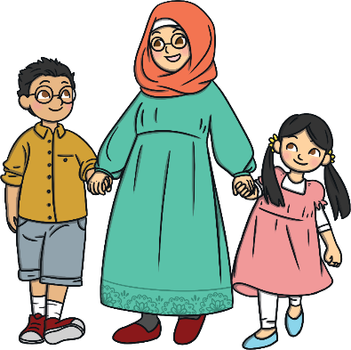
Remember It
Who do you think is right? Why?
Katie
Your sense of touch comes from your skin.
Jack
Your sense of touch comes from hands.

Slide 7

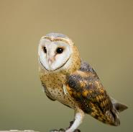
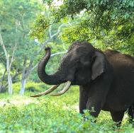
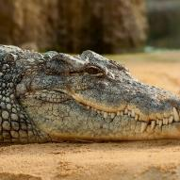
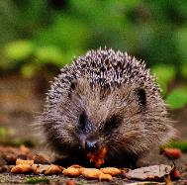
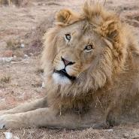
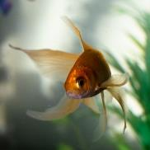
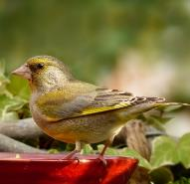


Animals All Around
Look at the pictures of animals. Discuss:
X
What animals
are they?
Which group
does each animal belong to?
Which animals would be loud
and which would be quiet?
How would
these animals
feel if you were
able to touch them?
What kind of
diet does each animal have?

Slide 8
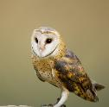
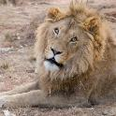
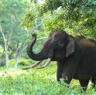

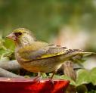

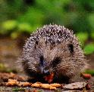
Grouping Animals
Can you help to sort the animals according to the criteria?
Mammals | Not Mammals

Slide 9
Grouping Animals
Can you help to sort the animals according to the criteria?
Carnivores | Not Carnivores

Slide 10
Grouping Animals
X
Can you find another way to sort these animals?
It could be: lives in water, lives on land, soft to touch or something else.

Slide 11
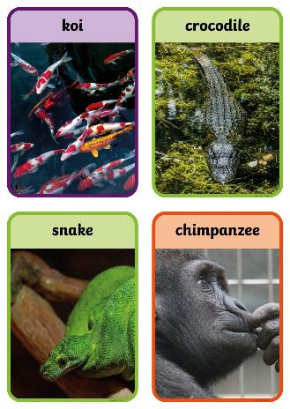
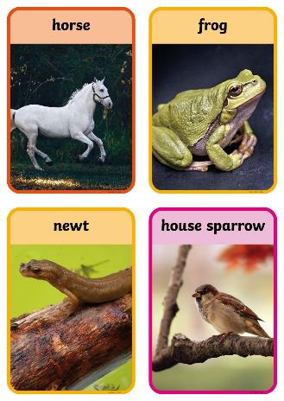


Sorting
You are going to sort different animals into groups, choosing your own criteria.

Slide 12
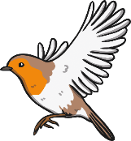

Sorting
To sort the animals, you will need to talk and to think about:
which animal group they belong to;
what they eat;
things that are the same or different. (Remember to use your senses – are they big or little, rough or soft, quiet or loud?)
Sort the animals into groups using the sorting hoops. Remember to label each group.
Once you have recorded your ideas, find a different way to sort the animals.

