Slide 1

We are learning
To find out a little bit more about each animal group.

Slide 2
What do you remember about mammals?

Slide 3
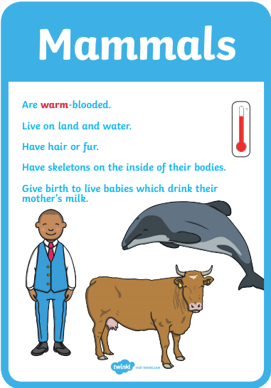

Slide 4
What do you remember about amphibians?

Slide 5
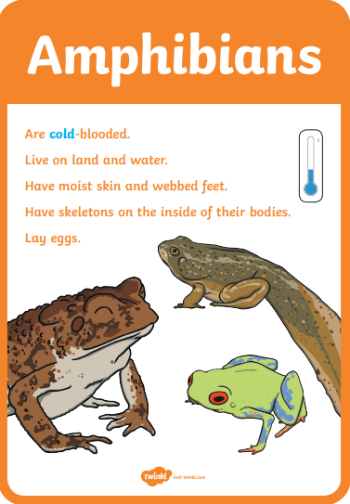

Slide 6
What do you remember about reptiles?

Slide 7
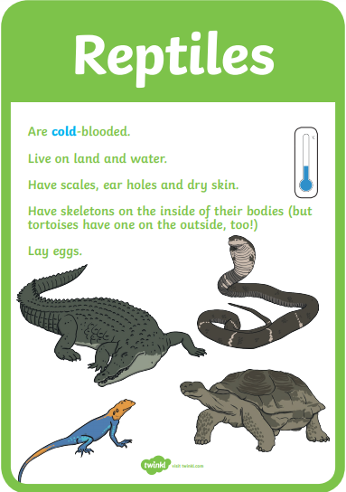

Slide 8
What do you remember about
fish?

Slide 9
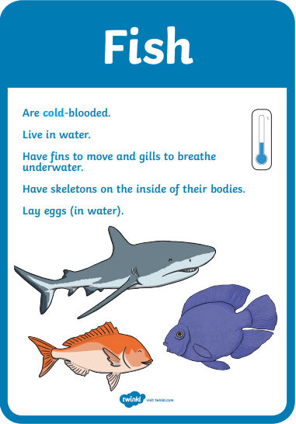

Slide 10
What do you remember about
birds?

Slide 11
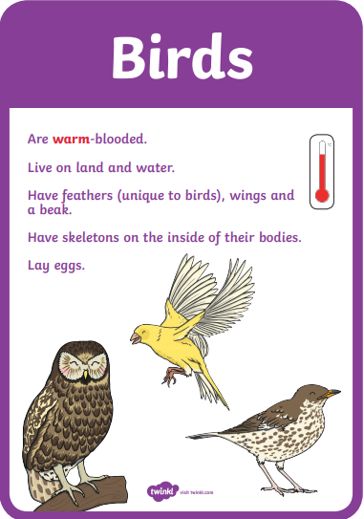

Slide 12
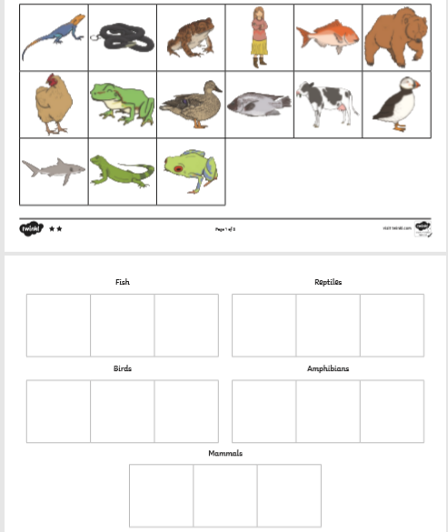
For today’s activity, I would like you to sort pictures of animals into their correct animal group.

