Slide 1

We are learning
To write our weekend news.
To use different conjunctions in my writing.

Slide 2
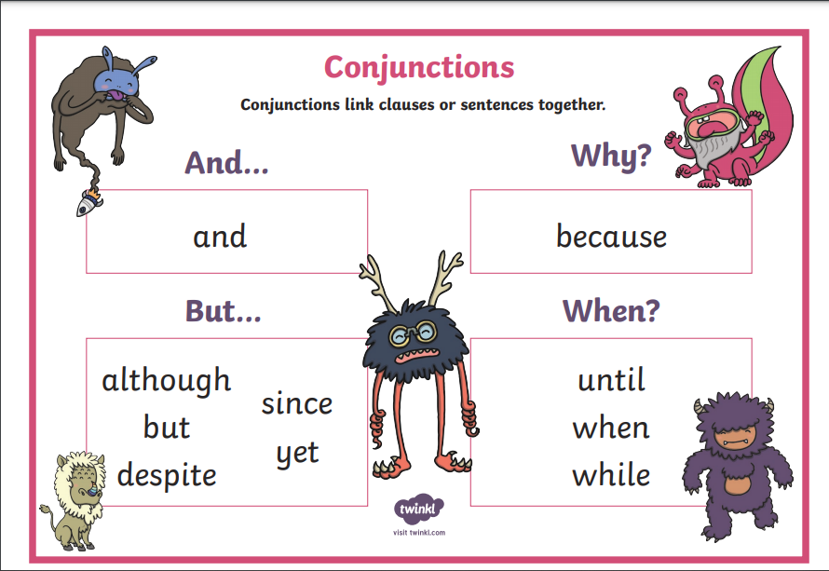
What are conjunctions?

Slide 3
It has been a very wet and soggy weekend but I have still enjoyed myself. On Saturday morning I got myself ready to take the dogs for a walk. I put my wellies on because it was so wet outside. It was raining quite heavily and I really didn’t want to go out but Logan and Roxy were so excited. About halfway through the walk Roxy decided to jump into the stream and got completely soaked! She has long fur so it takes a long time for her to dry. She acts more like a fish than a dog!

Slide 4
On Sunday morning while the dogs were sleeping, I made myself a coffee and watched a program on Netflix called ‘The Durrells’. It’s about a family who move to Greece to live. In the afternoon I called my Nan who lives in Sri Lanka. We had a lovely chat and then I made a start on the roast dinner. I made sure to keep an eye on the Yorkshire puddings as I have a tendency to burn them.

Slide 5
I would like you to write your weekend news.
I would like you to use conjunctions in your writing if you can:
and
but
because
Can you remember the things we must include in our writing?

Slide 6
full stops
ABC
capital letters
went
letters on the line
letter tails under the line
fgjpq
and, but, because
extend sentences

