Slide 1
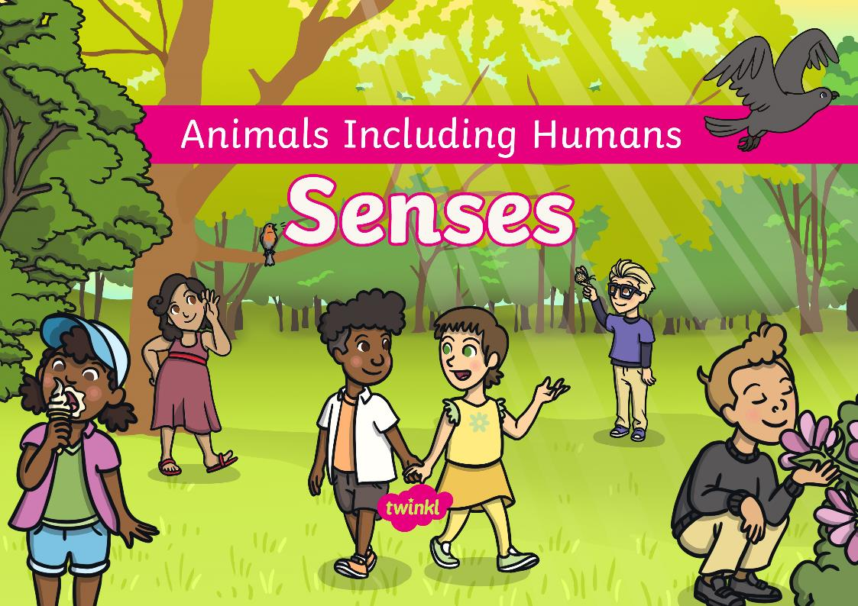

Slide 2

We are learning
To name the five senses and to perform simple tests to find out more about them.
Success Criteria
I can name the five senses.
I can identify which part of the body is used for each sense.
I can perform simple tests to answer questions about my senses.

Slide 3







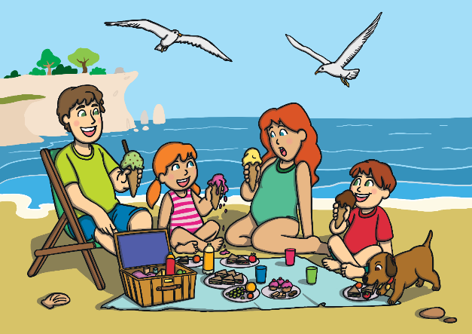
Senses
Look at the picture carefully. What do you see?
Which child is wearing the red top?
What is happening to the girl’s ice cream?
What is the dog doing?

Slide 4
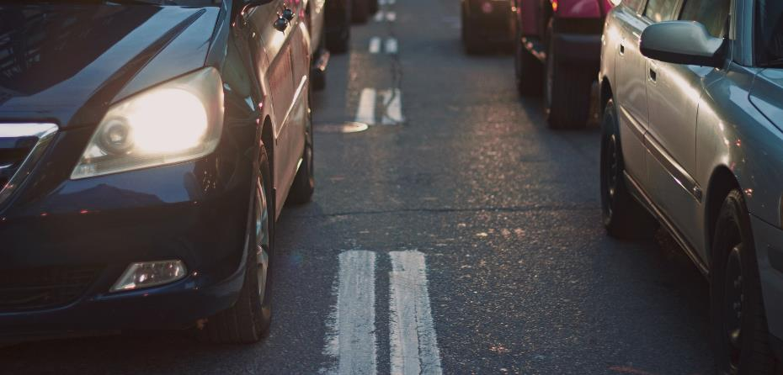
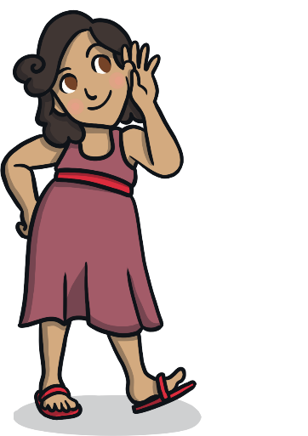

Senses
Close your eyes and listen carefully to the sounds. What can you hear?
What is making the sound?
What do you think is happening?
If you were standing near to this noise, what would you need to be careful of?

Slide 5
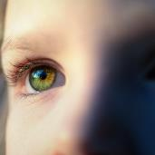
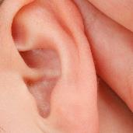
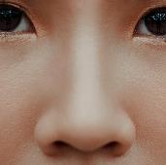
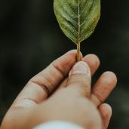
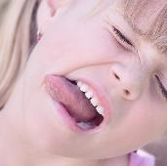

Senses
You have just used two of your senses: sight and hearing.
Humans have five senses:
sight
hearing
smell
touch
taste
Our senses help us to understand the world. They also help to keep us safe.
Let’s find out more about each sense.

