Slide 1


Amazing Animals

Slide 2
We are learning
About the jaguar.
To write a fact file about jaguars..

Slide 3
Jaguar
Habitat:
Jaguars can be found in South America, the Amazon Rainforest in particular. Sadly their habitat is being destroyed as large amounts of the Amazon Rainforest are being cut down each day.

Slide 4
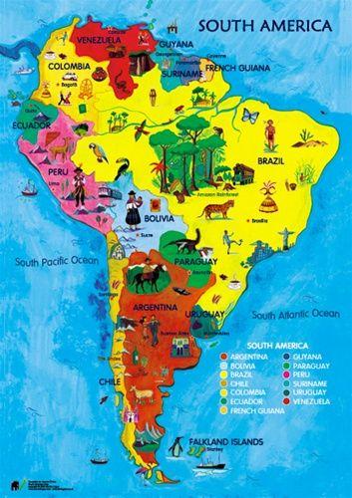
Jaguar
Habitat: Amazon
Rainforest

Slide 5
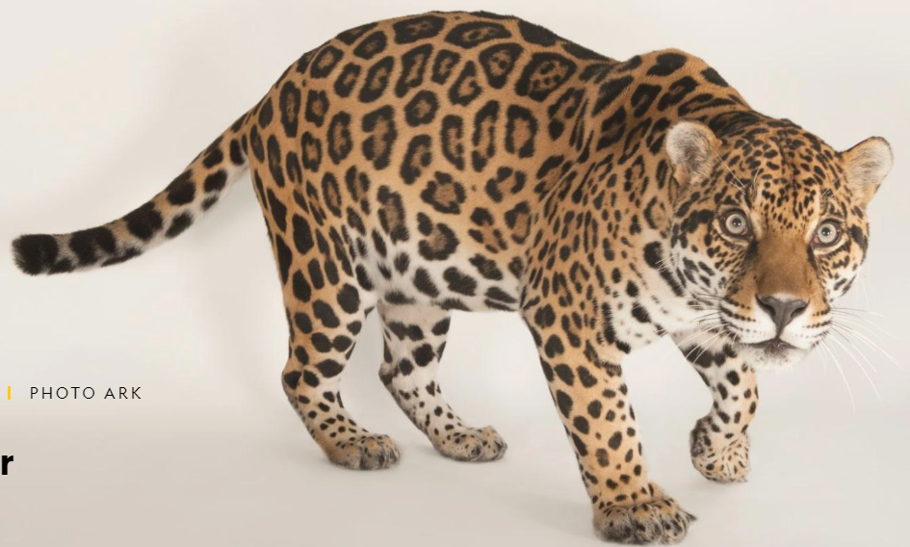
Jaguar
Appearance:
Jaguars have yellow or orange coats, dark spots and short legs. The dark spots on their coats are unlike any other cat’s spots. Each spot looks like a rose and are called rosettes.

Slide 6
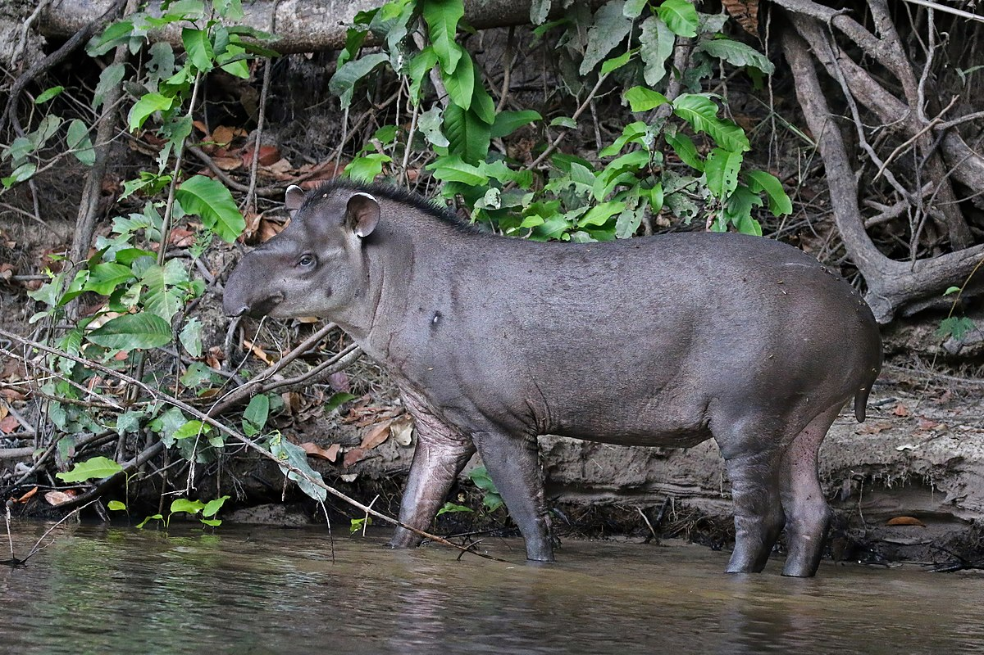
Jaguar
What they eat:
Unlike many other cats, jaguars do not avoid water. In fact, they are quite good swimmers. They hunt fish, turtles, and even caiman. Jaguars also eat deer, capybaras, tapirs, and a number of other land animals, which they prefer to hunt for at night.
tapir

Slide 7
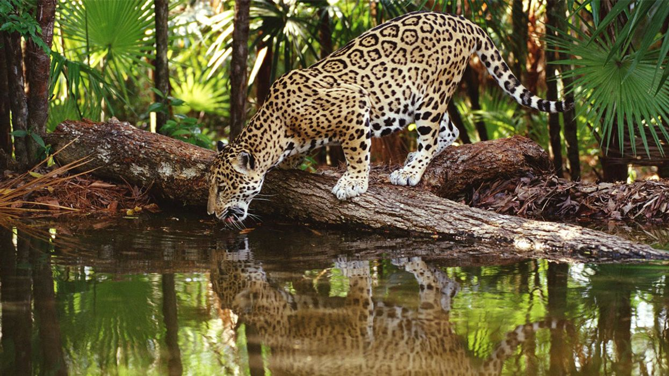
Jaguar

Slide 8
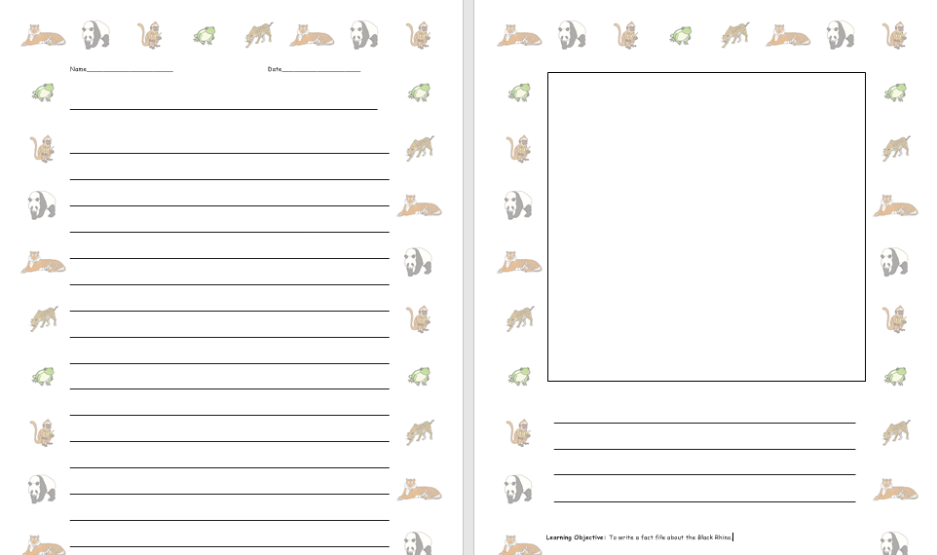
I would like you to write some facts about the jaguar.

