Slide 1


Amazing Animals

Slide 2
We are learning
About orcas.
To write a fact file about orcas..

Slide 3
Orca
Habitat:
Orca’s can be found in all seas and oceans across the world. They are able to live in cold and warm water.
They live and hunt in a group called a ‘pod’. There can be up to forty orcas in a pod.

Slide 4
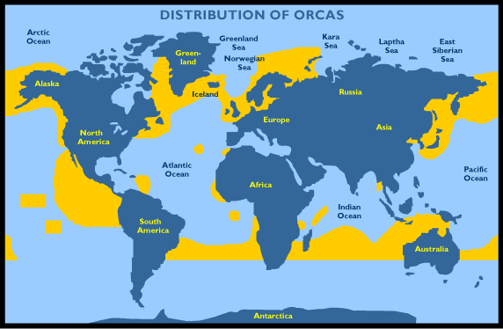
Orca
Habitat:

Slide 5
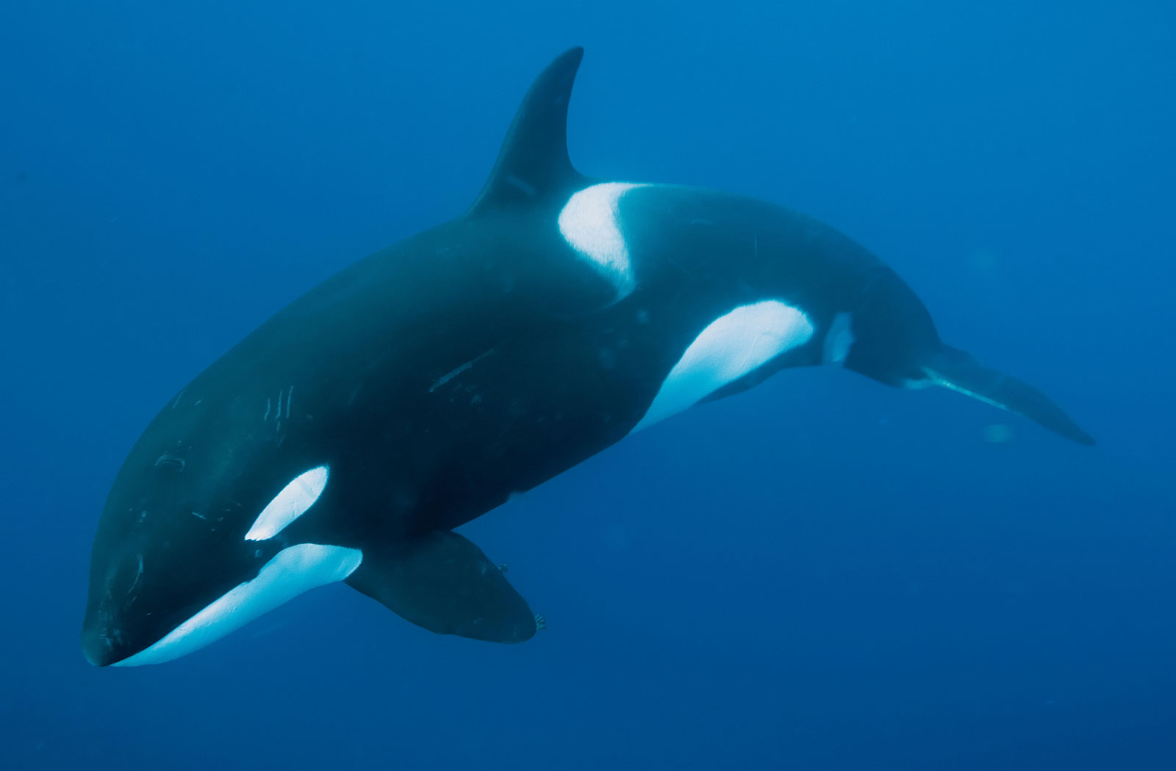
Orca
Appearance:
Orcas have a black back, white chest and sides, and a white patch above and behind the eye. Calves are born with a yellowish or orange tint, which fades to white.

Slide 6
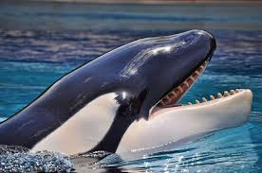
Orca
What they eat:
Orcas eat seals, fish, squid and sea birds. They have been seen hunting for penguins too. Orca’s don’t chew their prey but swallow it whole, even though they have teeth.

Slide 7
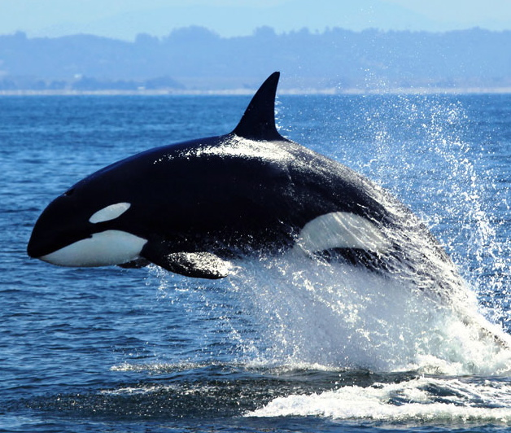
Orca

Slide 8
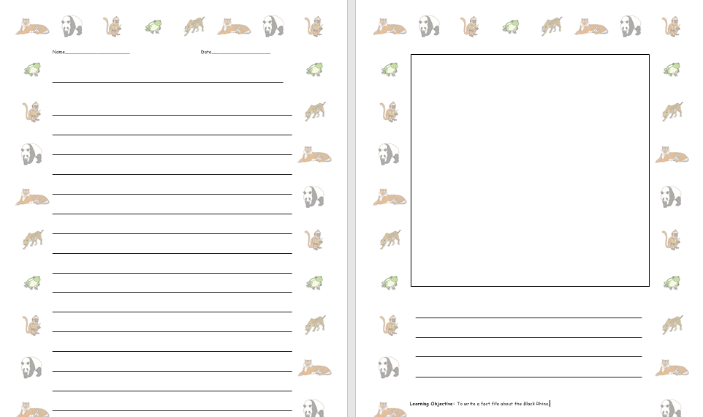
I would like you to write some facts about the orcas.

