Slide 1

We are learning
To choose the correct coins to make a given total.

Slide 2
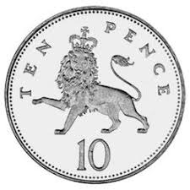
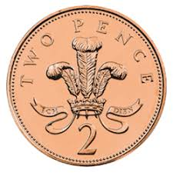
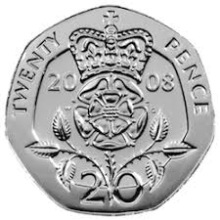
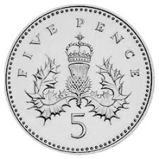
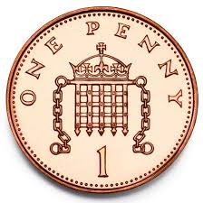
What coins can you use to make……..
15p

Slide 3
What coins can you use to make……..
7p

Slide 4
What coins can you use to make……..
12p

Slide 5
What coins can you use to make……..
24p

Slide 6
What coins can you use to make……..
30p

