Slide 1

LO To create word calligrams
Success criteria:
I know that calligrams are words or poems which create a shape.
I know the shape of a calligram usually represents the topic of the poem.

Slide 2

What Is a Calligram?
A calligram is a word or piece of writing which is written
to look like what the word means.
For example, the word crinkly can be written so that the letters look crinkly!

Slide 3




Some calligrams are used to describe movements and actions.
These are verbs.

Slide 4





What Type of Words Are These?
These calligrams show the name of something.
These are nouns.

Slide 5
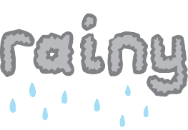




What Type of Words Are These?
These calligrams are used to describe.
These are adjectives.

Slide 6





What Type of Words Are These?
Answer:
verbs

Slide 7


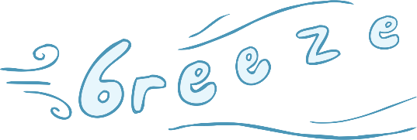
What Type of Words Are These?
Answer:
nouns

Slide 8
Independent Work
Design Your Own Calligrams!
Have a go at creating your own calligrams using
the Great Fire of London topic words!

