Slide 1
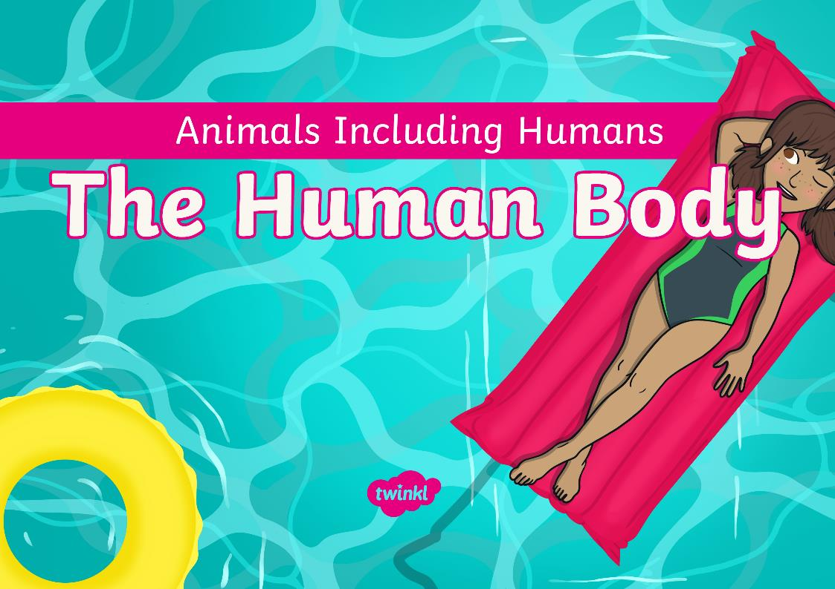


Slide 2
Aim
To name, identify and label the parts of the human body.
Success Criteria
I can name parts of the human body.
I can identify parts of the body.
I can label a diagram to show parts of the body.

Slide 3







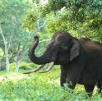
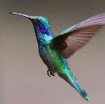
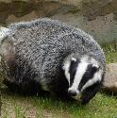
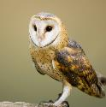
Remember It
Can you sort these animals by the groups they belong to?
Birds | Mammals

Slide 4
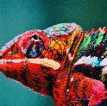
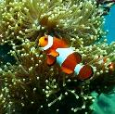
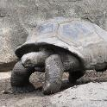
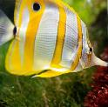
Remember It
Can you sort these animals by the groups they belong to?
Fish | Reptiles

Slide 5
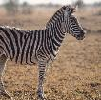

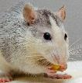
Remember It
Can you sort these animals by the groups they belong to?
Carnivore | Herbivore | Omnivore
I eat grass and
other plants.
I eat other animals such as mice, insects and spiders.
I eat fruit, seeds,
nuts as well as
other animals.

Slide 6
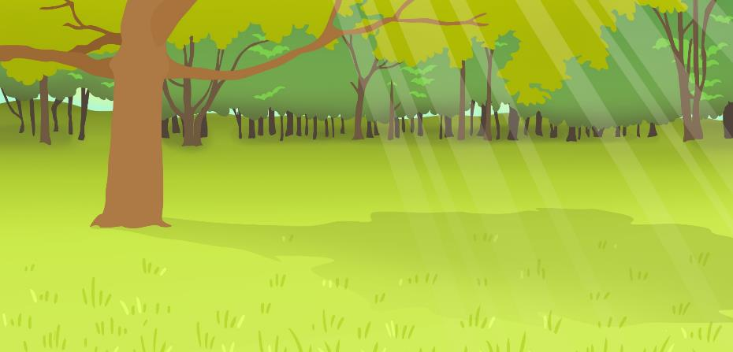

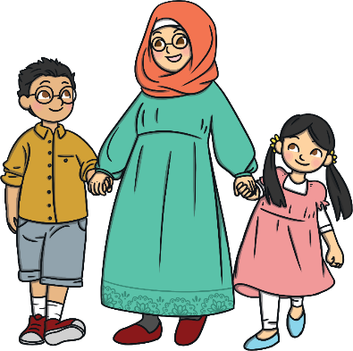
Simon Says
Can you remember what animal group humans belong to?
That’s right – humans are mammals.
We are going to find out about the parts of the human body.

Slide 7
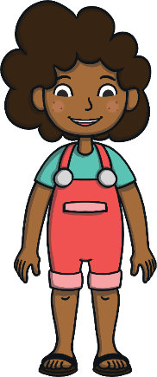

Humans
Our body is made up of lots of different parts.
X
head
hair
Can you help to name the body parts?
ear
eye
teeth
nose
mouth
neck
shoulder
hand
arm
X
Can you name any other parts?
foot
leg

Slide 8
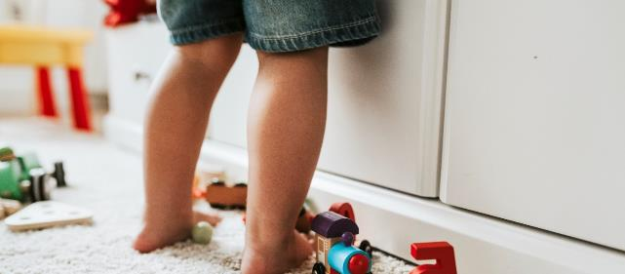
Humans
Each part of your body has its own special job to do.
What do you think the job of each of these body parts is?
These are legs.
What body parts are these?
What is the job of your legs?

Slide 9
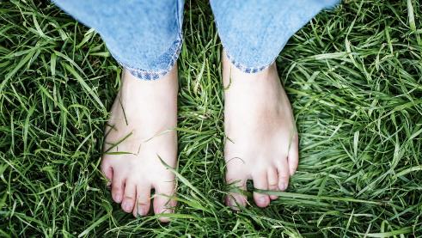
Humans
Each part of your body has its own special job to do.
What do you think the job of each of these body parts is?
These are feet.
What body parts are these?
What is the job of your feet?

Slide 10
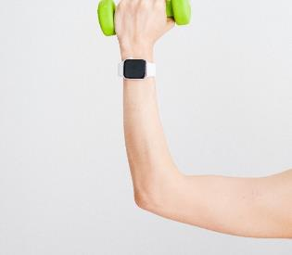
Humans
Each part of your body has its own special job to do.
What do you think the job of each of these body parts is?
This is an arm.
What body part is this?
What is the job of your arms?

Slide 11
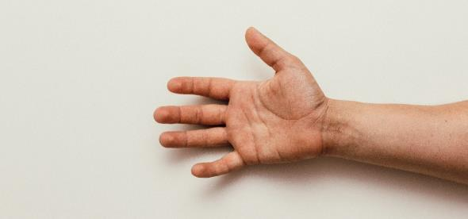
Humans
Each part of your body has its own special job to do.
What do you think the job of each of these body parts is?
This is a hand.
What body part is this?
What is the job of your hands?

Slide 12
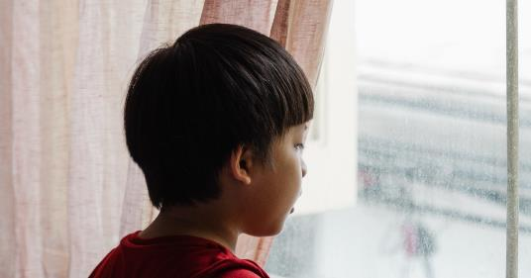
Humans
Each part of your body has its own special job to do.
What do you think the job of each of these body parts is?
This is a head.
What body part is this?
What is the job of your head?

Slide 13
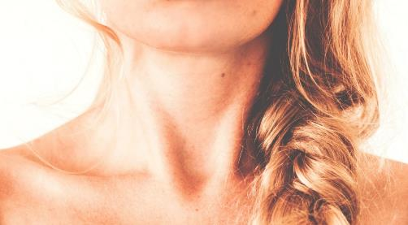
Humans
Each part of your body has its own special job to do.
What do you think the job of each of these body parts is?
This is a neck.
What body part is this?
What is the job of your neck?

Slide 14
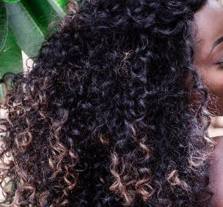
Humans
Each part of your body has its own special job to do.
What do you think the job of each of these body parts is?
This is hair.
What body part is this?
What is the job of your hair?

Slide 15
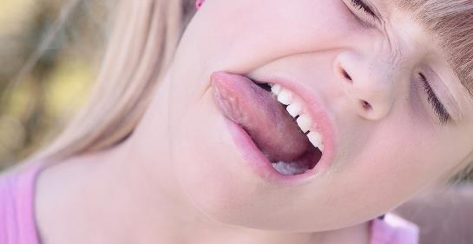
Humans
Each part of your body has its own special job to do.
What do you think the job of each of these body parts is?
This is a mouth.
What body part is this?
What is the job of your mouth?

Slide 16

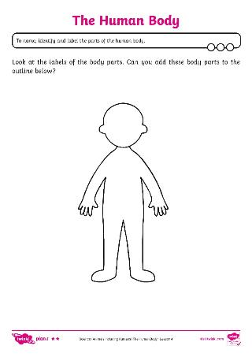
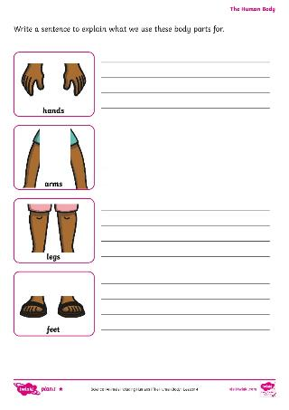

The Human Body
I would like you to label the parts of the body using the word bank.

