Slide 1
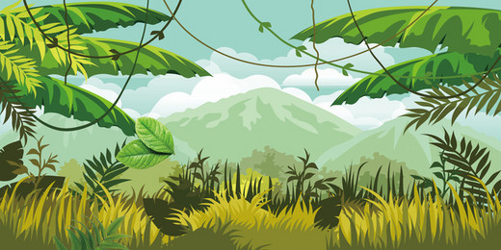

Amazing Animals

Slide 2
We are learning
About the Anaconda.
To write a fact file about the Anaconda..

Slide 3
Anaconda
Habitat:
Anaconda’s can be found in South America.
South America has the largest rainforest in the world, the Amazon Rainforest and this is where anacondas can be found.
They spend a lot of their time in the water but go onto the land to hunt for their prey.

Slide 4
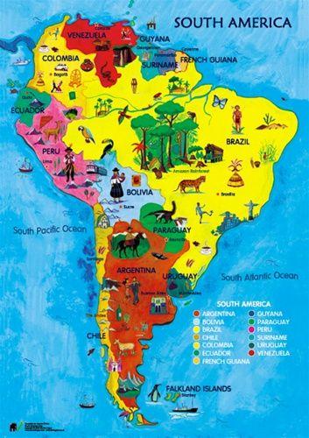
Anaconda
Habitat: Amazon
rainforest

Slide 5
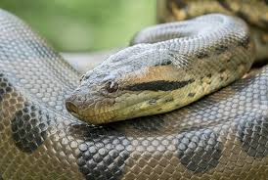
Anaconda
Appearance:
The anaconda is dark green with oval, black spots. Some anaconda’s have yellow scales on the side of their body. The eyes and nostrils are on the top of its head, which enables it to see and breathe whilst partly submerged in the water.

Slide 6
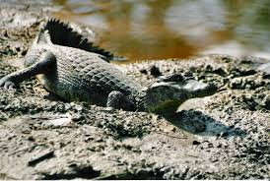
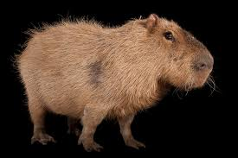
Anaconda
What they eat:
Anacondas eat fish, turtles, caiman, monkeys and capybara. They can’t chew their prey so they open their jaws very wide and swallow their prey whole.
caiman capybara

Slide 7
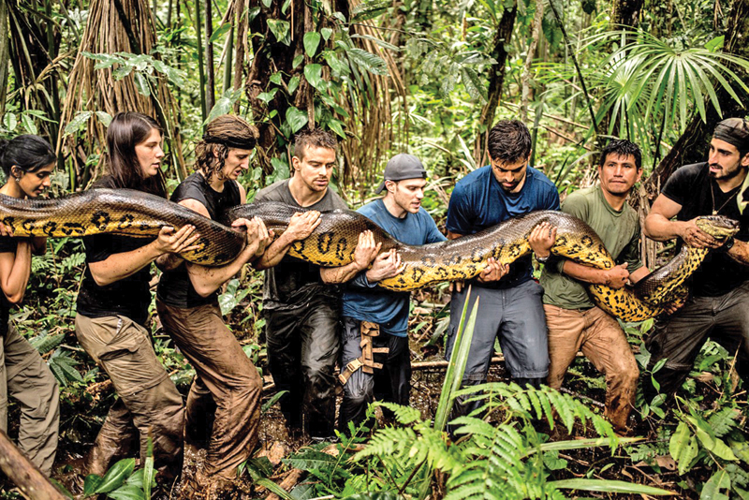
Anaconda

Slide 8
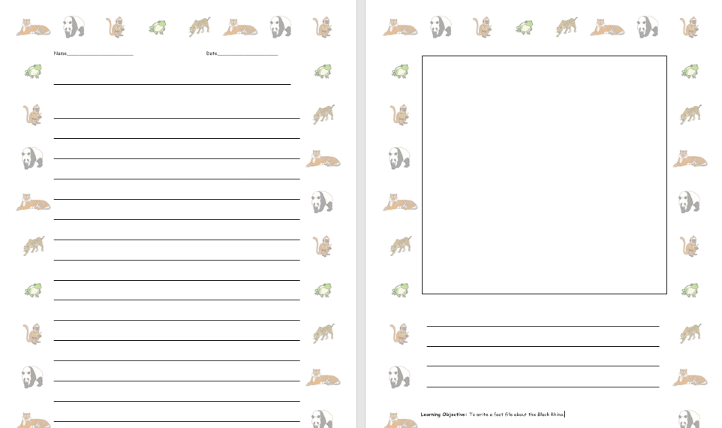
I would like you to write some facts about the anaconda.

