Slide 1

We are learning
To different ways of making 10p.

Slide 2
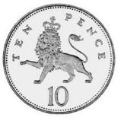
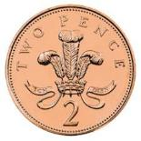

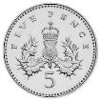

How many different ways are there to make 10p?

Slide 3
We could use all 1p coins……………

Slide 4
We could use all 2p coins……………

Slide 5
We could use 5p coins……..

Slide 6
What other coins could we use? Remember that we can also mix the coins.

