Slide 1


Slide 2
We are learing
To identify, name and sort animals that are herbivores, carnivores and omnivores.
Success Criteria
I can explain what herbivores, omnivores and carnivores eat.
I can identify what different animals eat.
I can sort animals into the diet groups they belong to.

Slide 3

Remember It
Match the description the right group.
have a beak, two legs, feathers and wings.
Amphibians
Birds
live in water. They have scaly skin, fins to help them swim and breathe through gills.
Mammals
Fish
are animals that breathe air, grow hair, or fur and feed on mother’s milk as a baby.
Birds
Mammals
Fish
breathe air. They have scales on their skin.
Reptiles
Reptiles
live in the water as babies and on land as they grow older. They have smooth, slimy skin.
Amphibians

Slide 4

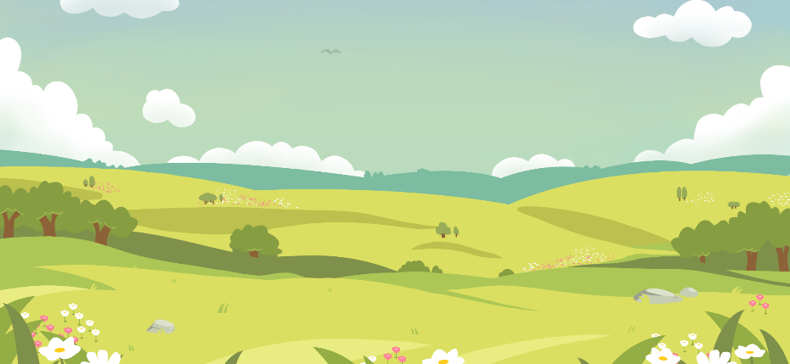
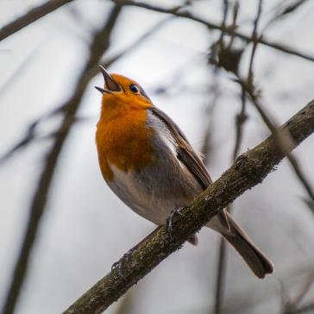
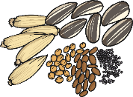
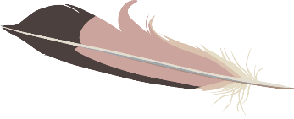
Diets
All living things need to eat. We call what animals eat their diet.
What do you think this animal eats?
robin
Robins eat insects and worms. They also eat fruit, seeds, peanuts and even little bits of grated cheese!

Slide 5
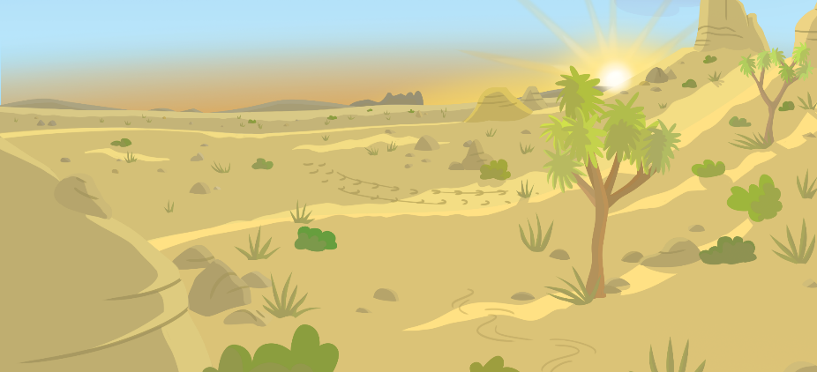
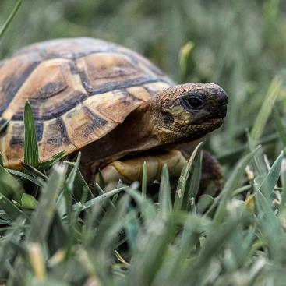

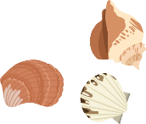
Diets
All living things need to eat. We call what animals eat their diet.
What do you think this animal eats?
tortoise
Tortoises and turtles both
eat plants.

Slide 6


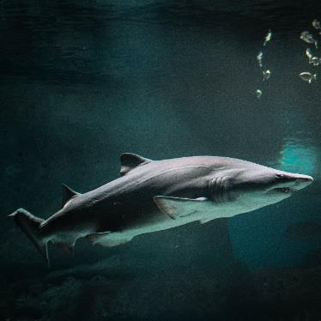
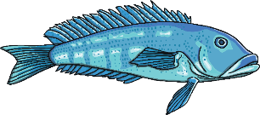
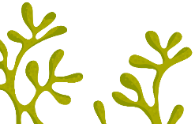
Diets
All living things need to eat. We call what animals eat their diet.
What do you think this animal eats?
shark
Sharks eat fish and other animals that live in the sea.

Slide 7
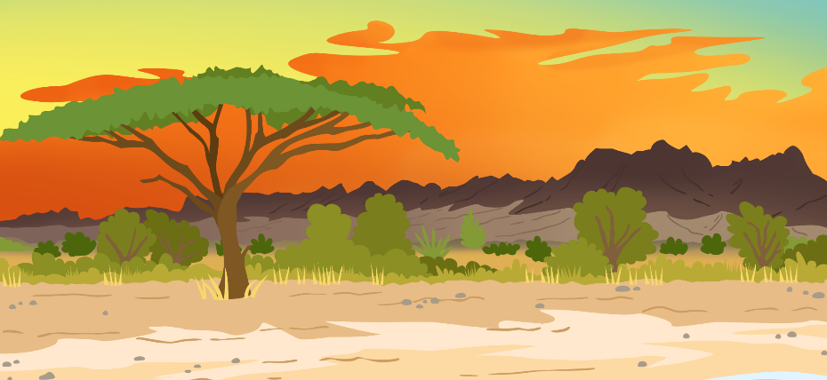
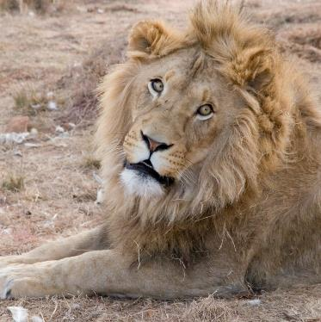

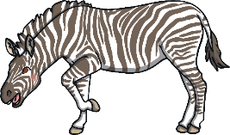
Diets
All living things need to eat. We call what animals eat their diet.
What do you think this animal eats?
lion
Lions eat other animals, such as giraffes and zebras.

Slide 8






Diets
Animals can be sorted into three groups of diets:
carnivore
herbivore
omnivore
Carnivores mostly eat meat. This is the flesh from animals.
Herbivores eat plants. This includes the leaves, fruit and seeds.
Omnivores eat both plants and meat.

Slide 9

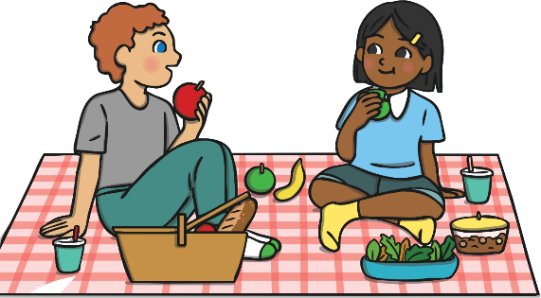
Diets
What kind of food do you eat and which diet you think you have. Are you a carnivore, omnivore or herbivore?
Humans are naturally omnivores. Their bodies are made for eating meat and plants.
Some humans choose not to eat meat.

Slide 10
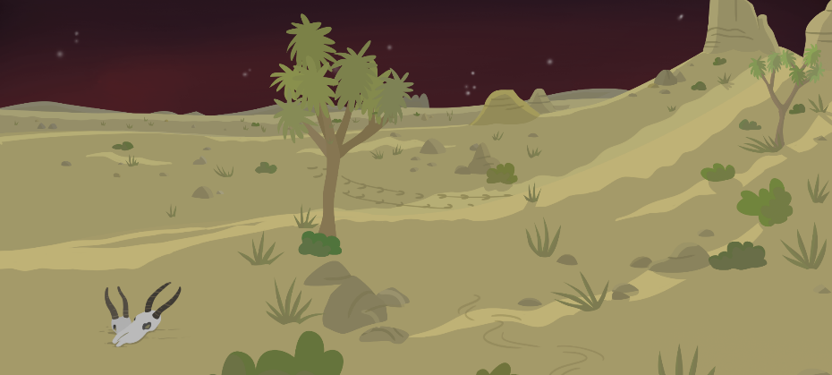
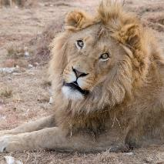
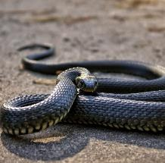
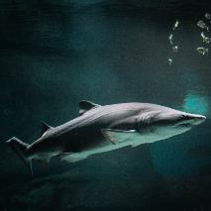
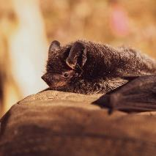
Herbivores, Carnivores and Omnivores
Carnivores
These animals are all carnivores. Which animal groups do they belong to?
lion
snake
shark
bat

Slide 11
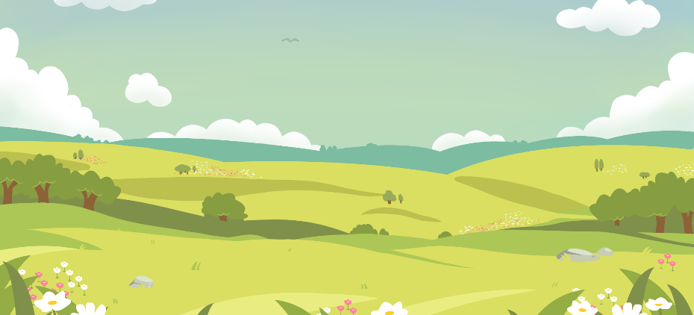
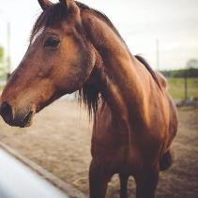
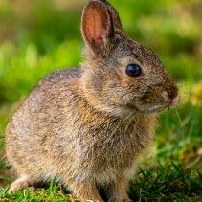
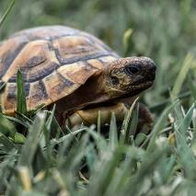
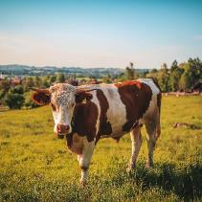
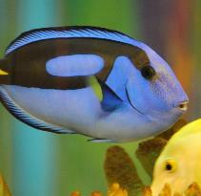
Herbivores, Carnivores and Omnivores
Herbivores
These animals are all herbivores. Which animal groups do they belong to?
horse
rabbit
tortoise
cow
blue tang

Slide 12

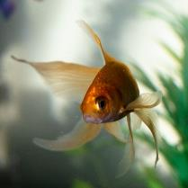
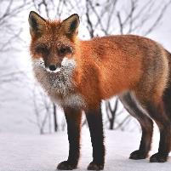
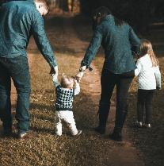
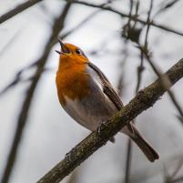
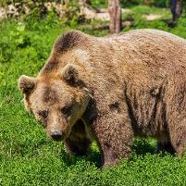
Herbivores, Carnivores and Omnivores
Omnivores
These animals are all omnivores. Which animal groups do they belong to?
fox
goldfish
human
robin
bear

Slide 13


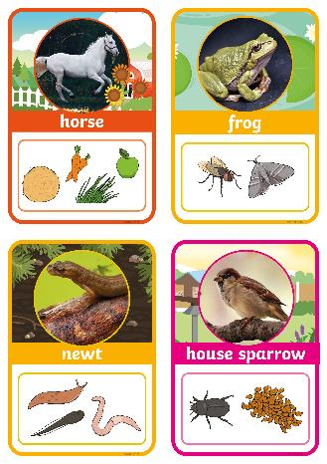
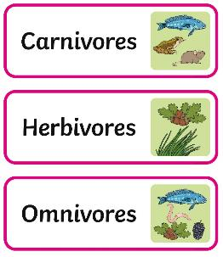

What Do They Eat?
You are going to sort animals according to their diet.
You need to sort the animals into herbivores, carnivores or omnivores.
Challenge!
Can you find any similarities or differences between animals who eat the same diet?

