Slide 1


Amazing Animals

Slide 2
We are learning
About the Black Rhino.
To write a fact file about the Black Rhino.

Slide 3

Black Rhino
Habitat:
Black rhino’s can be found in Africa. They live in the dry savannah, woodlands and wetlands.

Slide 4
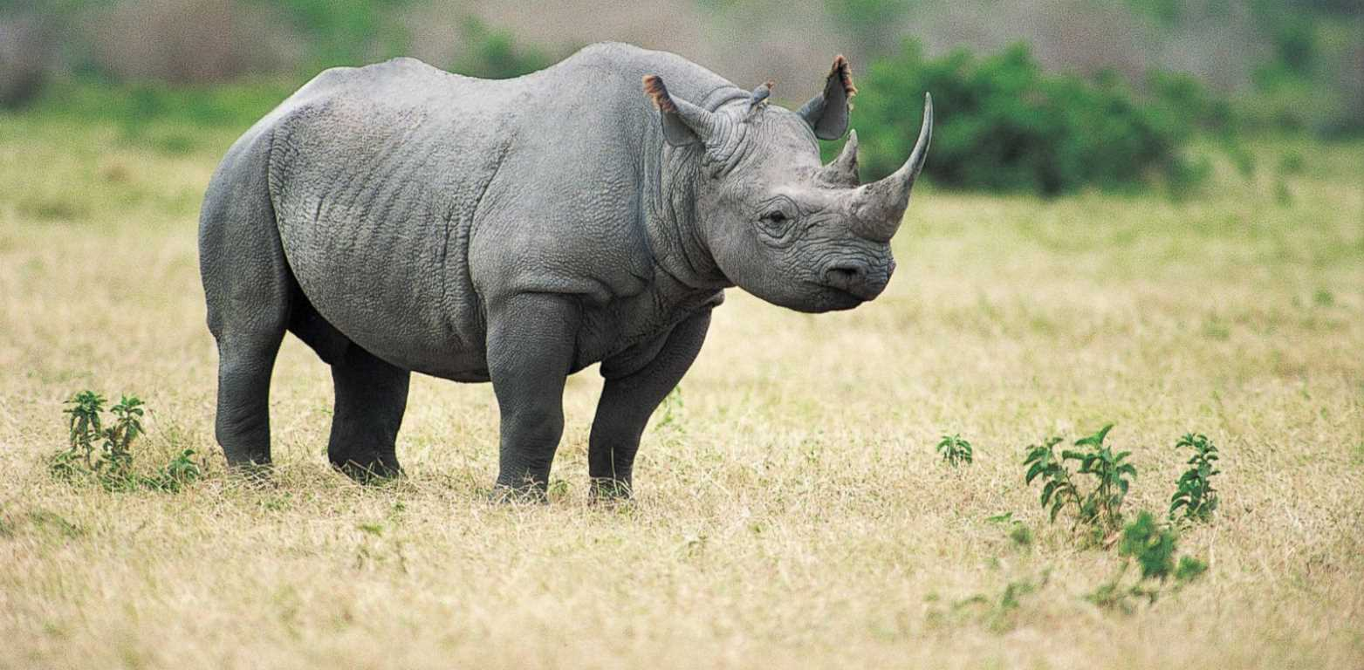
Black Rhino
Appearance:
Black rhino's are actually grey. Rhino's have thick skin called hide. They have two horns which sit on their head. The front horn is the longest. Rhino's have three toes on each foot.

Slide 5
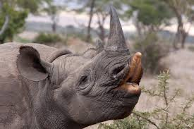
Black Rhino
What they eat:
Black rhino’s eat leaves, fruit, grass and trees. They have a pointed top lip which they use for pulling leaves off from branches.

Slide 6
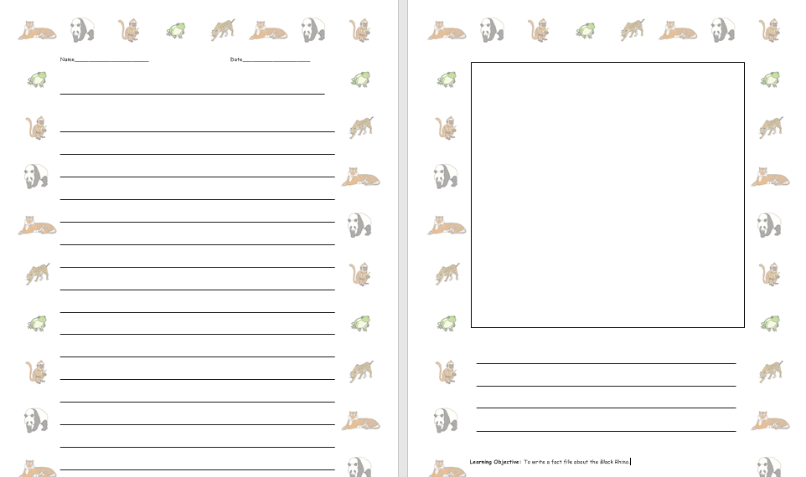
Black Rhino
I would like you to write some facts about the Black Rhino.

