Slide 1
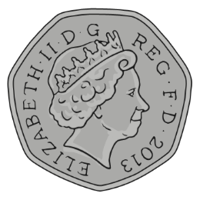
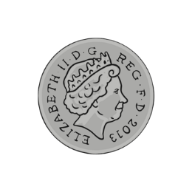
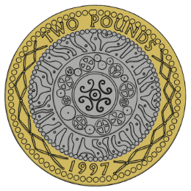
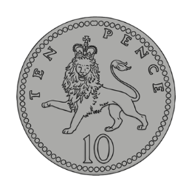
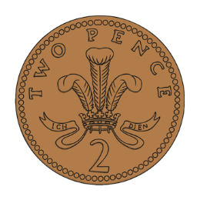

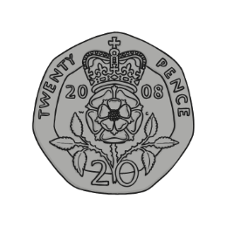
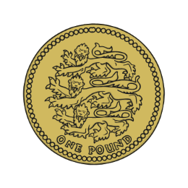
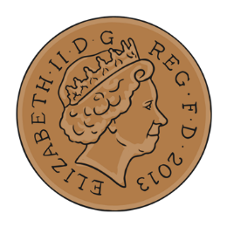
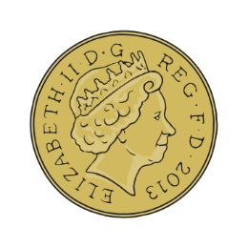
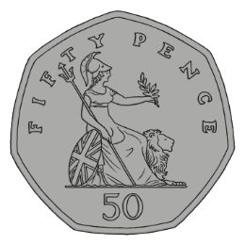
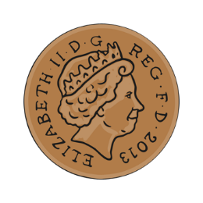
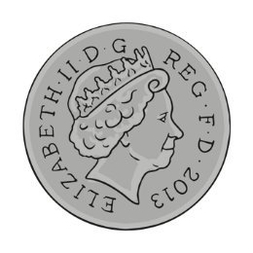
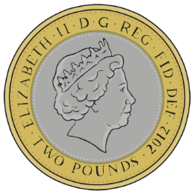
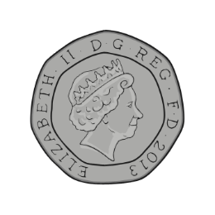
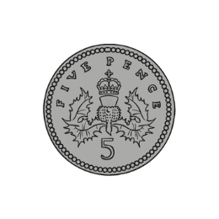

We are learning
To recognise coins.
To add coins to find a total.

Slide 2
Coins
What Do They Look Like?
1p
2p
5p
10p

Slide 3
Coins
What Do They Look Like?
20p
50p
£1
£2

Slide 4
Coins
What Do They Look Like?
1p
2p
5p
10p
20p
50p
£1
£2

Slide 5
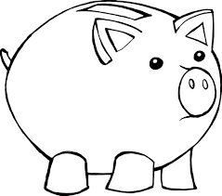
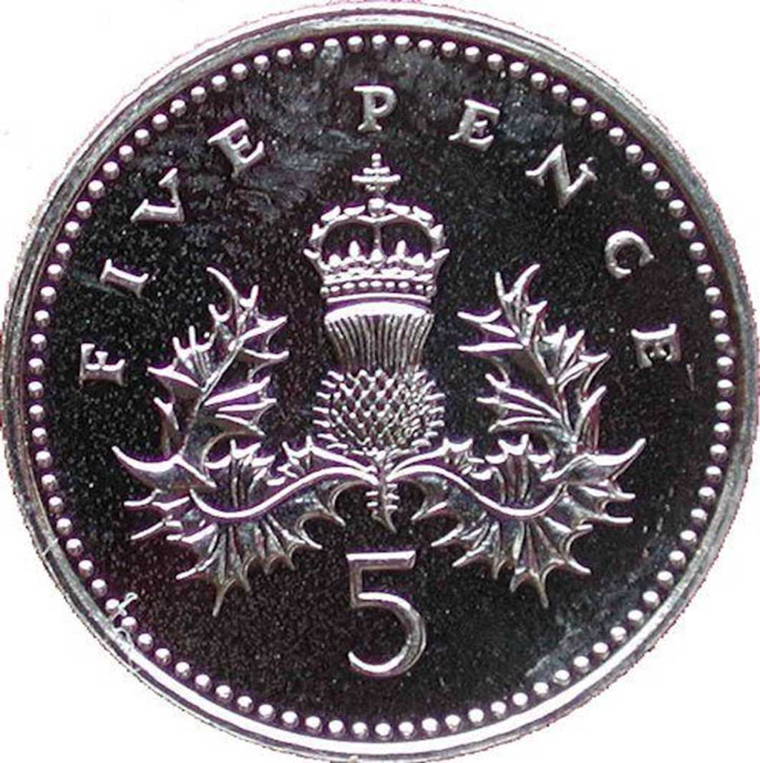
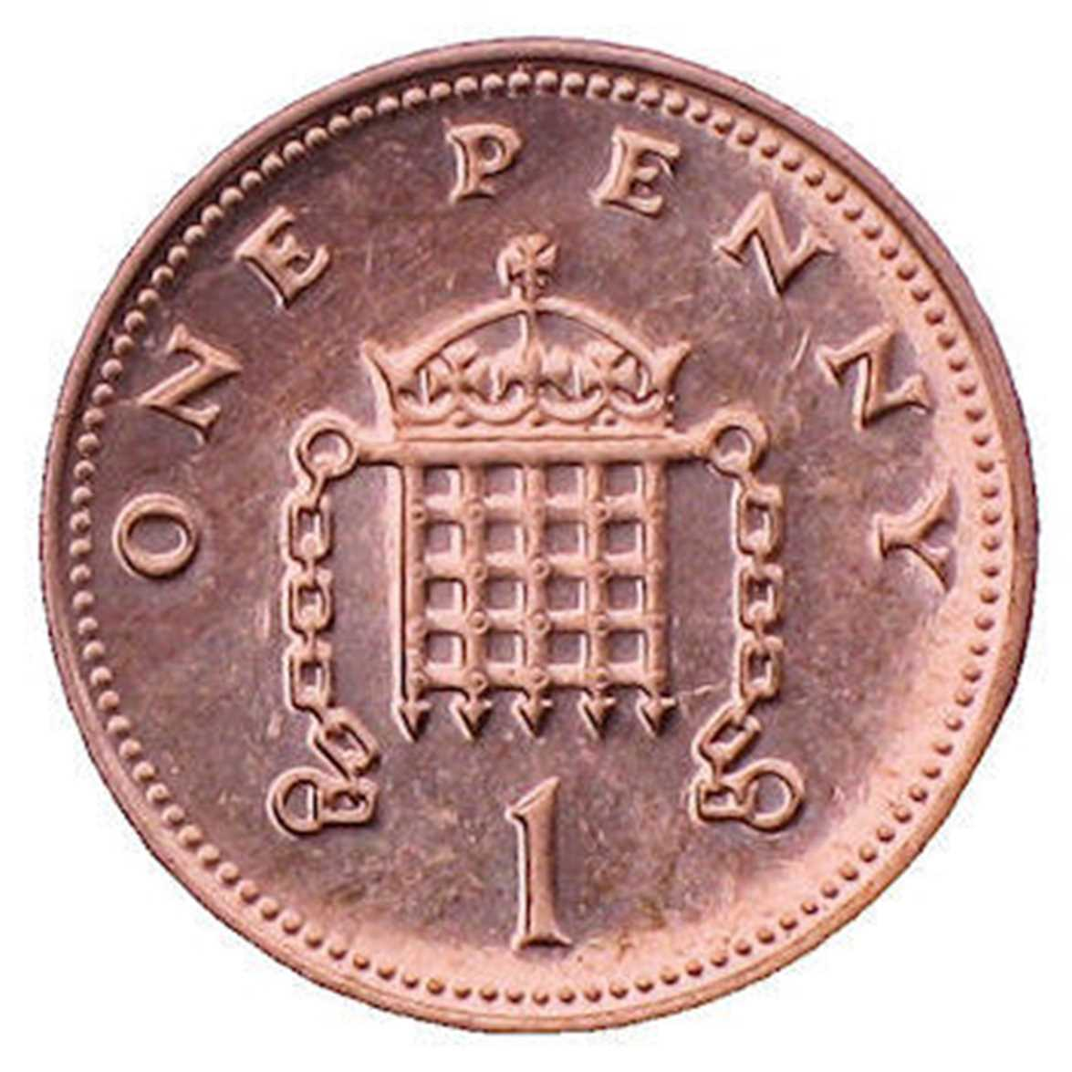
To find out how much money is in the piggy bank, we need to add.
Which coin has the largest value?

Slide 6
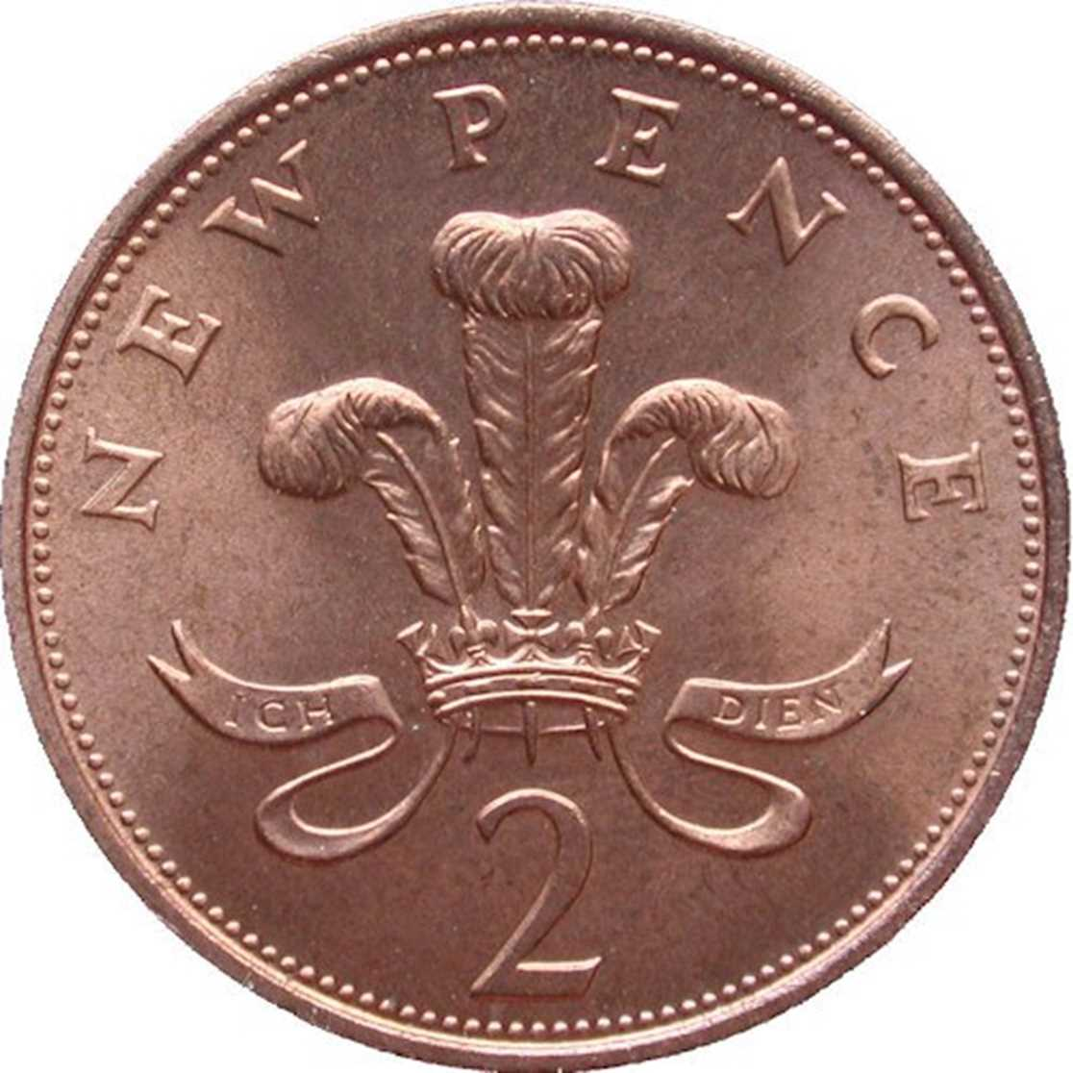
To find out how much money is in the piggy bank, we need to add.
Which coin has the largest value?

Slide 7
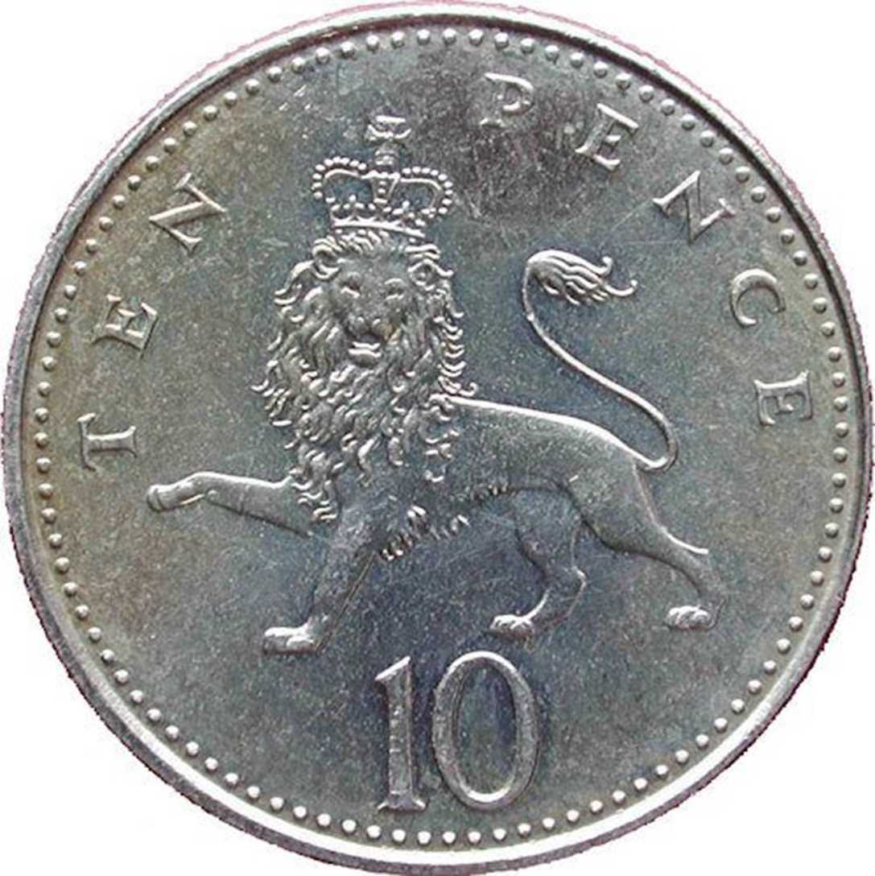
To find out how much money is in the piggy bank, we need to add.
Which coin has the largest value?

Slide 8
To find out how much money is in the piggy bank, we need to add.
Which coin has the largest value?

Slide 9
To find out how much money is in the piggy bank, we need to add.
Which coin has the largest value?

Slide 10
To find out how much money is in the piggy bank, we need to add.
Which coin has the largest value?

