Slide 1


Slide 2
We are learning
To identify and name some common animals.
Success Criteria
I can name some common animals.
I can name the groups of animals including fish, mammals, birds, reptiles and amphibians.
I can identify what groups animals belong to.

Slide 3







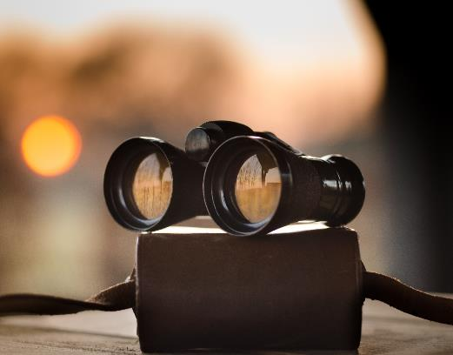

Remember It
Pretend I have never seen an animal.
How would you describe what an animal is?
X
What is an animal?
Can you spot the animals in these pictures?
Look carefully. How do you know they are animals?

Slide 4
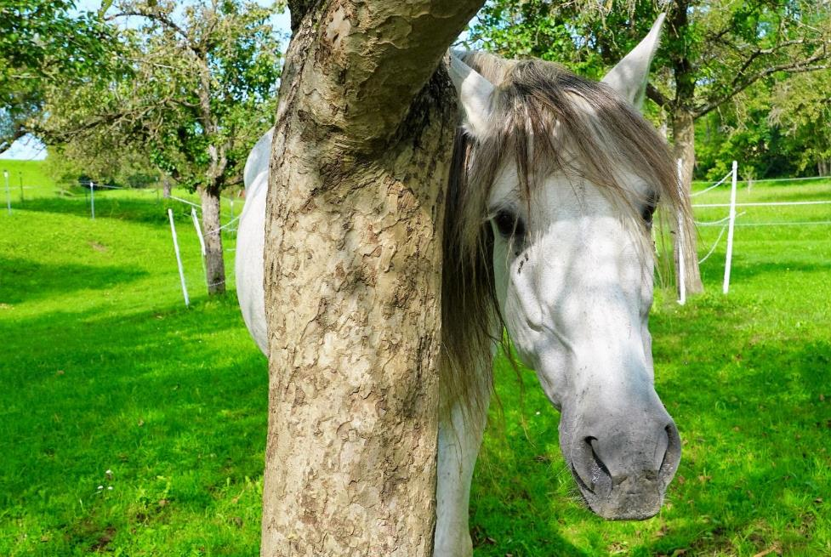

Slide 5
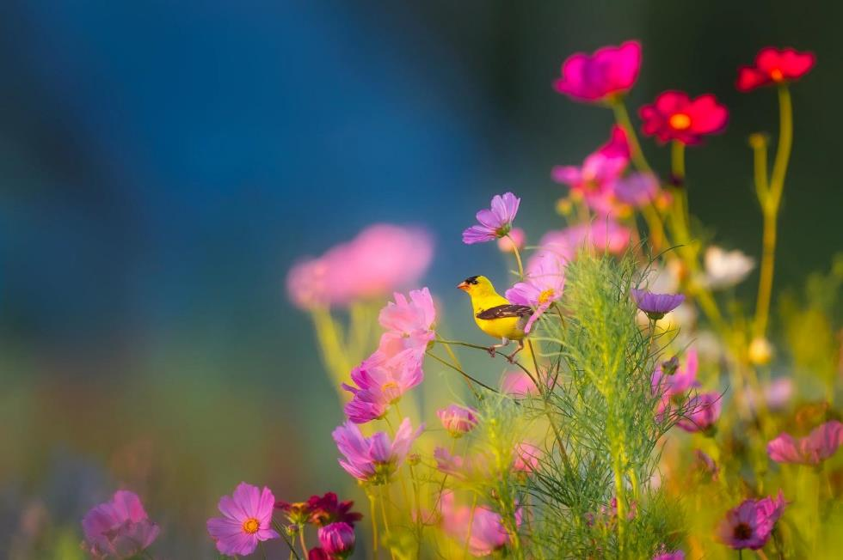

Slide 6
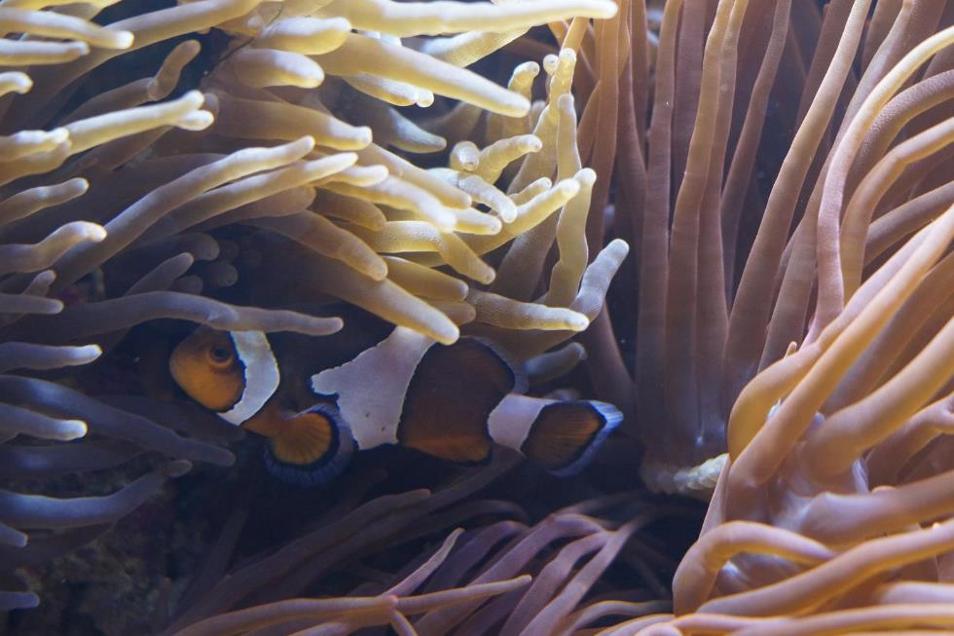

Slide 7
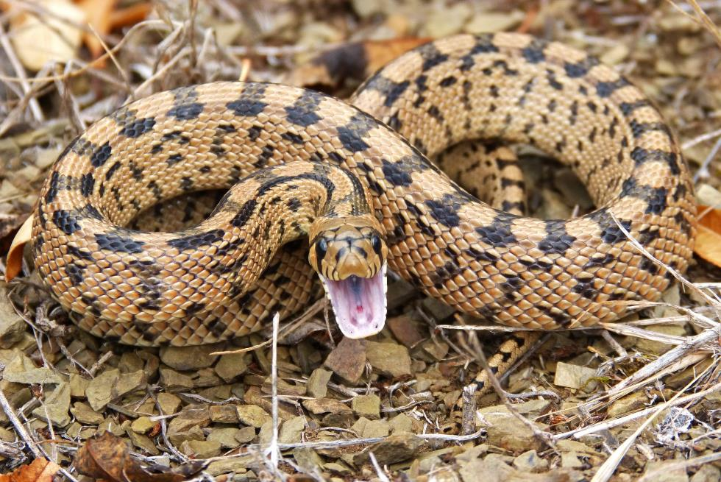

Slide 8
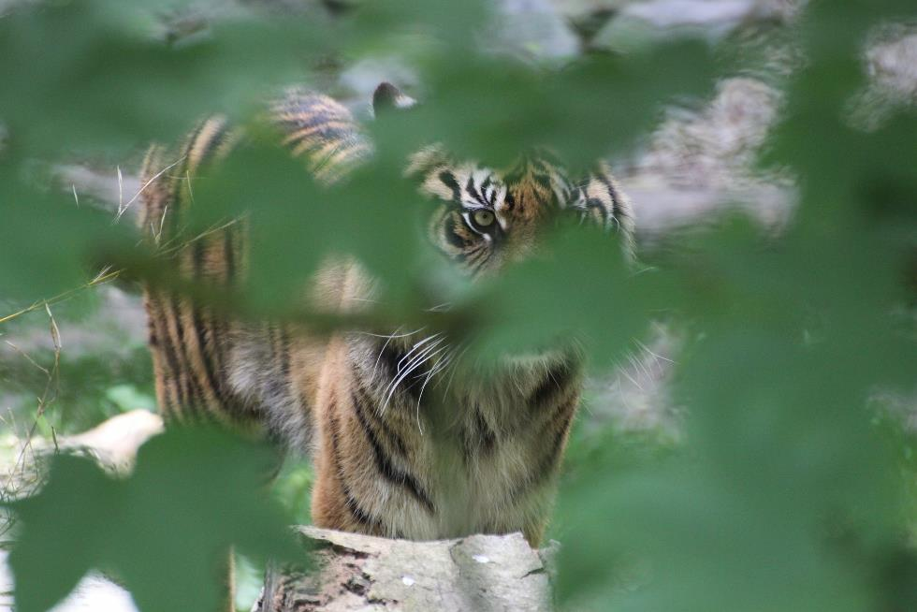

Slide 9
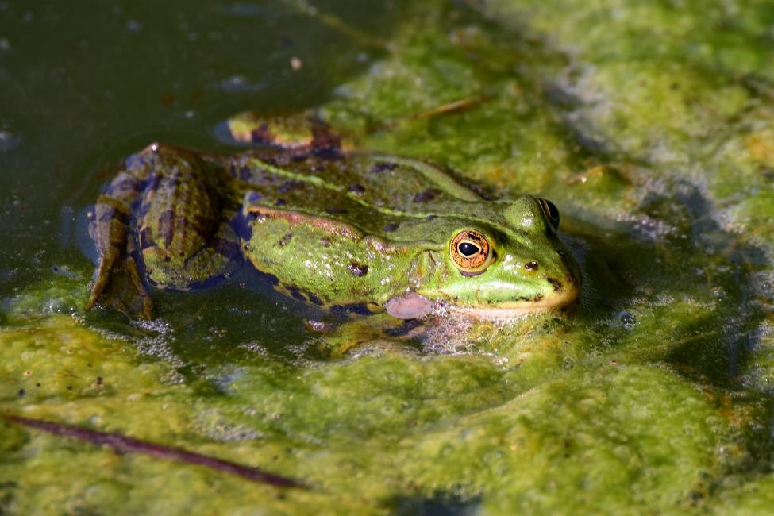

Slide 10
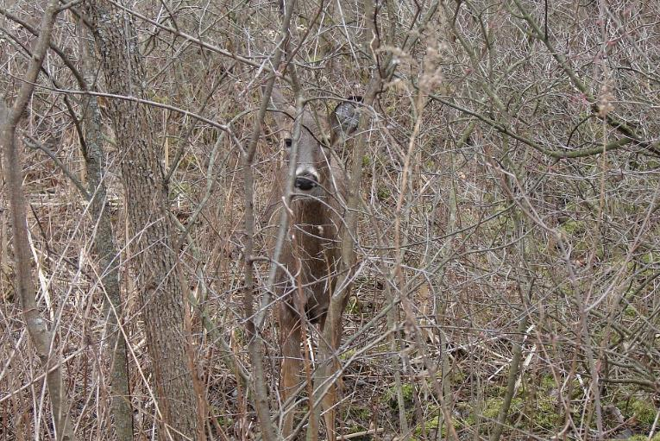

Slide 11
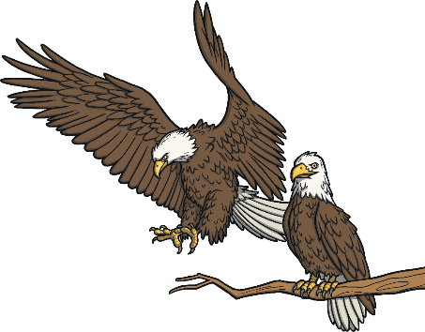
Different Types of Animals
There are lots of different animals.
Scientists sort them into groups to help to identify them.
Here are some of the animal groups that they can be sorted into:
mammals
birds
amphibians
fish
reptiles

Slide 12

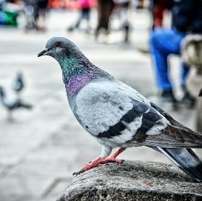
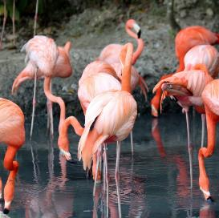
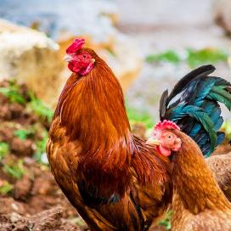
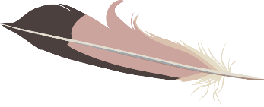
Different Types of Animals
Do you know the names of these animals?
Do you know what type of animal they are?
pigeon
flamingo
chicken
These animals are birds.

Slide 13

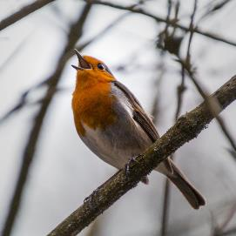
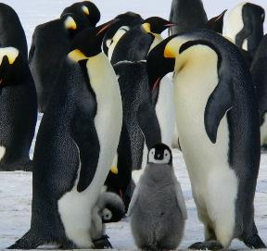
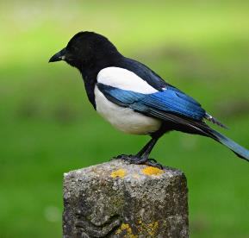
Different Types of Animals
Here are some more birds. Do you know any of their names?
robin
penguin
magpie
Where might you see birds?

Slide 14

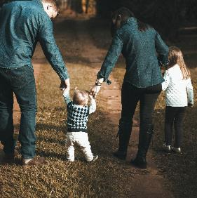
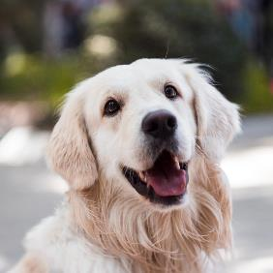
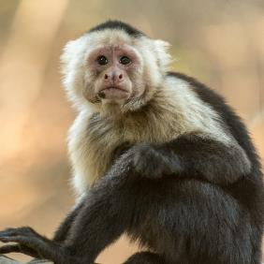
Different Types of Animals
Do you know the names of these animals?
Do you know what type of animal they are?
human
dog
monkey
Did you
You are an animal
and you belong to the
mammal group.
know
These animals are mammals.
?

Slide 15

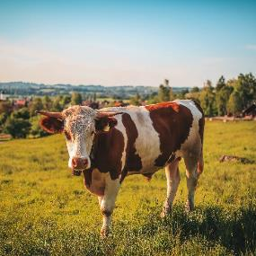
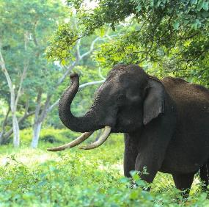
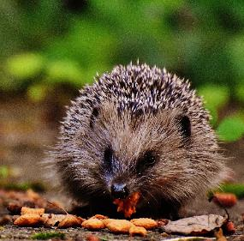
Different Types of Animals
Here are some more mammals. Do you know any of their names?
cow
elephant
hedgehog
Where might you see mammals?

Slide 16

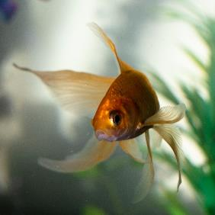
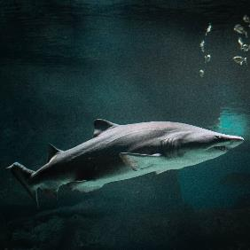

Different Types of Animals
Do you know the names of these animals?
Do you know what type of animal they are?
goldfish
shark
These animals are fish.

Slide 17


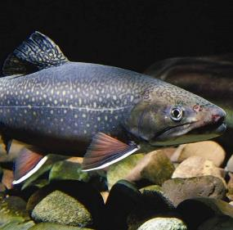
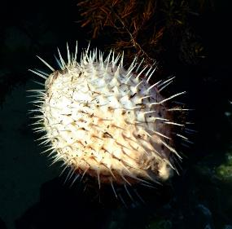
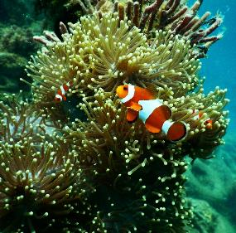
Different Types of Animals
Here are some more fish. Do you know any of their names?
trout
pufferfish
clownfish
Where might you see fish?

Slide 18

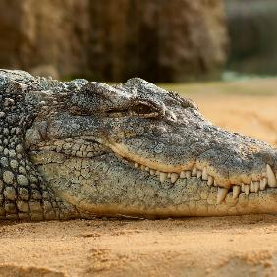
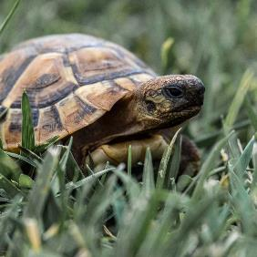
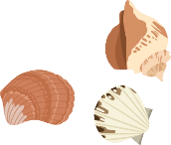
Different Types of Animals
Do you know the names of these animals?
Do you know what type of animal they are?
crocodile
tortoise
These animals are reptiles.

Slide 19

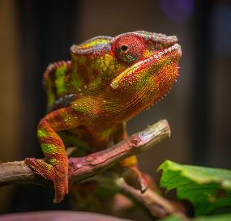
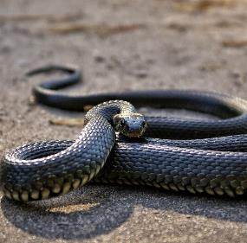
Different Types of Animals
Here are some more reptiles. Do you know any of their names?
chameleon
snake
Where might you see reptiles?

Slide 20

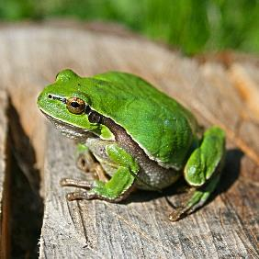
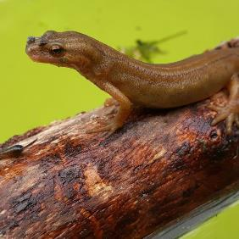
Different Types of Animals
Do you know the names of these animals?
Do you know what type of animal they are?
frog
newt
These animals are amphibians.

Slide 21

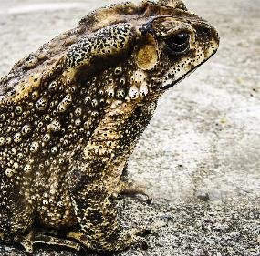
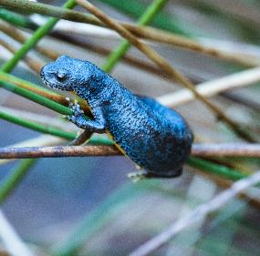
Different Types of Animals
Here are some more amphibians. Do you know any of their names?
toad
salamander
Where might you see amphibians?

Slide 22
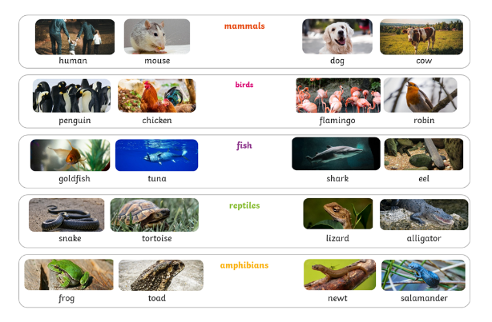


Animals All Around Us
Which types of animals do you think will not live around your school and home? Why?

Slide 23
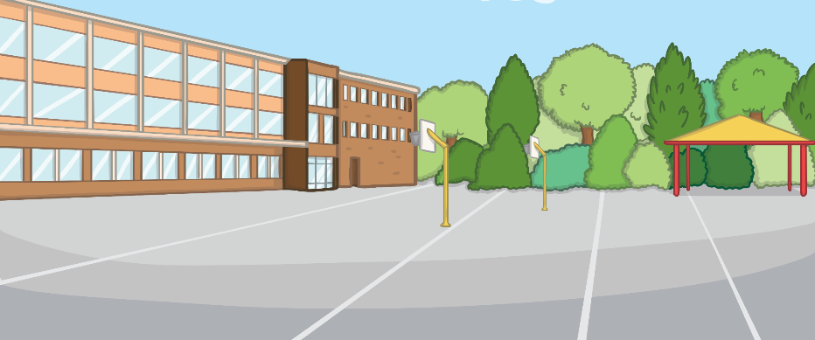


Observing Animals
How can we find out if we are right about the types of animals that might live around our school and home and the types that don’t?
What could we do?
You are going to go outside to look for animals.

Slide 24
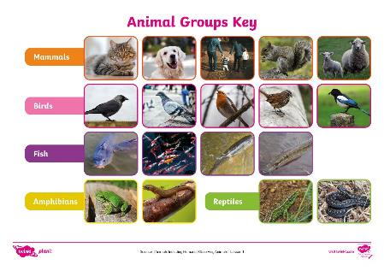
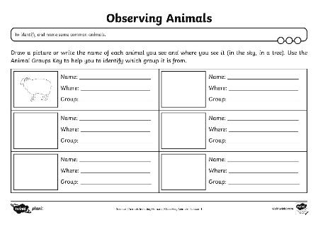

Observing Animals
Whenever you see an animal, draw a picture and write down its name (if you know it) and where you saw it on your Observing Animals Activity Sheet.
Then, use the Animal Groups Key to try and work out what group it belongs to.

Slide 25

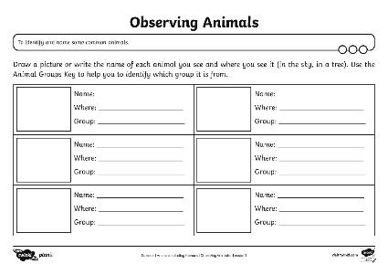
Observing Animals
Make sure you have:
a pencil
your Observing Animals Activity Sheet
your Animal Groups Key
All set? Let’s go!

