Slide 1

We are learning
To recall how we count in 2s, 5s and 10s

Slide 2
I would like for us to practise counting in 2, 5 and 10.
On the next few pages are the painted squares so use them if it will help you.

Slide 3
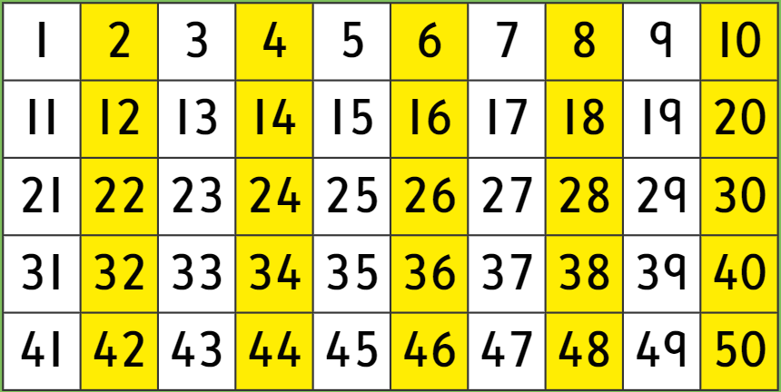

Slide 4
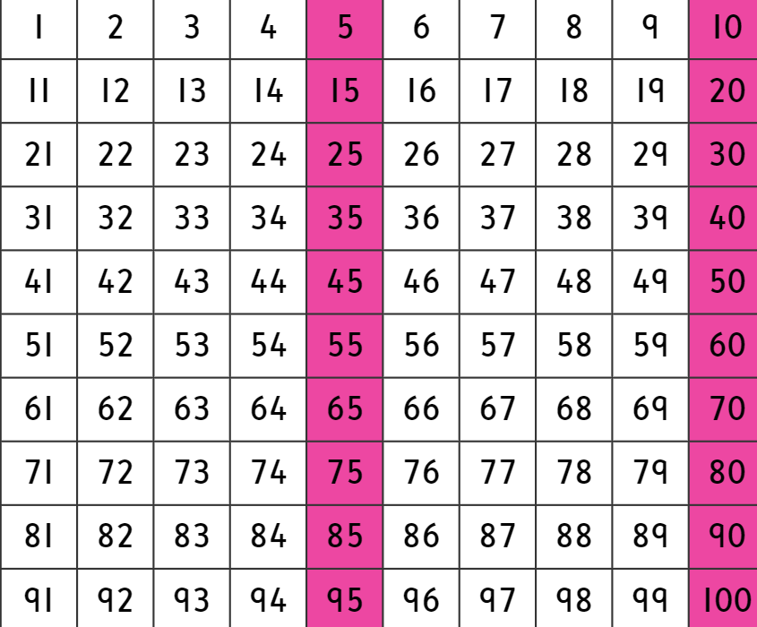

Slide 6


