Slide 1

We are learning
To recall how we count in 2s, 5s and 10s

Slide 2
I’ve found a really fun game for you to play. It will help you practice counting in 2s, 5s and 10s.
Counting in 2, 5 or 10

Slide 3
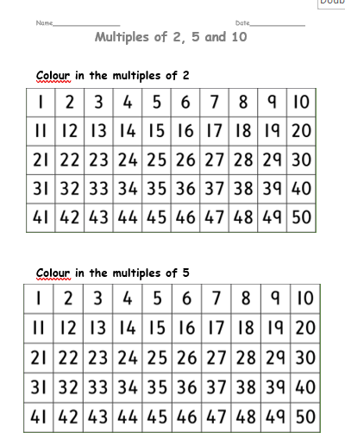
I would like you to colour in the numbers that we count aloud when we count in 2s, 5s and 10s.
These numbers are called multiples.

