Slide 2
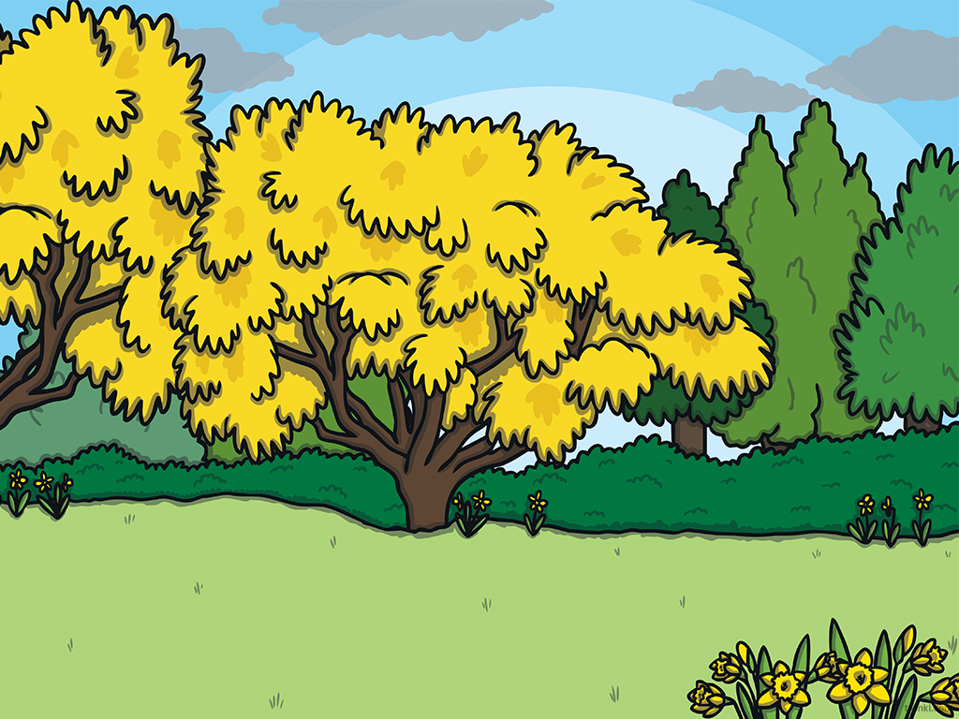

We are learning
To remind ourselves about the four seasons.
To think about what the weather is like in each season.
To design a house that is suited to the weather in England.

Slide 3
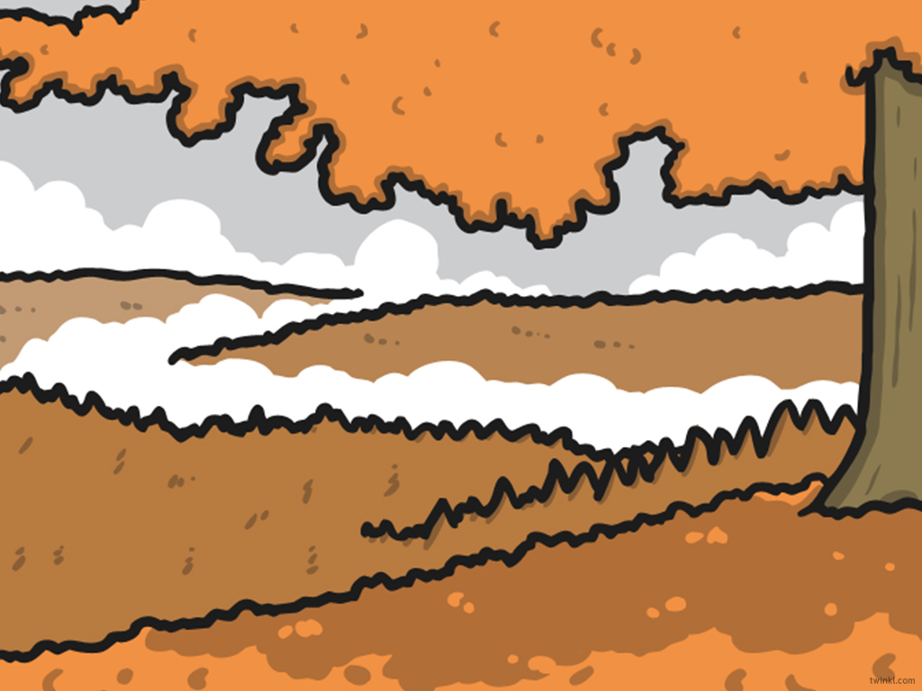
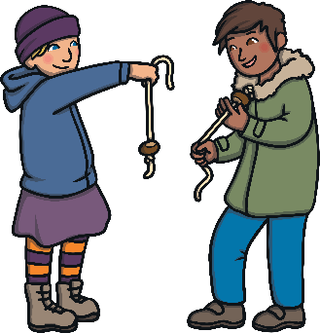

Autumn
The weather gets colder and it gets darker much earlier. The sun rises later on in the morning.
There is a lot of rain in Autumn and not very much sun.
I saw leaves falling from the trees. They had changed colour too!
I collected conkers on the way to school.

Slide 4
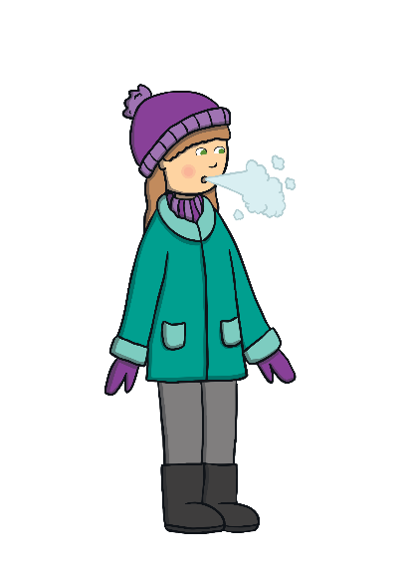
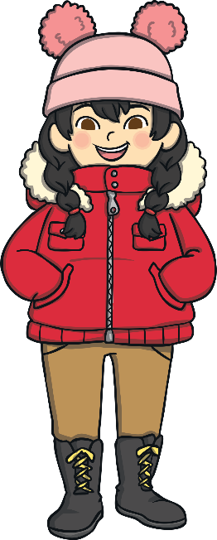
Winter
The next season is Winter. It starts to get dark very early.
Winter has the least amount of daylight. It rains quite a lot in the Winter and if we’re lucky, it snows!
Wow! I can see my breath in the air when I walk to school on frosty mornings.
I’m so cold, I have to wear my hat, scarf and gloves at playtime. They help to keep me warm.

Slide 5

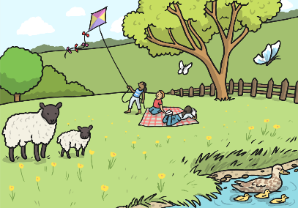

Spring
The season after Winter is Spring. The sun rises earlier in the morning and it starts to get dark later, so the evenings are lighter than in Autumn and Winter. It rains in Spring but there is also lots of sunshine.
I love flying my kite on windy days!
I can see all of the blossom twirling and swirling in
the wind!

Slide 6
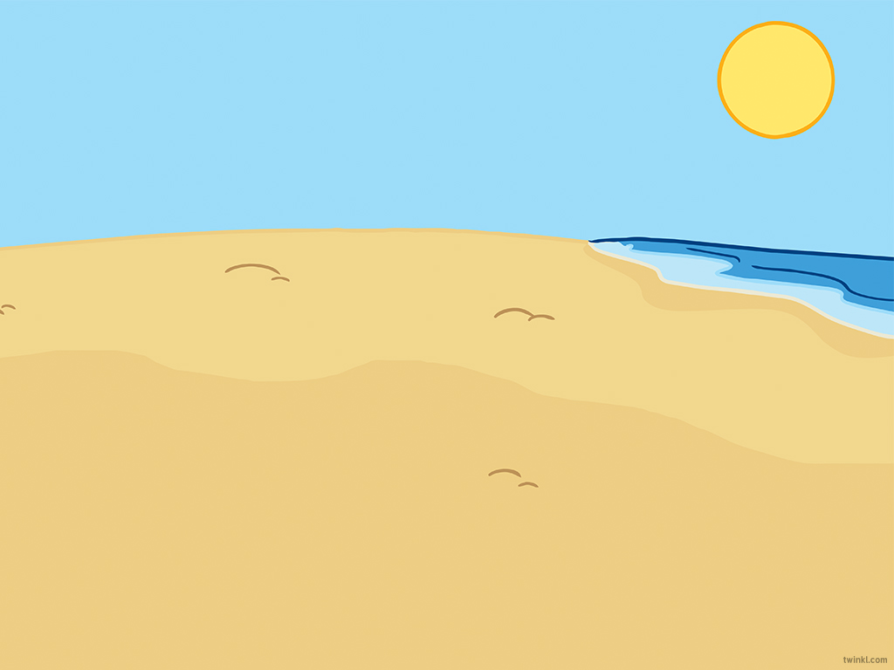
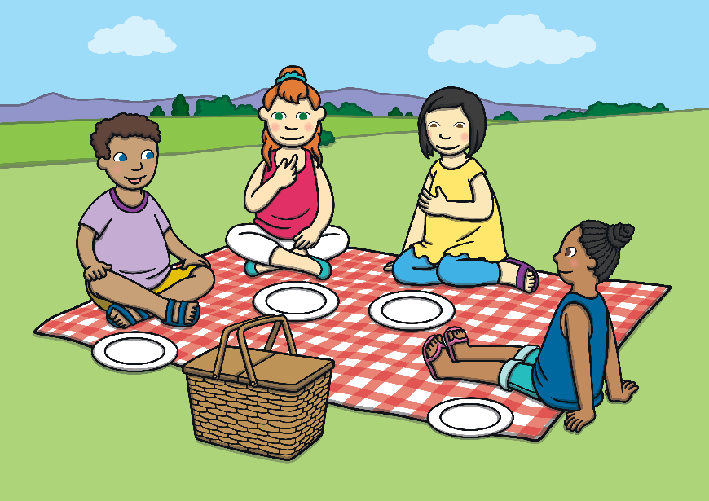
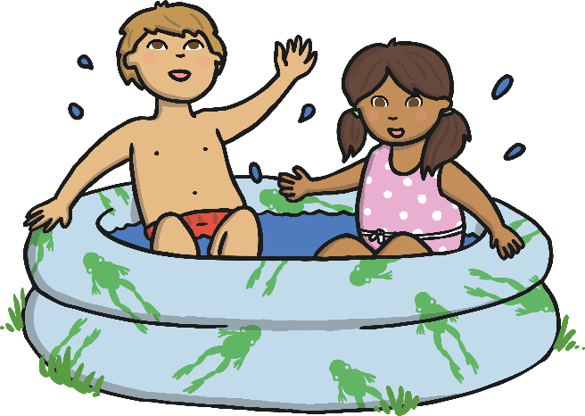
Summer
After Spring, it is Summer. It gets dark very late and it is still light when you go to bed.
The weather is much warmer, although not every day in summer is sunny!
We had a picnic in the park. It was really sunny and warm!
I kept cool in the paddling pool. I had to wear sun cream and drink lots of water too!

Slide 7
Now that we have reminded ourselves of the four seasons, I would like you to draw a home that is suited to the weather in England.
In England we have………. quite a bit of rain some sunny days some windy days a little bit of snow sometimes
Think about the homes you have learnt about this week and how they are suited to their climate.

Slide 8
There is no right or wrong answer for this activity. I just want you to be creative and design a house that would suit the climate in England.

