Slide 1

We are learning
To read a story together.
To retell ‘The Magic Paintbrush’ on a story path.

Slide 2
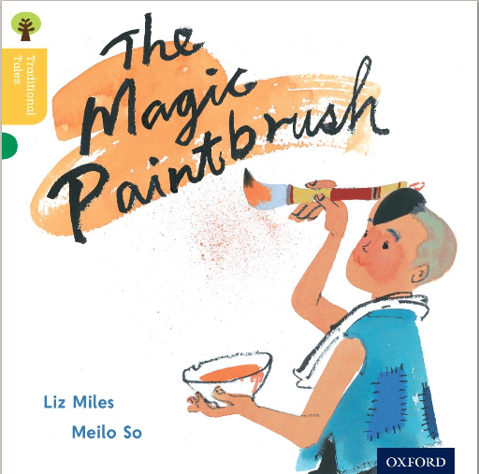

Slide 3
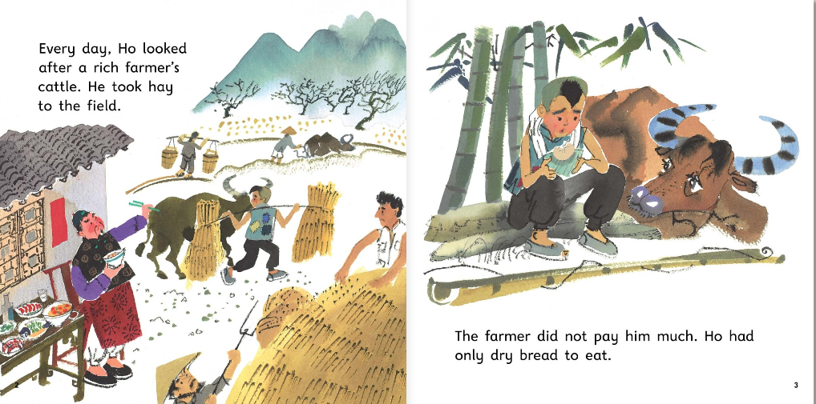

Slide 4
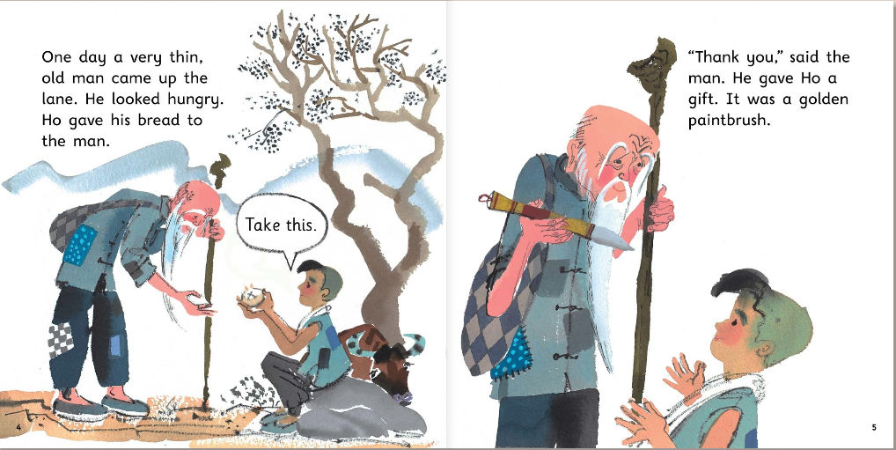

Slide 5
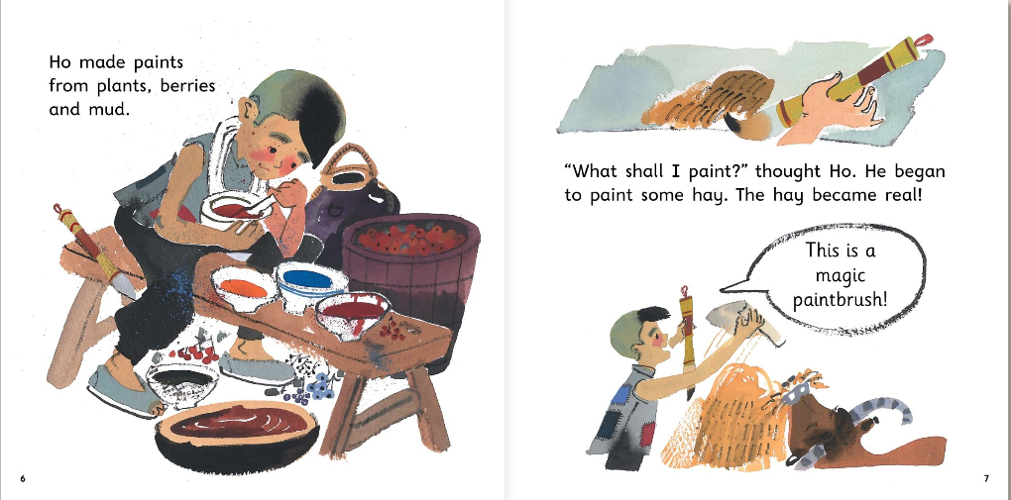

Slide 6
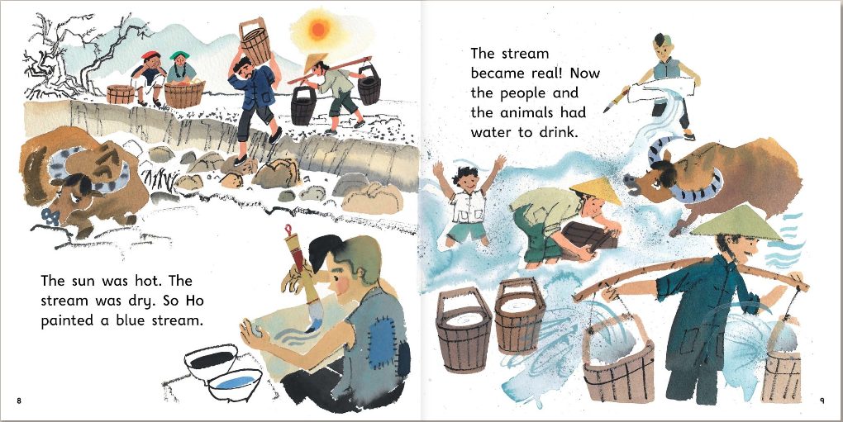

Slide 7
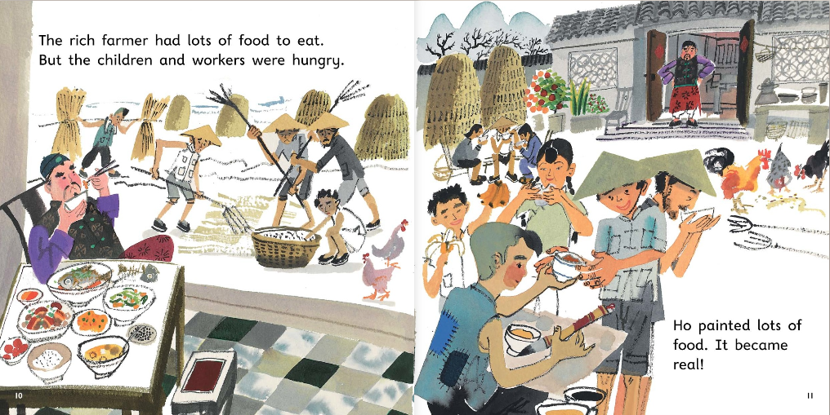

Slide 8
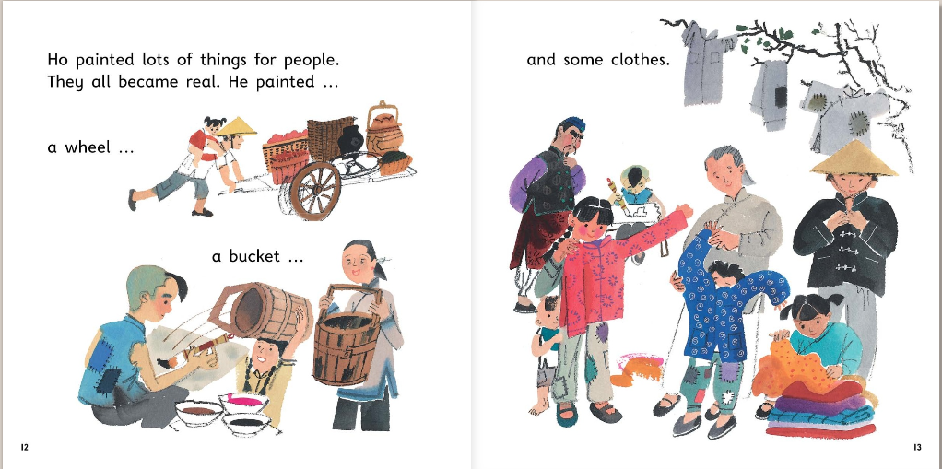

Slide 9
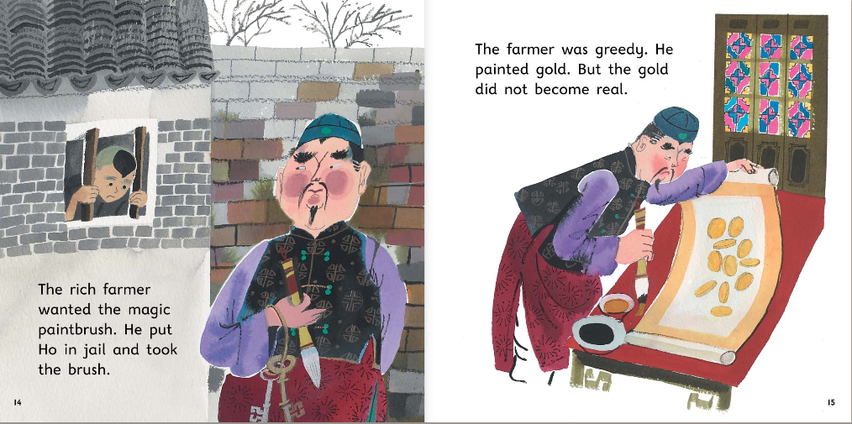

Slide 10
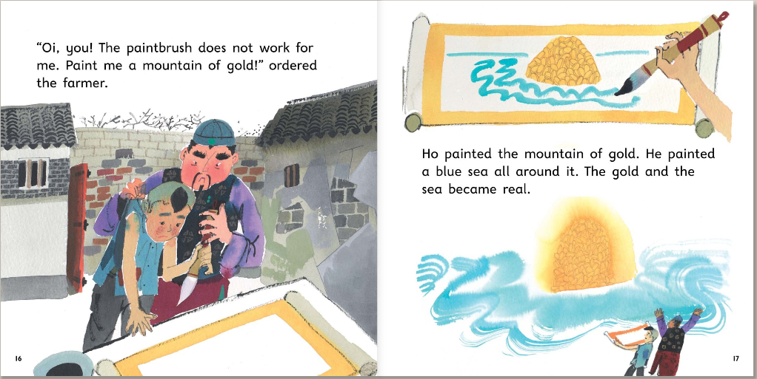

Slide 11
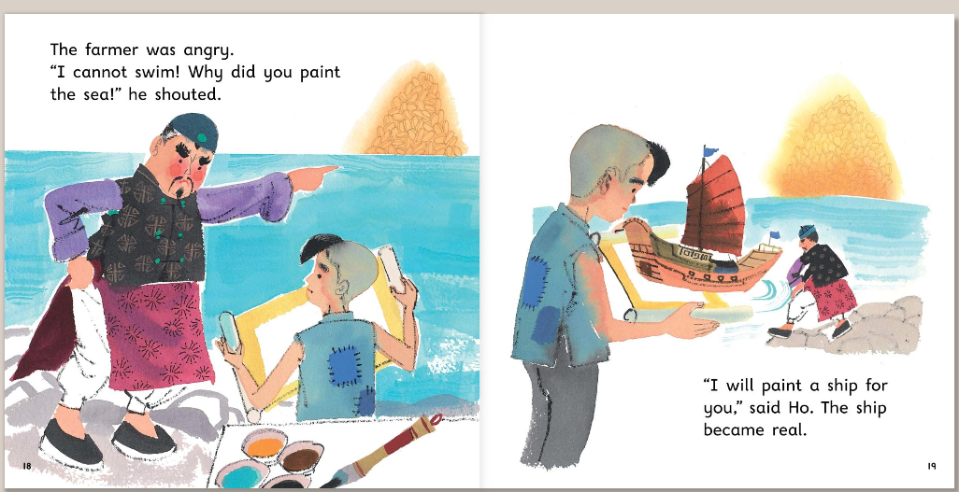

Slide 12
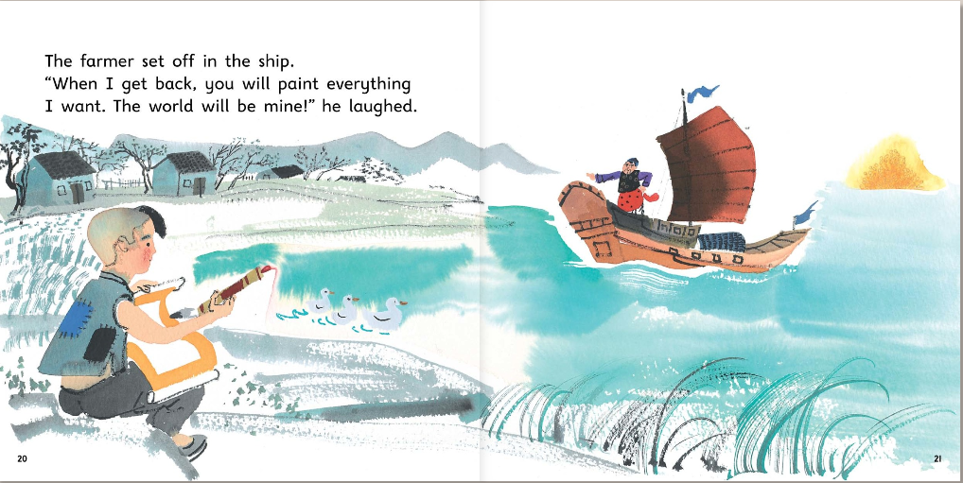

Slide 13
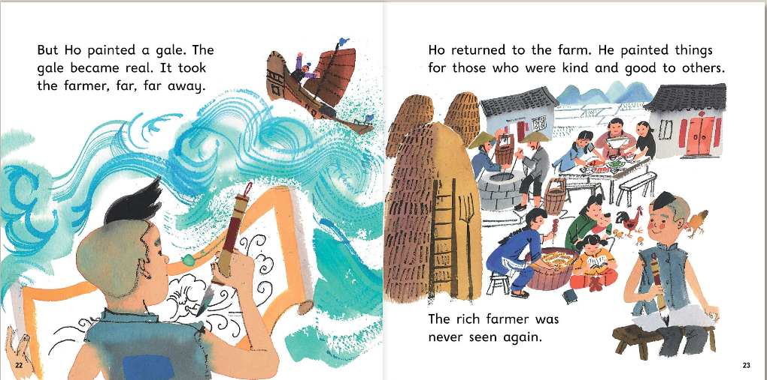

Slide 14
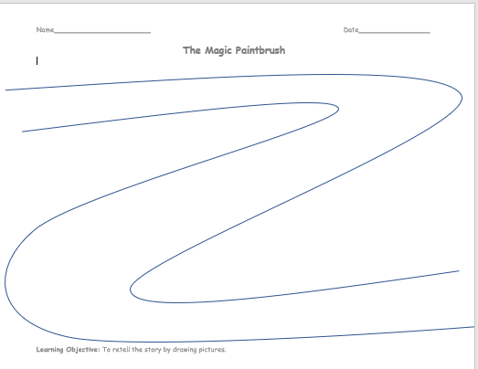
I would like you to retell the story on a story path.

Slide 15
full stops
ABC
capital letters
went
letters on the line
letter tails under the line
fgjpq
and to extend sentences
and

