Slide 1

We are learning
To count forwards in 10's.

Slide 2
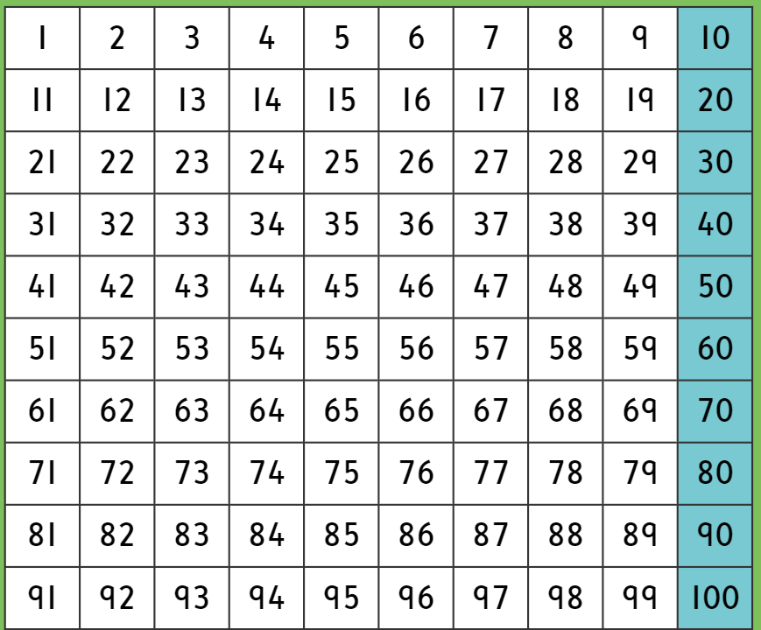
Can you spot any patterns?

Slide 4
What is the missing number?
10 | 20 |  | 40 | 50

Slide 5
What are the missing numbers?
10 |  |  | 40

Slide 6
What are the missing numbers?
20 |  | 40

Slide 7
What are the missing numbers?
30 |  | 50

Slide 8
What are the missing numbers?
 | 20 |  |  | 50

Slide 9
What are the missing numbers?
 | 40 |  |  | 70

Slide 10
What are the missing numbers?
60 |  |  |  | 100

Slide 11
What are the missing numbers?
 | 30

Slide 12
I would like you to fill in the missing numbers on the number tracks that I have made for you.

