Slide 1
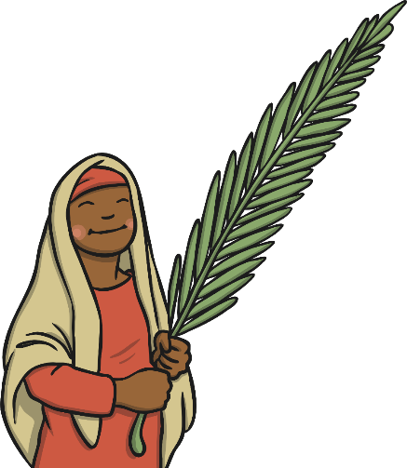
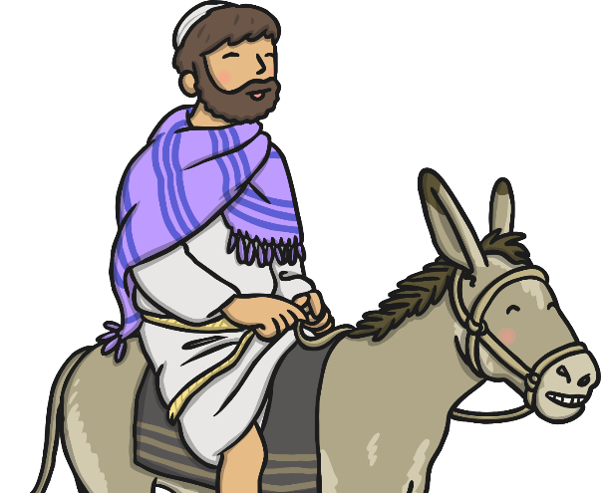


Palm Sunday

Slide 2
LO To explain why Palm Sunday is important to Christians
Success Criteria
I can tell you what happened on the first Palm Sunday.
I can tell you what the palm leaves mean.

Slide 3

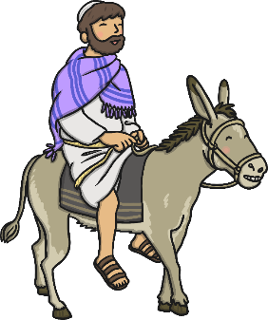
What Is Easter?
Easter is the oldest and most important Christian festival.
The week leading up to Easter is called Holy Week and has these important days which are remembered for different reasons:
Palm Sunday
Maundy Thursday
Good Friday
Easter Sunday
The Easter Story is important to Christians because it remembers the death of Jesus and celebrates his resurrection.

Slide 4

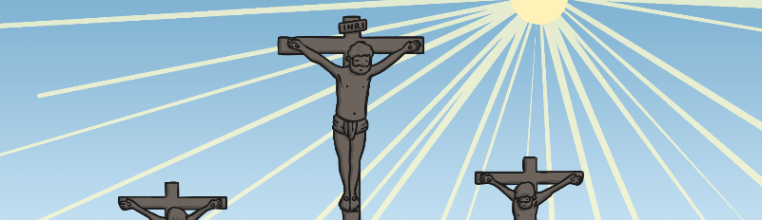
Why Is Celebrating Easter
Important to Christians?
Easter is the time when Christians remember the crucifixion and the resurrection of Jesus, the Son of God. Although they remember that Jesus died on the cross, they also celebrate that he came back to life.
The resurrection of Jesus is very important to Christians as it gives them the promise of eternal life in heaven.

Slide 5
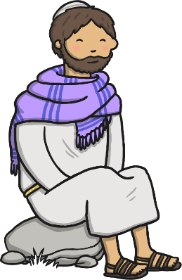
Palm Sunday
Palm Sunday marks the start of Holy Week for Christians.
Christians feel happy because they are praising Jesus, but also sad because they know it was only one week later that Jesus died.

Slide 6
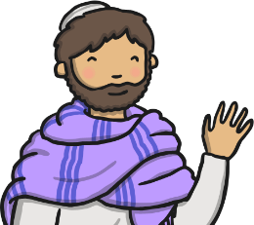
Palm Sunday
Jesus and his followers went to Jerusalem for the Passover Feast. Jesus told two of his followers to bring him a donkey and told them where to find it. He also said, “Tell the people of Jerusalem your King is coming, he is gentle and riding on a donkey.”
The followers did as Jesus asked, they found and brought the animal to Jesus. They lay their cloaks on its back and Jesus sat on them and rode on the donkey.
Tell the people of Jerusalem your King is coming, he is gentle and riding on a donkey.

Slide 7
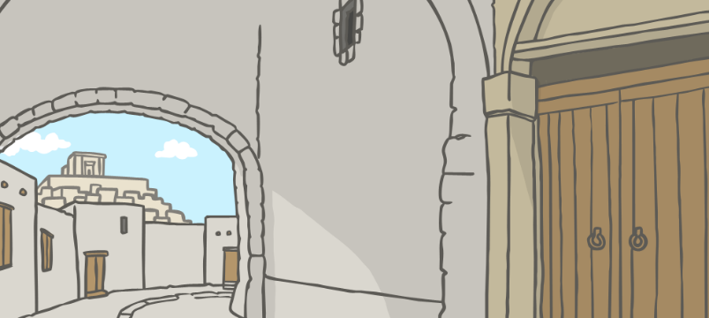
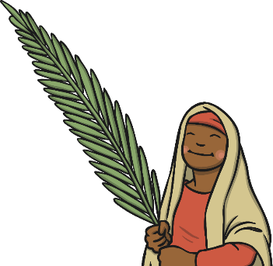
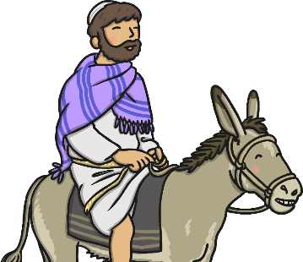
Palm Sunday
As Jesus rode the donkey towards Jerusalem, people cut branches from the palm trees and placed them and their cloaks on the ground in front of him. They shouted, “Hosanna! Hosanna! Blessed is the King of Israel!”

Slide 8
Palm Sunday
When Jesus entered Jerusalem, a large and excited crowd welcomed him and waved palm leaves. They shouted “Hosanna!” because they were so pleased to see him and believed his message. Jesus went to the Temple where he healed the blind and lame people.

Slide 9
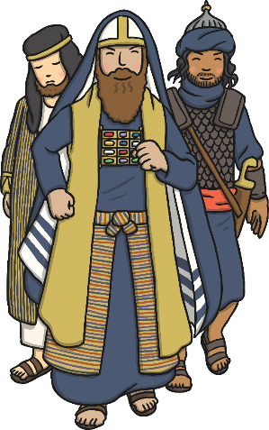
Palm Sunday
The leaders in Jerusalem did not like Jesus. They saw how many people were following him and they were angry and jealous.
Jesus understood that this was part of God’s plan and it would be his last trip into Jerusalem.

Slide 10

Activity
1.How did Jesus arrive in Jerusalem?
2.What did the people do when they saw him?
3.Who wasn’t happy to see Jesus?
4.Why didn’t they like Jesus?

Slide 11

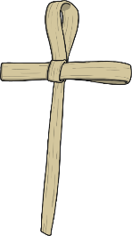
Palm Leaves
Palm leaves symbolise goodness and well-being.
People laid down palm leaves in front of Jesus as a sign that they believed his message and that he was King.
Sometimes, people are given a cross made from a single palm leaf on Palm Sunday.

Slide 12

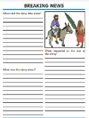
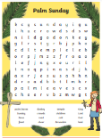
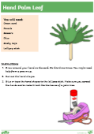
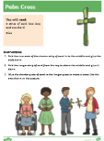
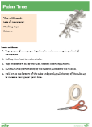
Independent Work
Write a newspaper report about Palm Sunday.
Make a hand palm leaf.
Make a palm tree.
Complete the Palm Sunday wordsearch.
Make a palm cross.
**Choose 2 activities to complete.

