Slide 1
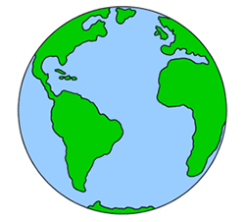

Geography
Homes around the World

Slide 3
We are learning
How homes are made to suit the climate they are in.

Slide 4
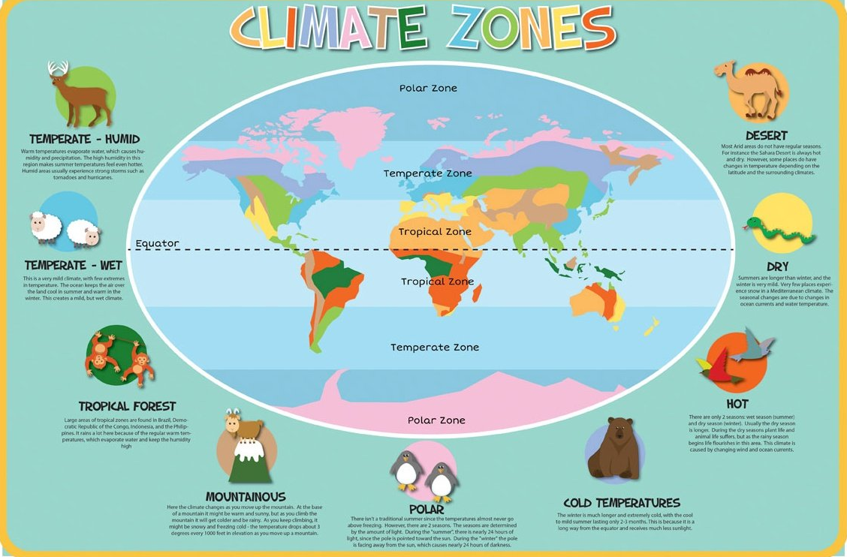
What does the word climate mean?

Slide 5
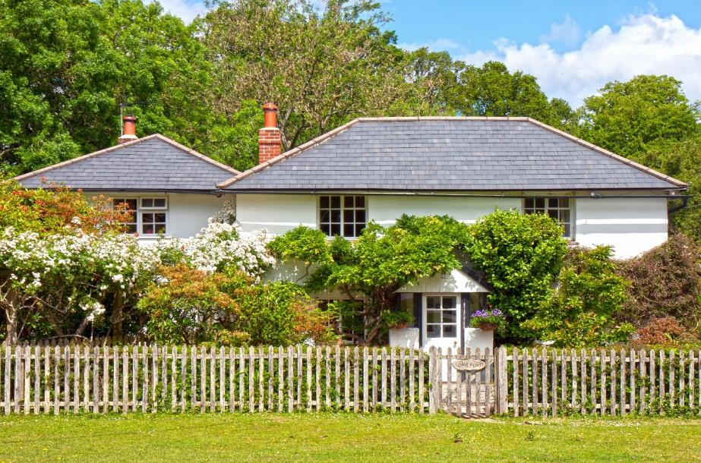
Homes Adapted to Climates
People from around the world build their houses differently depending on the climate of the country that they live in.
The climate in Britain and Europe is quite mild and so most people live in houses.

Slide 6
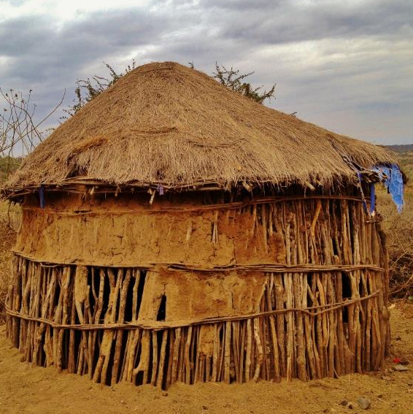
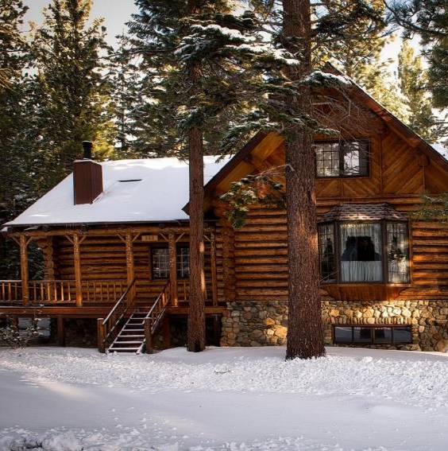
Homes Adapted to Climates
Some countries are very hot, some have severe floods, and some are very cold.
The houses in these countries are adapted to suit the weather conditions.

Slide 7
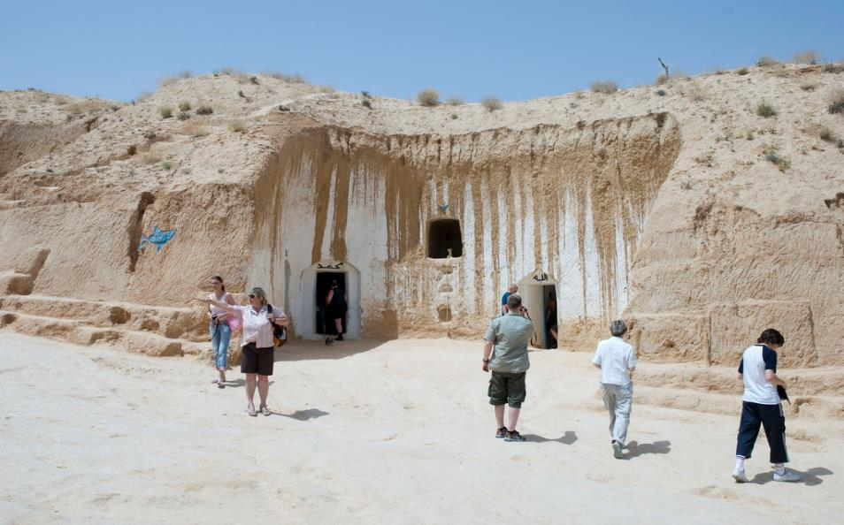
Tunisia
It is so hot in Tunisia in Africa, that some people live underground, because it is cooler!
They dig deep into the ground and then build the walls using clay, dung, and dirt.

Slide 8
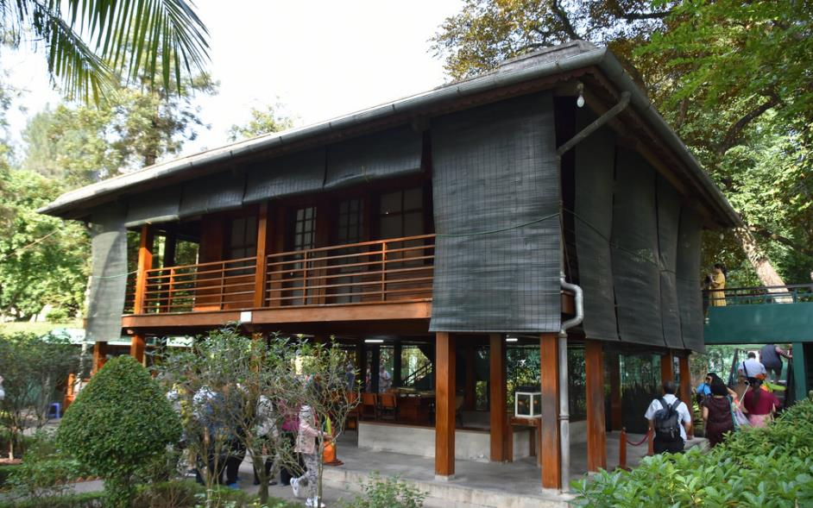
Vietnam
People live in houses built on stilts to avoid water damage. In Vietnam, stilt houses have two doors. The one on the right is called a Quam. The one on the left is called a Cham.

Slide 9
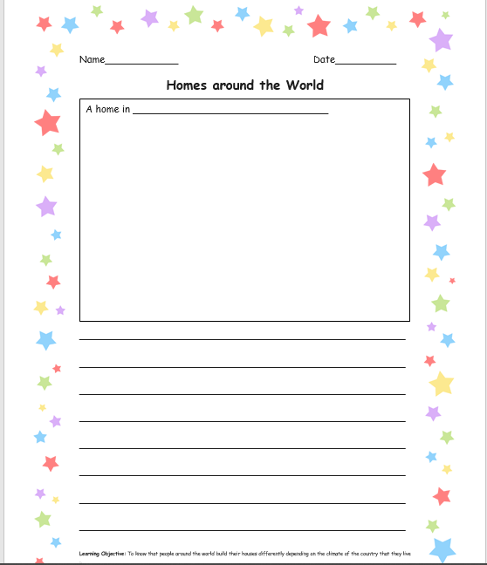
I would like you to draw one of the homes you have learnt about today.
I would also like you to write a little bit about how the home is suited to the climate.

