Slide 1

We are learning
To read a story together.
To write about our favourite part of the story.

Slide 2
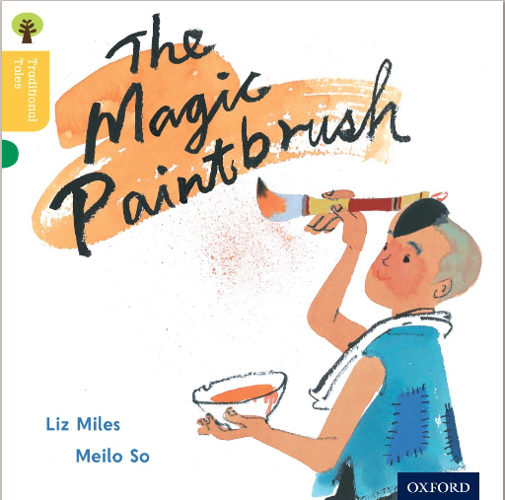
I’ve found a lovely story for us. It’s called ‘The Magic Paintbrush’. Here is the front cover.
What do you predict will happen in this story?

Slide 3
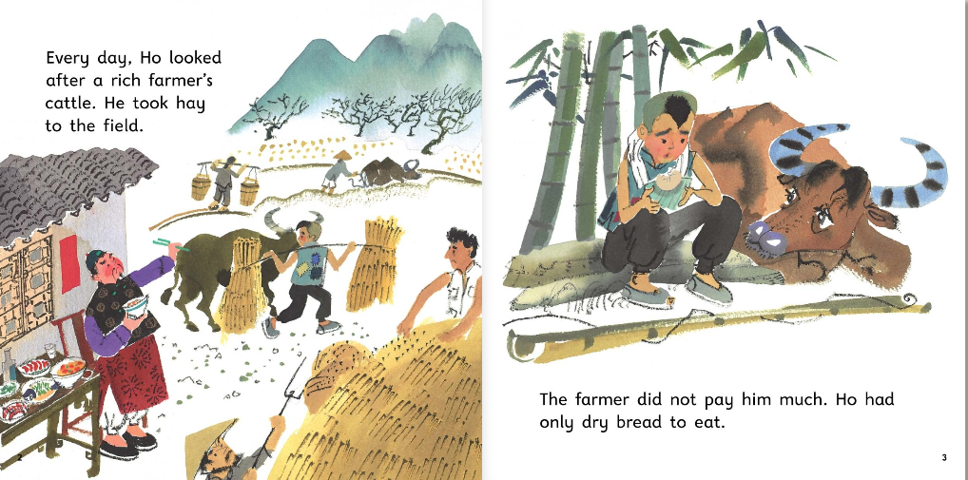

Slide 4
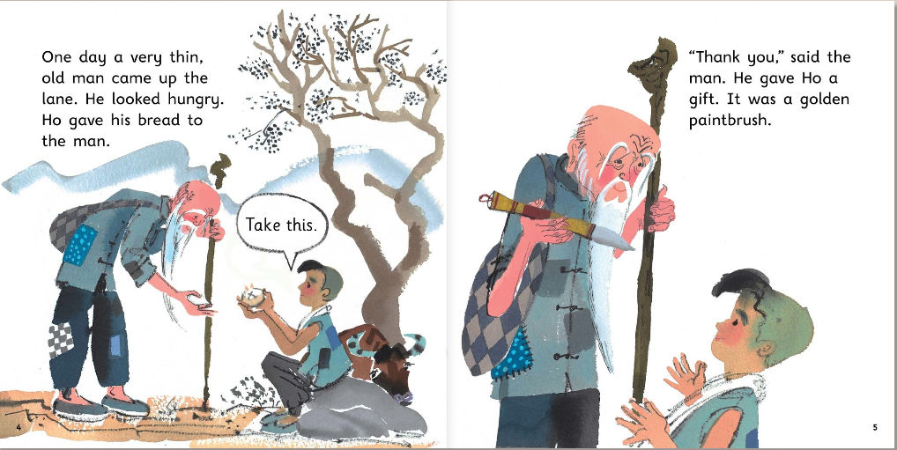

Slide 5
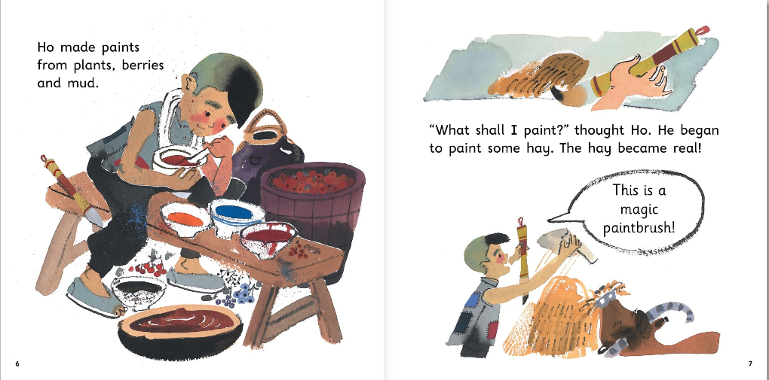

Slide 6
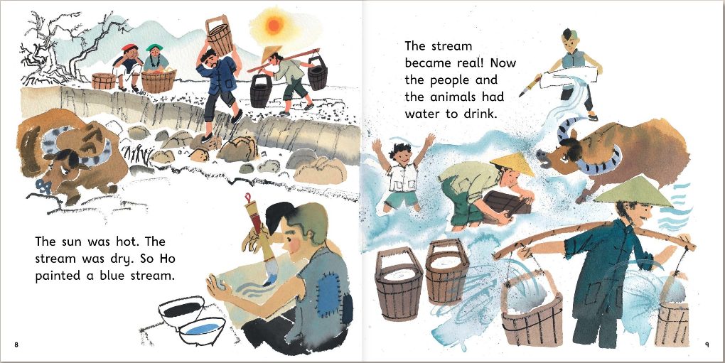

Slide 7
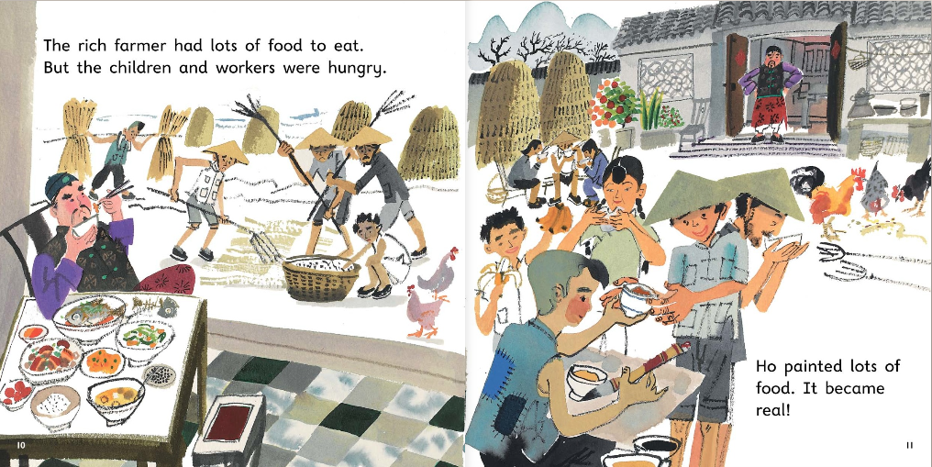

Slide 8
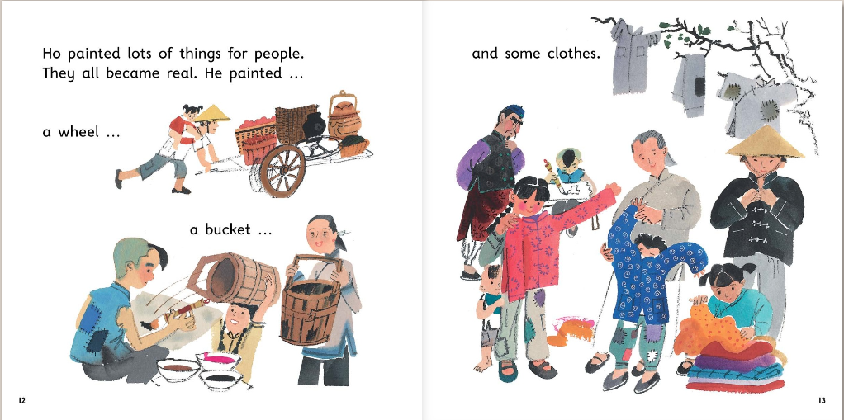

Slide 9
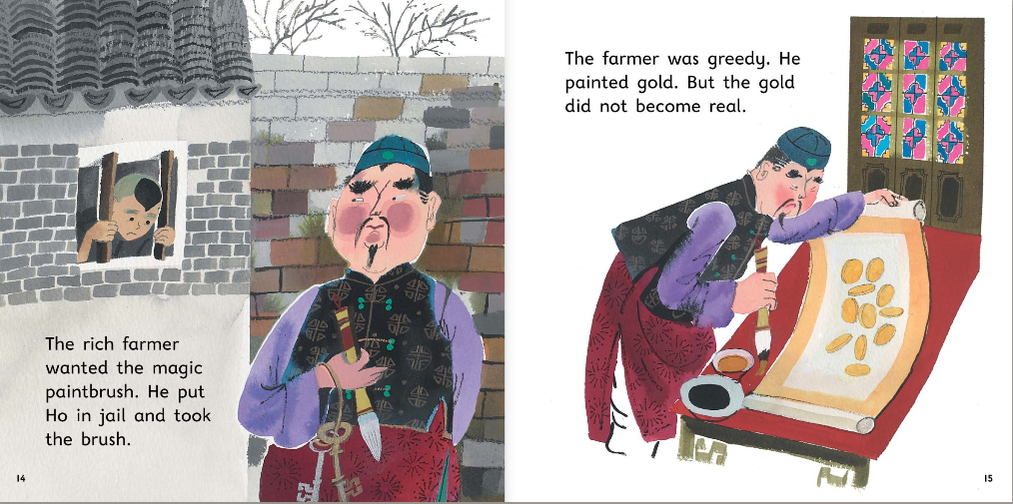

Slide 10
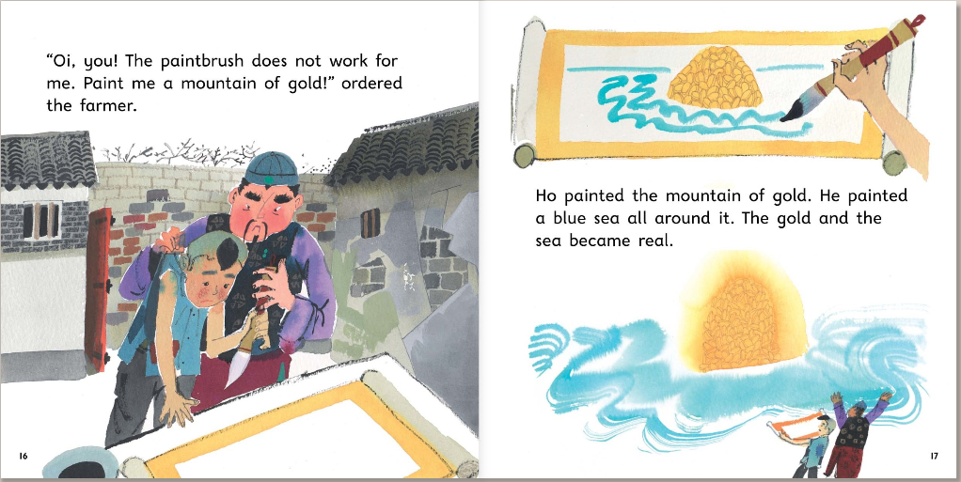

Slide 11
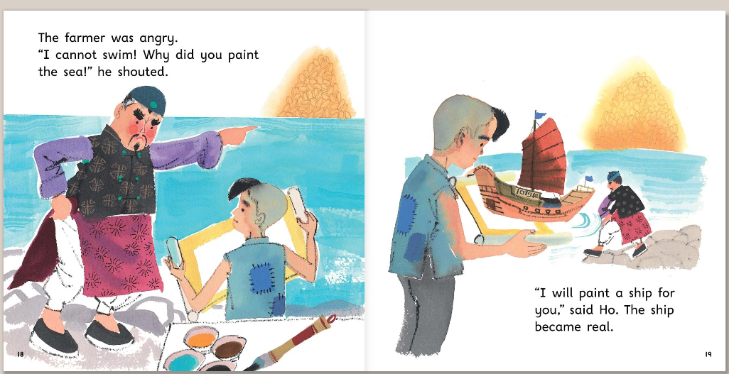

Slide 12
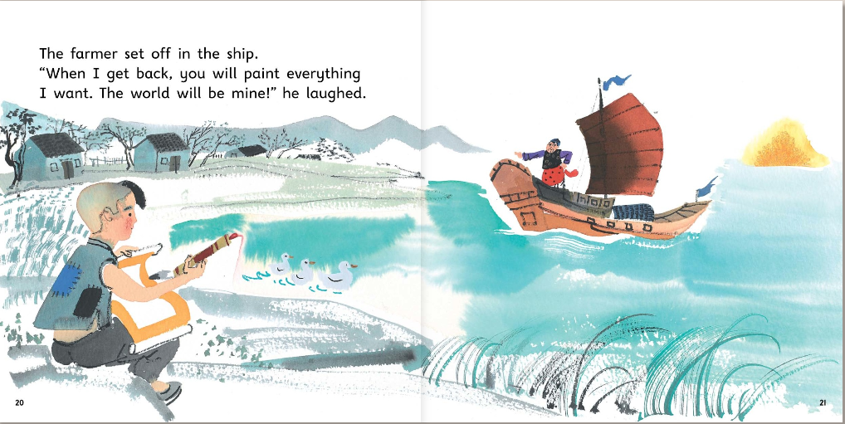

Slide 13
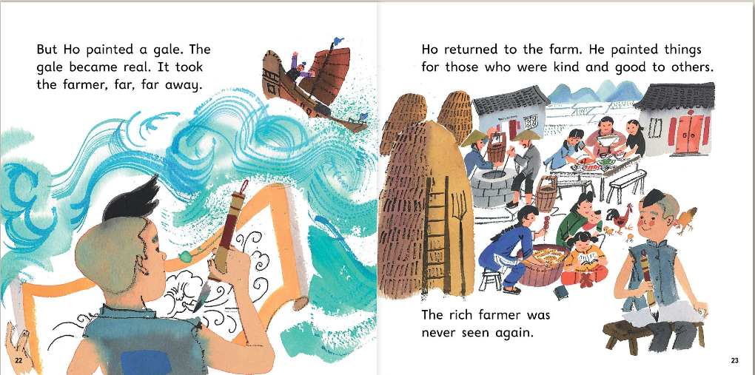

Slide 14
I would like you to draw your favourite part of the story and to write a couple of sentences about it.
You may want to use the sentence starter:
My favourite part of the story is….

Slide 15
full stops
ABC
capital letters
went
letters on the line
letter tails under the line
fgjpq
and to extend sentences
and

