Slide 1

We are learning
To count forwards in 5's.

Slide 2
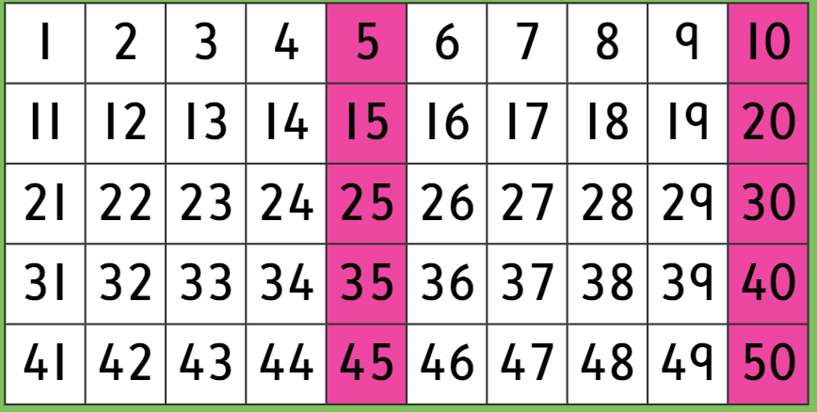
Can you spot any patterns?

Slide 4
What is the missing number?
5 | 10 |  | 20 | 25

Slide 5
What are the missing numbers?
5 |  |  | 20

Slide 6
What are the missing numbers?
5 | 10

Slide 7
What are the missing numbers?
10 |  | 20

Slide 8
What are the missing numbers?
 | 20 |  |  | 35

Slide 9
What are the missing numbers?
 | 15 |  |  | 30

Slide 10
What are the missing numbers?
20 |  |  |  | 40

Slide 11
I would like you to fill in the missing numbers on the number tracks that I have made for you.

