Slide 1
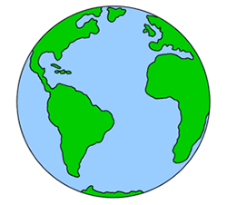

Geography
Homes around the World

Slide 3
We are learning
How homes are made to suit the climate they are in.

Slide 4
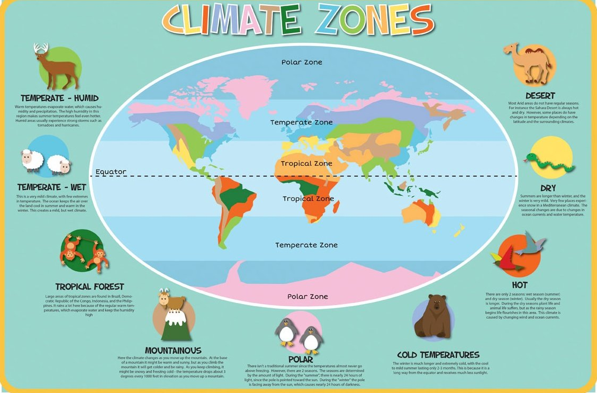
What does the word climate mean?

Slide 5
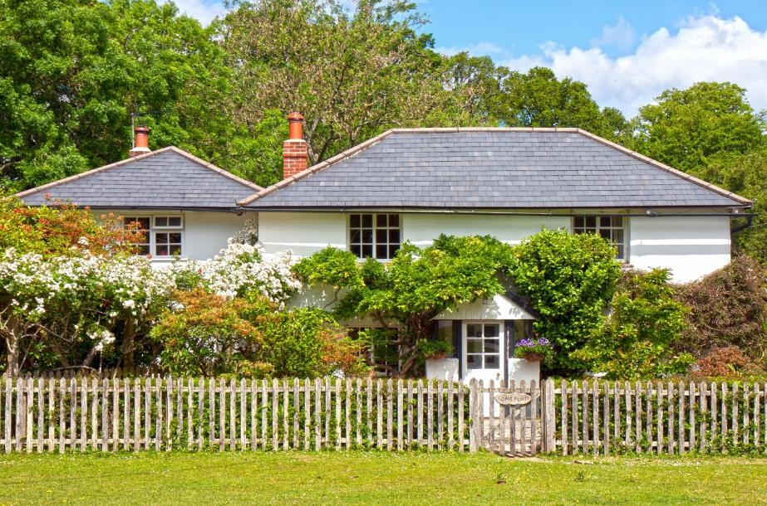
Homes Adapted to Climates
People from around the world build their houses differently depending on the climate of the country that they live in.
The climate in Britain and Europe is quite mild and so most people live in houses.

Slide 6
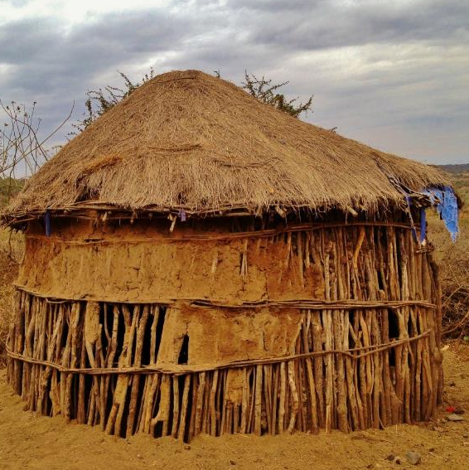
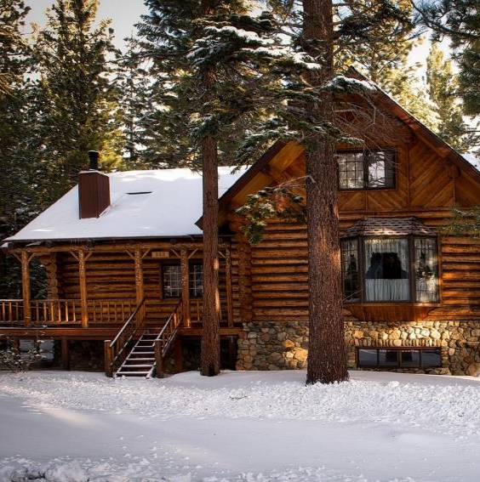
Homes Adapted to Climates
Some countries are very hot, some have severe floods, and some are very cold.
The houses in these countries are adapted to suit the weather conditions.

Slide 7
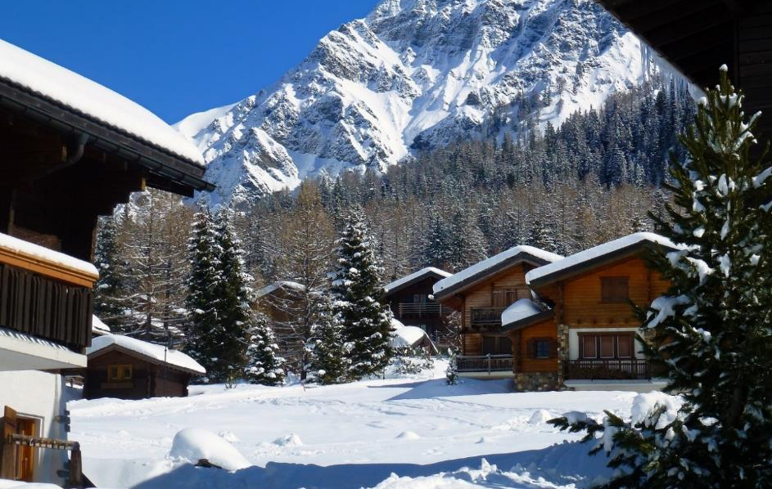
Switzerland
In the winter months, Switzerland has heavy snow and is a popular skiing destination.
Chalets in Switzerland have a sloped roof
and huge eaves that snow can slide and fall off easily.

Slide 8
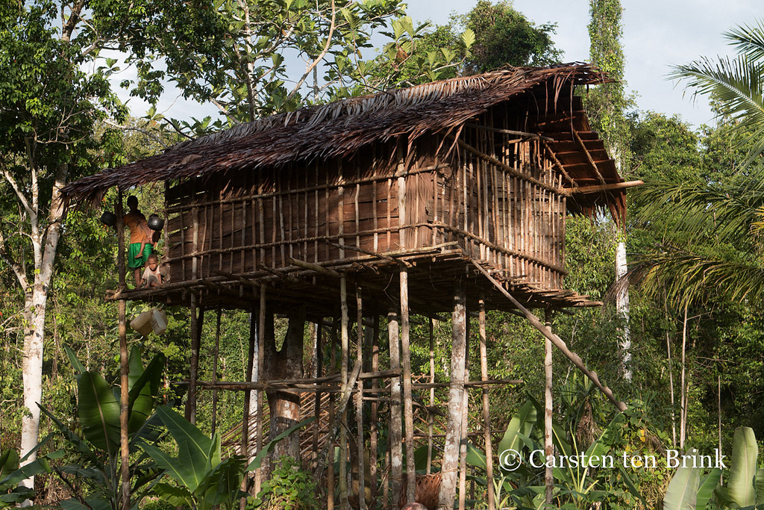
New Guinea
The Korowai tribe of New Guinea build their amazing tree houses high up to avoid the life-threatening floods and biting insects of the rainforest.
They can easily reach up to 90 feet.

Slide 9
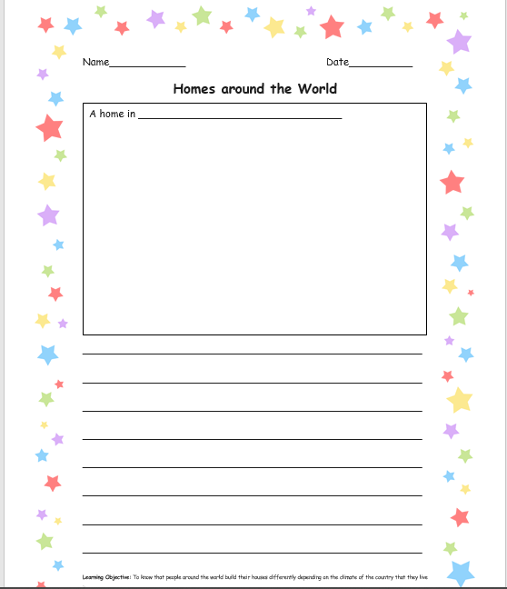
I would like you to draw one of the homes you have learnt about today.
I would also like you to write a little bit about how the home is suited to the climate.

