Slide 1

Phonics
This morning, we are learning about the split ‘e’ digraph…………
e e

Slide 2
Phonics
The blue arrow shows us that a single letter belongs in the space between the ‘e’ and the ‘e’.
e e

Slide 3
Phonics
We call the ‘e’ at the end of this split digraph ‘Magic e’. It has an important job to do.
It turns the ‘e’ from a short sound into a long sound.
e e
Watch this ‘Magic e’ video:
Magic e Song

Slide 4
Phonics
On the next few pages are words that contain the split ‘e’ digraph.
Sound them out with me and don’t forget to use your fingers.
e e

Slide 5




Slide 6
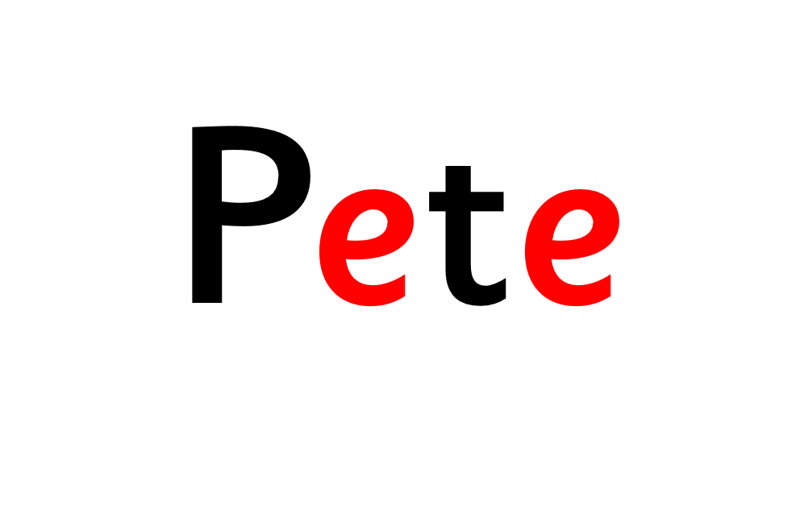

Slide 7
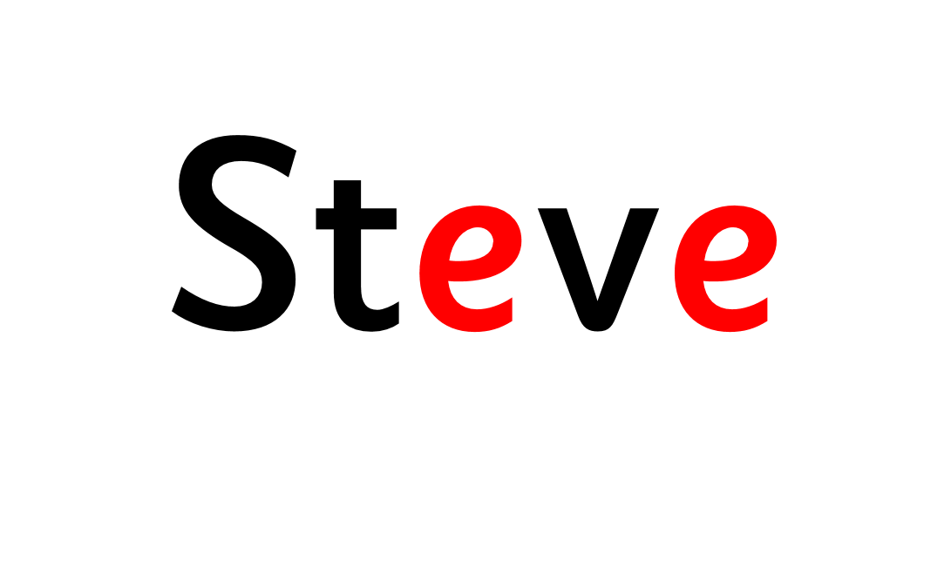


Slide 8


Slide 9



Slide 10


Slide 11



Slide 12
DICTATION ACTIVITY:
Listen to the sentences that I read aloud. Write them down and don’t forget to draw the curved arrow under the split digraph.

Slide 14
My friend is called Pete and he is shorter than me.

Slide 16
I went to a theme park and it was so much fun.

