Slide 1

We are learning
To count forwards in 2's.

Slide 2
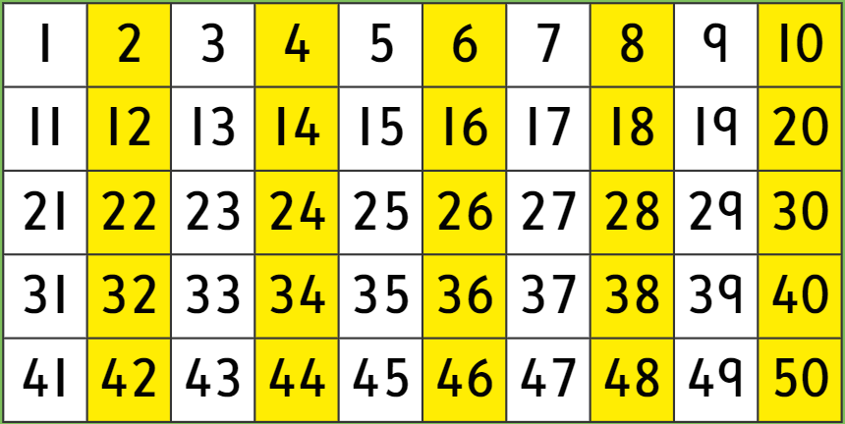
Can you spot any patterns?

Slide 4
What is the missing number?
2 | 4 |  | 8 | 10

Slide 5
What are the missing numbers?
4 | 6 |  |  | 12

Slide 6
What are the missing numbers?
8 |  |  | 14 | 16

Slide 7
What are the missing numbers?
10 |  | 14 | 16

Slide 8
What are the missing numbers?
8 | 10 |  |  | 16

Slide 9
What are the missing numbers?
 | 14 |  |  | 20

Slide 10
What are the missing numbers?
 | 18 |  |  | 24

Slide 11
I would like you to fill in the missing numbers on the number tracks that I have made for you.

