Slide 1


Geography
Homes around the World

Slide 3
We are learning
How homes are made to suit the climate they are in.

Slide 4
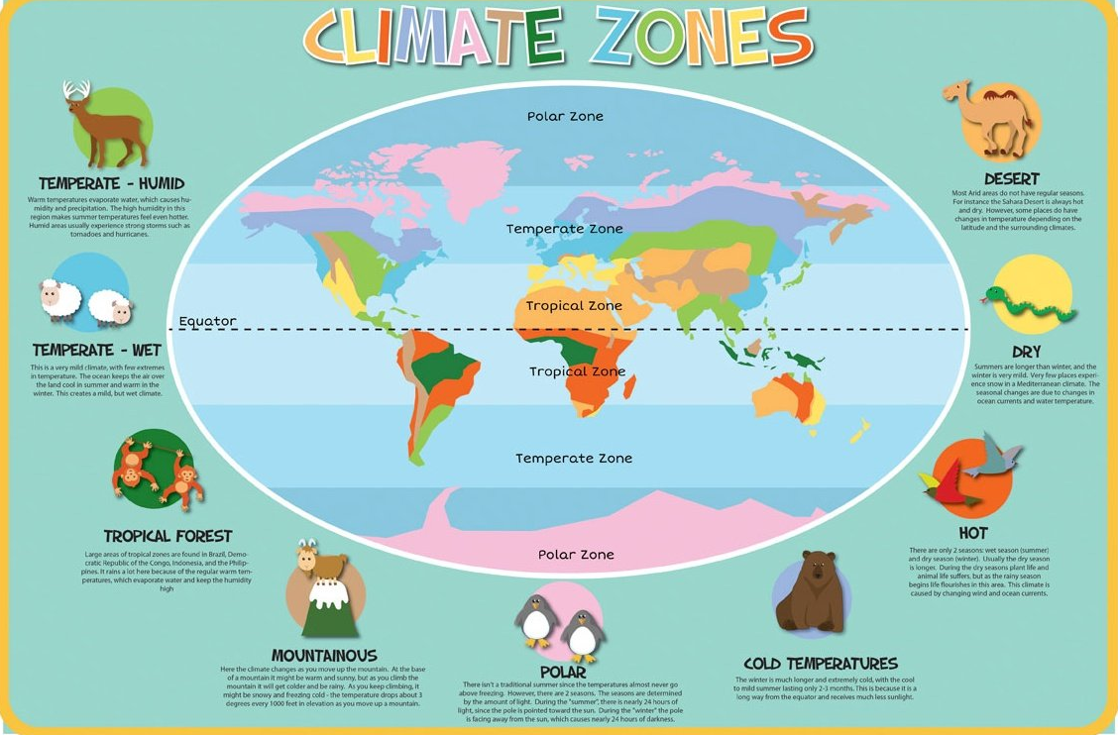
What does the word climate mean?

Slide 5
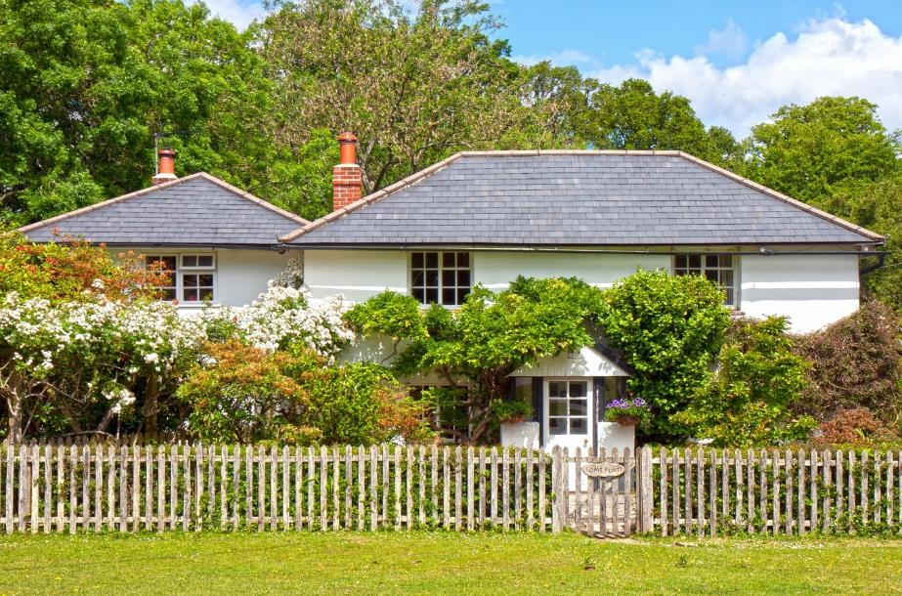
Homes Adapted to Climates
People from around the world build their houses differently depending on the climate of the country that they live in.
The climate in Britain and Europe is quite mild and so most people live in houses.

Slide 6
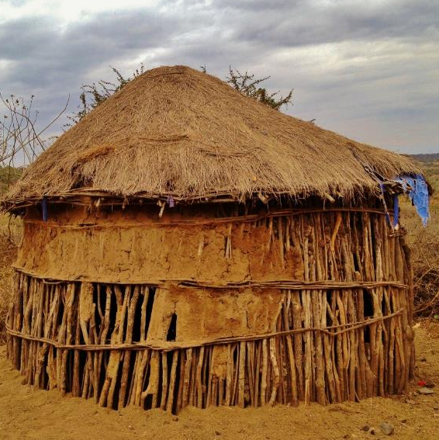
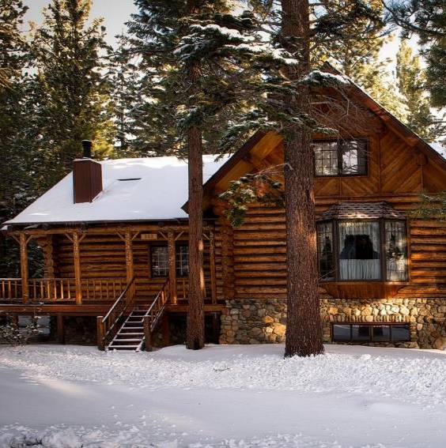
Homes Adapted to Climates
Some countries are very hot, some have severe floods, and some are very cold.
The houses in these countries are adapted to suit the weather conditions.

Slide 7
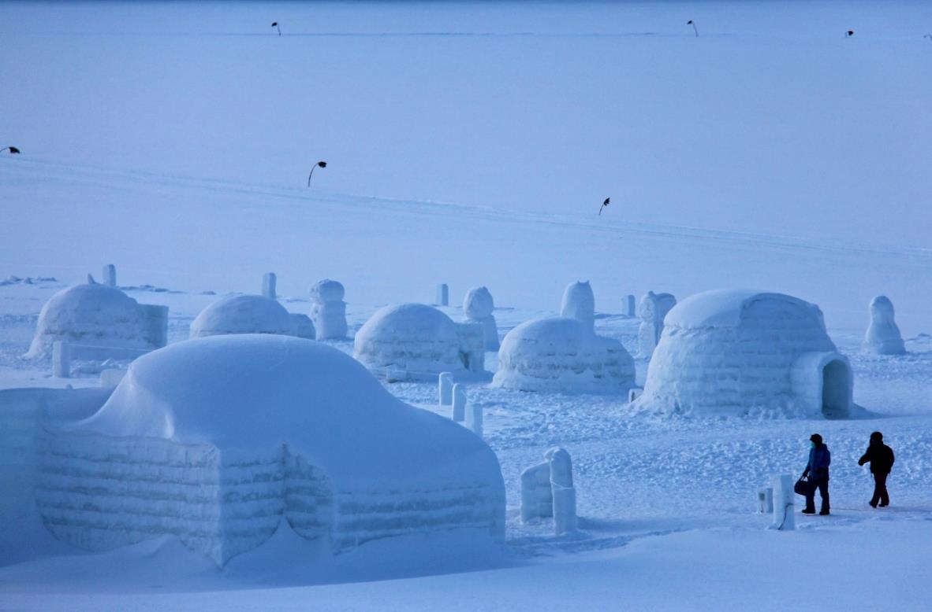
Greenland
It is very cold and snowy in Greenland. The Inuit people build igloos out of snow to live in because they are good insulators. Even though it is extremely cold outside, the igloos stay warm inside.
There is only one room in an igloo for the whole family to sleep and live in.

Slide 8
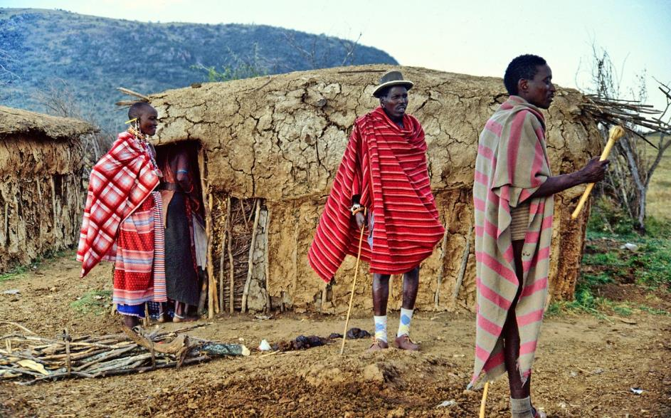
Kenya
It is very hot in Kenya, but they also have very heavy rain. Therefore, their houses need to be waterproof. The Maasai cover their roofs with cow dung.
The rest of the house is built with twigs,
mud, and leaves. The whole family live in
one room together.

Slide 9
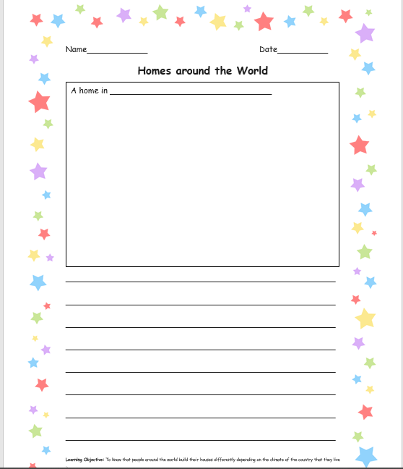
I would like you to draw one of the homes you have learnt about today.
I would also like you to write a little bit about how the home is suited to the climate.

