Slide 1

Phonics
This week, we are learning about the split digraph…………
a e

Slide 2
Phonics
This morning’s lesson is a little bit different. I haven’t included words for us to read together.
Have a look on the next page to find out what you will be doing instead.

Slide 3
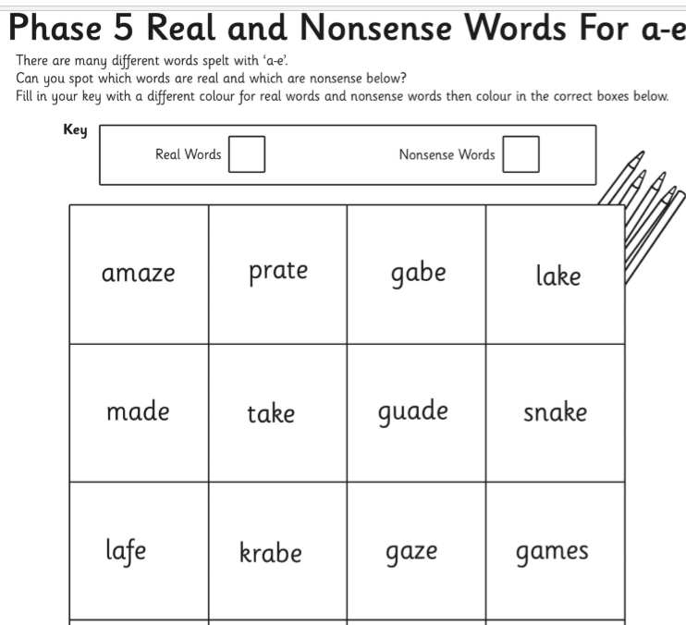
Phonics

