Slide 1

LO To complete a painting of the Great Fire of London
Success criteria:
Match the colours from the painting.
Sketch the picture looking carefully at the size and shape.
Add detail

Slide 2
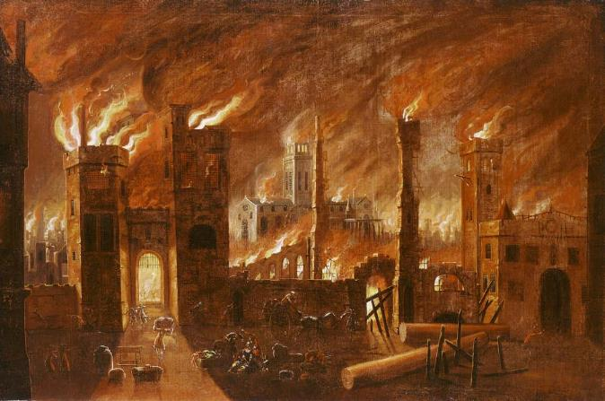

Slide 3
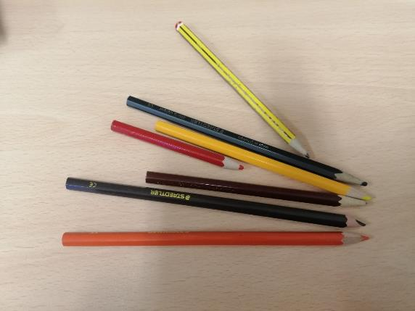

Slide 4
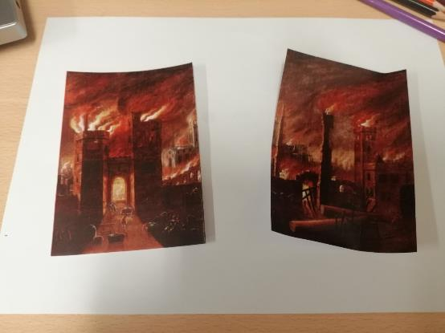

Slide 5
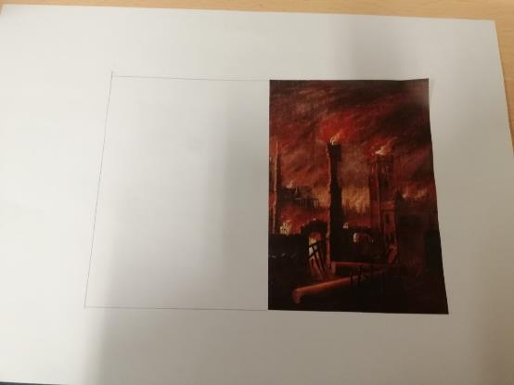

Slide 6
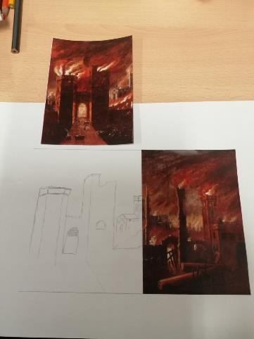

Slide 7
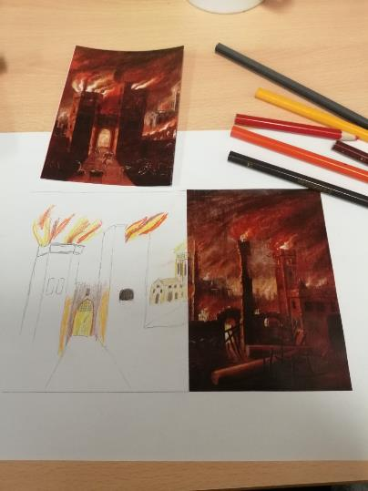

Slide 9
Independent Work
1.Stick 1 half of the picture onto a plain sheet of paper and sketch the missing half.
2.Add colour using pencils, crayons, pastels, pens or paints. Try and match the colours as accurately as you can.
3.Compare your finished picture with the original painting.
**If you are unable to print the picture, look at it on the screen whilst completing your work then hold it up to compare.

