Slide 1

We are learning
To remind ourselves what a list is.
To write a list.

Slide 2
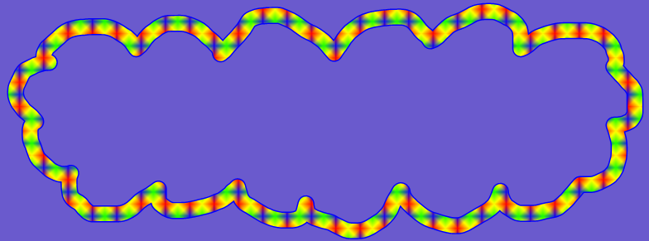
Can you remember what
a list is?

Slide 3
A list is a set of words that have been written.
A list looks different to the writing we normally do in class.
Usually, we write all the way to the end of a line before starting a new line.
When we write a list, we write a new thing on each line.
We don’t need to use a capital letter at the beginning of each word because we are not writing sentences.

Slide 4
I’m going to show you a list that I have written.
It’s my shopping list.

Slide 5
My Shopping List
bread
milk
bananas
easy peelers
red grapes
broccoli
potatoes
chicken breast
cornflakes
washing up liquid
foil
kitchen towel

Slide 6
I would like you to write a shopping list.
Perhaps you could work with Mummy and Daddy and they could let you know what they need to buy when they next go shopping.
Or, you could write a list of things that you would like Mummy and Daddy to buy (like chocolate and sweeties).

