Slide 1

We are learning
To solve subtraction word problems.

Slide 2
We will be reading and solving word problems today.
Word problems are just like calculations except that the calculation is hidden within a sentence.
It’s our job to find the calculation and solve it.

Slide 3

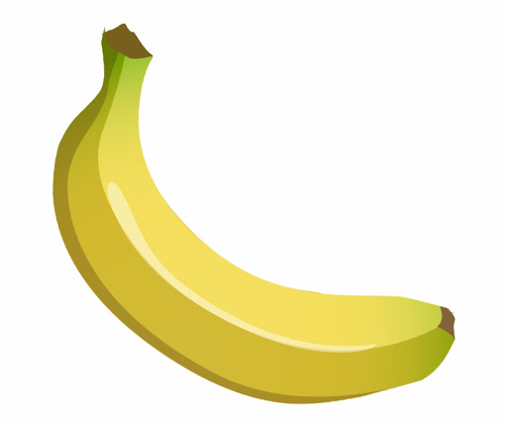
Tom has 5 bananas.
He eats 3 bananas.
How many bananas are left?
5 - 3 =

Slide 4
Tom has 8 bananas.
He eats 4 bananas.
How many bananas are left?
8 - 4 =

Slide 5
Tom has 6 bananas.
He eats 2 bananas.
How many bananas are left?

Slide 6
That is the end of our lesson today.
Now it is your turn to solve subtraction word problems on your own.
I have typed some up for you. Draw pictures to solve them.
Don’t forget to turn the numbers in the word problem, into a calculation.

