Slide 1


Geography
Homes around the World

Slide 2
We are learning
To observe the different types of homes in our local area.

Slide 3
Today we will be making observations and recording the information we find.

Slide 4
There are lots of ways that we can show information.
We can write sentences.
We can draw pictures.
We can take photographs.
We can film things.

Slide 5
Today, we are going to show information by creating a pictogram.
Do you remember when we created a pictogram to show what colour eyes were the most common in Year 1?

Slide 6
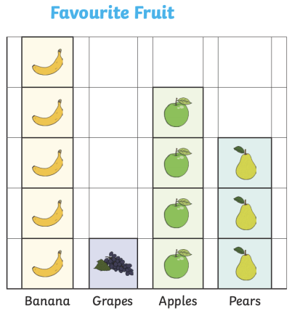
This pictogram shows what type of fruit is the most popular.
Which type of fruit is the most popular?
Which type of fruit do people like the least?

Slide 7


