Slide 1

We are learning
To remind ourselves what a caption is.
To write captions to match photographs.

Slide 2
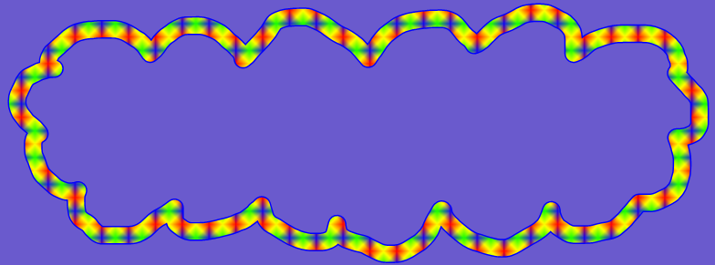
Can you remember what
a caption is?

Slide 3
A caption is a sentence that describes what can be seen in a photograph.
You can find captions in lots of places but mostly in non-fiction books.
A caption is always a fact about a picture and only what can be seen, not what someone thinks.

Slide 4
I’m going to show you some photographs of animals.
I have written a caption underneath each picture.

Slide 5
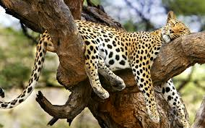
The jaguar is sleeping in a tree.

Slide 6
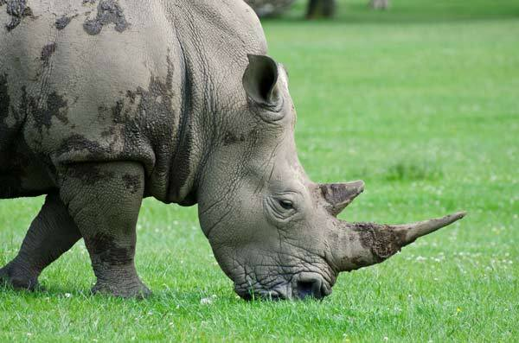
The rhino is eating grass.

Slide 7
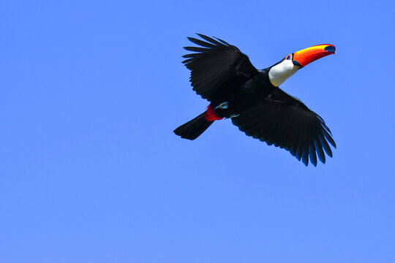
The toucan is flying.

Slide 8
I would like you to add a caption to some photos.
You must only write what you can see.
Don’t forget to use capital letters and full stops.

