Slide 1

We are learning
To solve subtraction calculations.
To use a hundred square to help us.

Slide 2
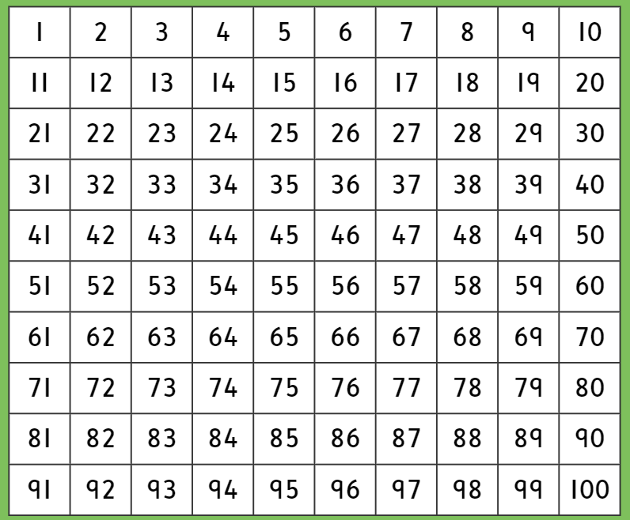
Here is a hundred square. We’ve been using it this week.

Slide 3
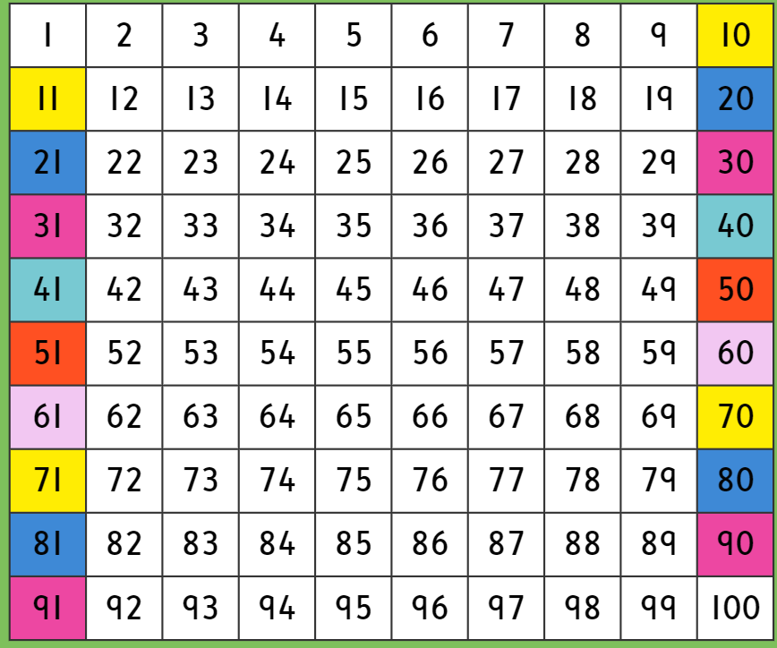
When we subtract on a hundred square, it can be tricky as we need to move backwards. When we get to the beginning of a line, it is hard to know which number to move to next. That is why it is a good idea to use the hundred square from Monday’s lesson to help you.

Slide 4
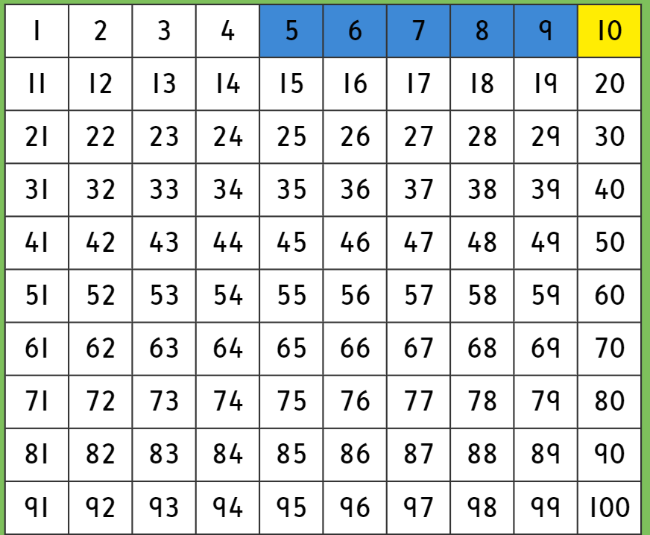

Read this subtraction calculation with me……
10 - 5 =
TOP TIP
Remember that when you subtract on a hundred square. You jump backwards (to the left)

Slide 5
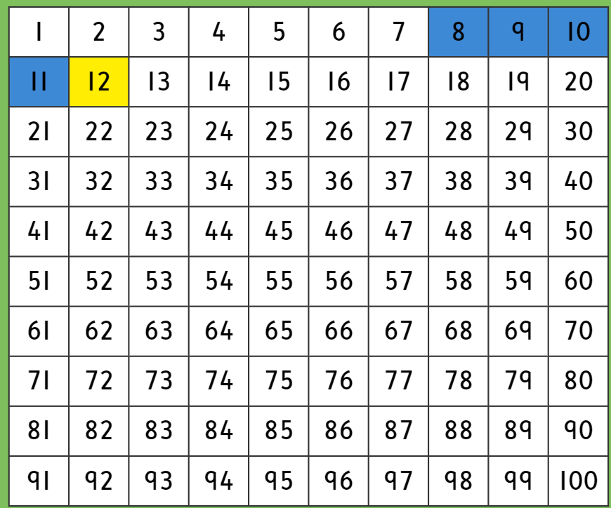
Read this subtraction calculation with me……
12 - 4 =
TOP TIP
Remember that when you subtract on a hundred square. You jump backwards (to the left)

Slide 6
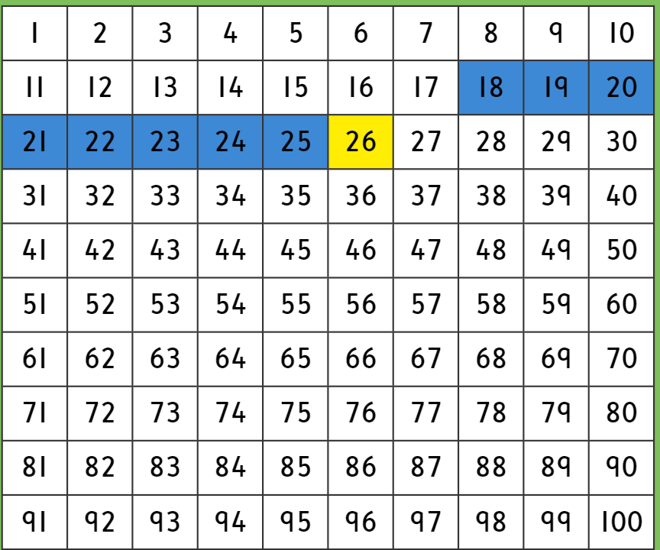
Read this subtraction calculation with me……
26 - 8 =
TOP TIP
Remember that when you subtract on a hundred square. You jump backwards (to the left)

Slide 7
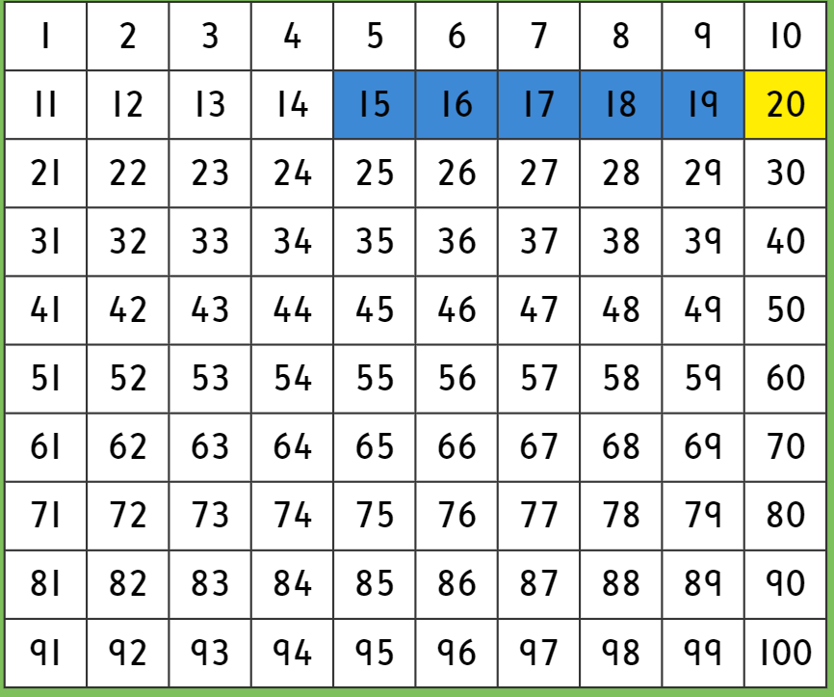
Read this subtraction calculation with me……
20 - 5 =
TOP TIP
Remember that when you subtract on a hundred square. You jump backwards (to the left)

Slide 8
It’s time to solve some subtraction calculations on your own. The calculations are on a piece of paper.
Don’t forget………………………….
No backwards numbers!

