Slide 1


Geography
Homes around the World

Slide 2
We are learning
To make observations of the different types of homes around us.

Slide 3
Do you remember what type of home you live in?

Slide 4
Today, I would like you to do a bit of exploring.
If you go out for a walk, see if you can draw the different homes around you.
If you can’t go for a walk, look out of your window and draw the homes you can see.

Slide 5
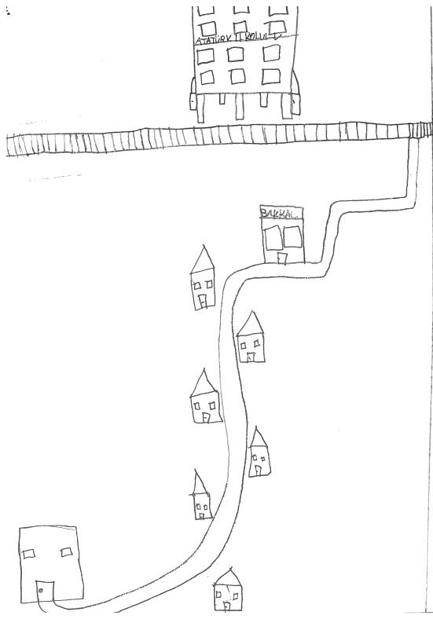

Slide 6
On the paper that I have typed for you, draw and label the homes around you.

