Slide 1


LO To write a calligram poem
Success Criteria:
I know that calligrams are poems which create a shape.
I know the shape of a calligram usually represents the topic of the poem.
I know that calligrams are also known as shape poems or concrete poems.

Slide 2
What is a calligram?
A calligram is a type of poem that describes an object and is written in the shape of the object that is being described. The way the poem is organised is often just as important in conveying the meaning of the poem as the actual written words.
Calligram poems do not have rules about the amount of words, lines, verses, syllables or rhymes that are needed. They simply need to describe an object and be written in the shape of that object.

Slide 3
Calligram Examples
Calligrams, or shape poems, represent the topic of the poem in their shape.
Have a look at these two calligrams.
It’s
It’s
cold outside.
I don’t want to go
outdoors and play.
But mum says
I have to
anyway
It’s starting to snow
brrr…
and I’m going to freeze –
brrr….
I hate playing outside on days like these.
brrr….
But wait a sec, I’ve had the
brrr….
most amazing, brilliant idea!
‘Snowman’
by Kenn Nesbitt
I’ll cover myself up
with snow and I’ll
hide in here!

Slide 4

Calligram Examples
Shines
bright
above.
in the
Star
winks
darkness
of the
and
night
twinkles

Slide 5
Calligram Features
What did you notice?
Think about:
the position of the words or phrases
any colours the poet has used
the shape the poem makes
Calligrams are often written as ‘free’ verse
– they don’t have to rhyme!
Some shape poems (like ‘The Snowman’) are written inside a very light outline of a shape. The words have to be different sizes to fill the shape up just right!
Other calligrams (like ‘Star’) follow the outline of a shape, so the words make the edges.

Slide 6
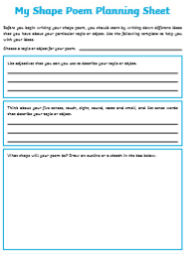
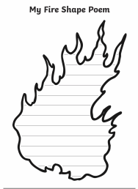
Independent Work
Plan a fire calligram poem.
Write your poem.

